Slide 1

Government of the People’s Republic of Bangladesh
Ministry of Housing and Public Works
Urban development Directorate (UDD)
“Preparation of Development Plan for Fourteen Upazilas”
Package-03
Bagmara Upazila, Rajshahi Faridpur Sadar Upazila, Faridpur and
Gangni Upazila, Meherpur.
Implemented By:
Engineering Consultants and Associates Limited (ECAL)

Slide 2
Presentation
on
Final Plan of Bagmara Upazila, Rajshahi Under Fourteen Upazilas Project
Date: 30th May, 2018
Presented by
Mohammad Jamal Uddin (Chief Consultant)
Abdulla Al Fahad (Urban Planner)
Implemented By:
Engineering Consultants and Associates Limited (ECAL)

Slide 3
Vision
Bangladesh is now approaching towards achieving the status of developing nation. This plan will help meet this goal along with the SDGs of Bangladesh at Upazila level. There are some upazillas which are not well enough but rich in terms of resources. These Upazillas need proper utilization of it s resources in planned manner to achieve the vison of development that Bangladesh heading for. Bagmara is rich in resources and now needs planned development for its sustainable growth.
Objectives
To find the development issues and potential of the Upazila and make a 20 year development vision
To develop, improve and update provisions for better transport network, housing, social and community needs of the poor and the disadvantaged groups for a better quality of life.
To prepare a multi-sector short and long term investment plan through participatory process for better living standards by identifying area based priority
To provide controlled provisions for private sector development, clarity and security with regard to future development

Slide 4
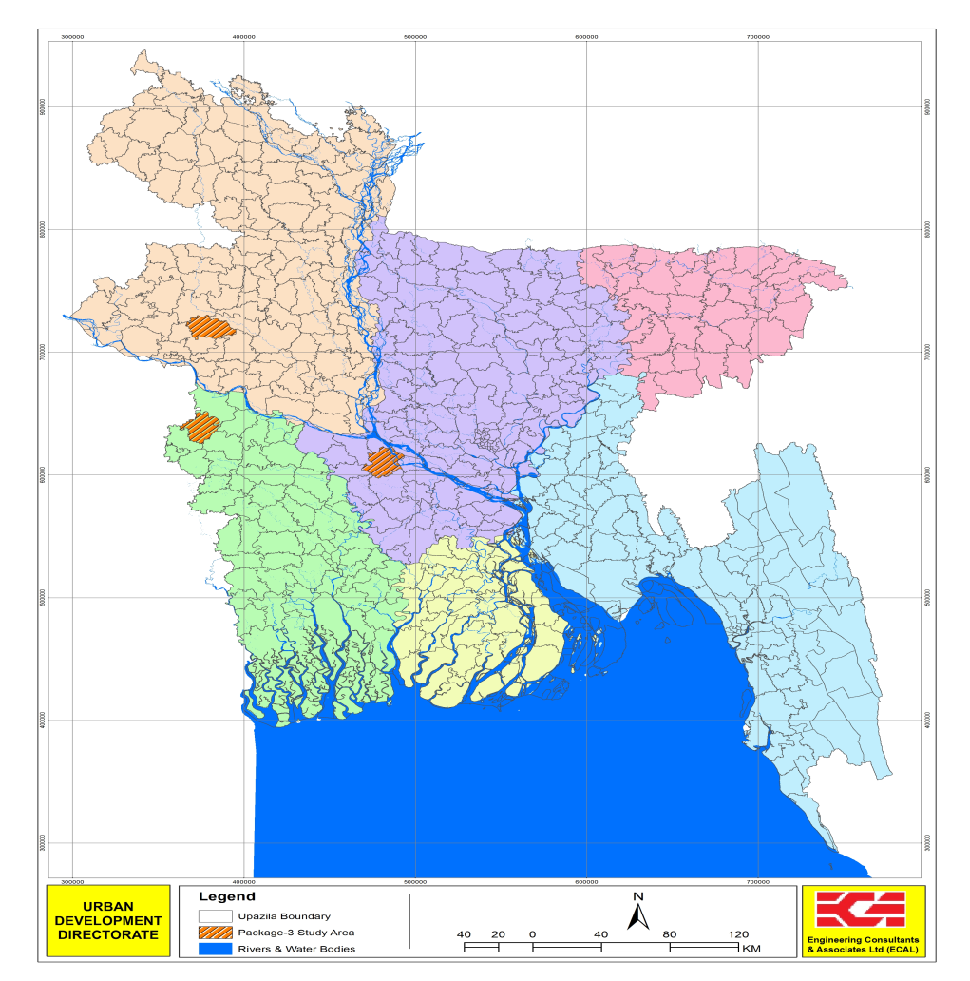
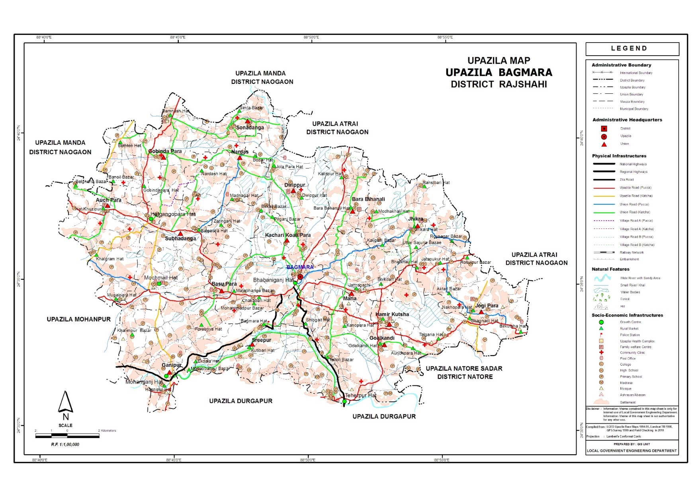
Bagmara Upazila

Slide 5
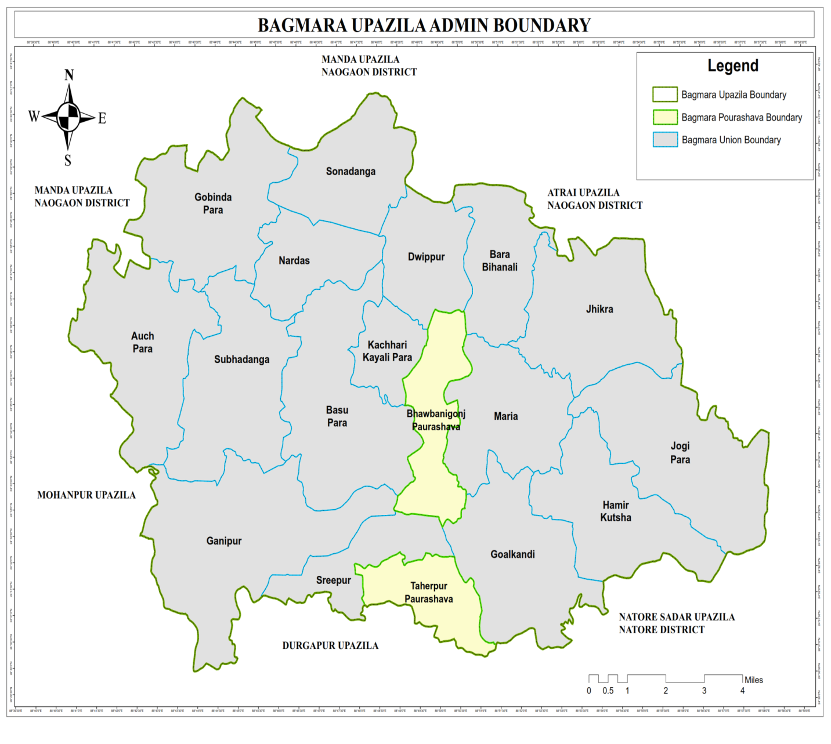
Introduction to Bagmara Upazila
Area = 363.3 sq km,
Thana was formed in 1869 and it was turned into an Upazila in 1984.
Water Bodies:
Baranai; Fakinni river, Beel Joshoi, Takta Beel, Mosher Beel, Nakkati Beel, Katila Beel

Slide 6
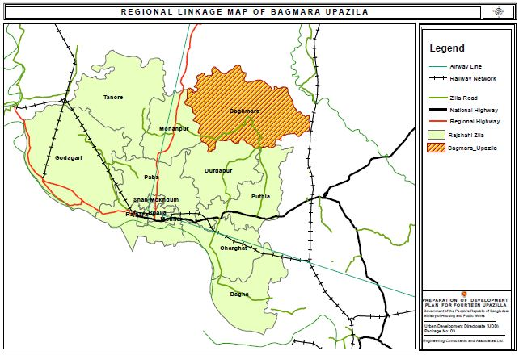
Regional Context of Bagmara Upazila
Bagmara Upazila has great significance in the context of road network. Bagmara Upazila is directly connected with Mohonpur, Durgapur and Puthia through the zila road.This zila road also covers Godagari, Poba, Shahmokhdum, Rajpara, Boalia Charghat and Bagha. The regional highway doesn’t cover Bagmara Upazila. It covers Godagari, Poba, Shahmokhdum, Rajpara, Boalia and Moanpur. There is no railway network in Bagmara Upazila. Railway network passes by the outside of Bagmara Upazila area.

Slide 7
Population Distribution at Different Administrative Tier
Upazila (363.3 sq.km)
Municipality | Union | Mouza | Village | Population |  | Density (per Sq. km) | Literacy Rate (%)
 |  |  |  | Urban | Rural
 |  |  |  |  |  |  | Urban | Rural
2 | 16 | 358 | 332 | 35,899 | 3,18,765 | 881 | 70.30 | 38.31
Bwabaniganj Municipality (Pouro Webportal)
Area (sq. km.) | Ward | Mahalla | Population | Density (per sq. km) | Literacy rate (%)
10.00 | 9 | 23 | 17955 | 1,178 | 64.6
Taherpur Municipality (Pouro Webportal)
Area (sq. km.) | Ward | Mahalla | Population | Density (per sq. km) | Literacy rate (%)
10.825 | 9 | 18 | 17944 | 778 | 76

Slide 8
Plan Preparation Methodology
Survey
Existing Condition
PRA Demand Analysis
Workshop
Draft Plan
Suitability Analysis
Final Plan
Public Hearing
Consultation Meeting

Slide 9
Conducted Survey
Surveying
Agriculture Survey
PRA (Participatory Rapid Appraisal)
Geological Survey
Hydrological Survey
Formal Informal Survey
Physical Feature Survey
Socio Economic Survey
Transport Survey

Slide 10
Plan Procedure
Draft Plan
Survey Findings
(Thematic Maps)
PRA Demand
Demand Analysis
Suitability Analysis
Final Plan
Draft TMC Meeting
Public Hearing
Consultation
(MP, Local Authority)
Workshop at Upazila

Slide 11
5 Tier of Development Plan
Sub-Regional Plan
(20 years)
Structure Plan
(20 Years)
Urban Area Plan
(10 Years)
Rural Area Plan
(10 Years)
Action Area Plan
(5 Years)

Slide 12
Draft Plan
Survey Findings
(Thematic Maps)
PRA Demand
Demand Analysis
Suitability Analysis
Survey Findings
(Thematic Maps)

Slide 13
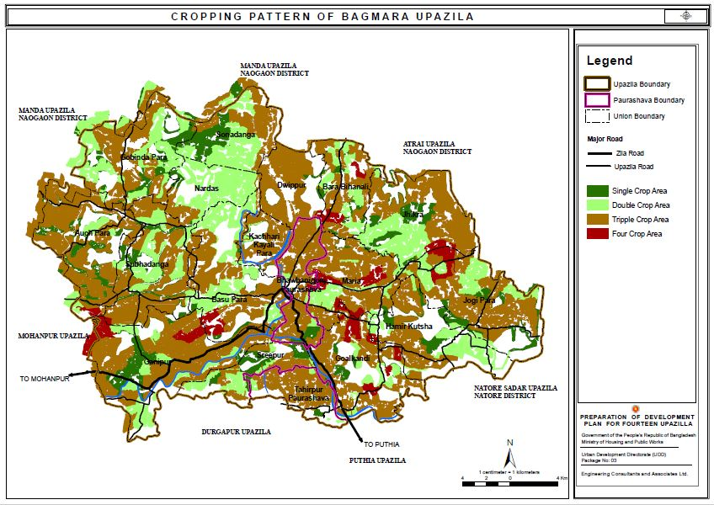
Cropping Intensity Map of Bagmara Upazila
Cropping Pattern | Area in Acre | Area in Sq.km | Percentage
Single Cropping | 7790.023111 | 31.525105 | 12.85%
Double Cropping | 15651.78868 | 63.340542 | 25.81%
Triple Cropping | 34876.84722 | 141.141593 | 57.51%
Four Cropping | 2324.321155 | 9.406194 | 3.83%
Total | 60642.98017 | 245.413434 | 100%

Slide 14
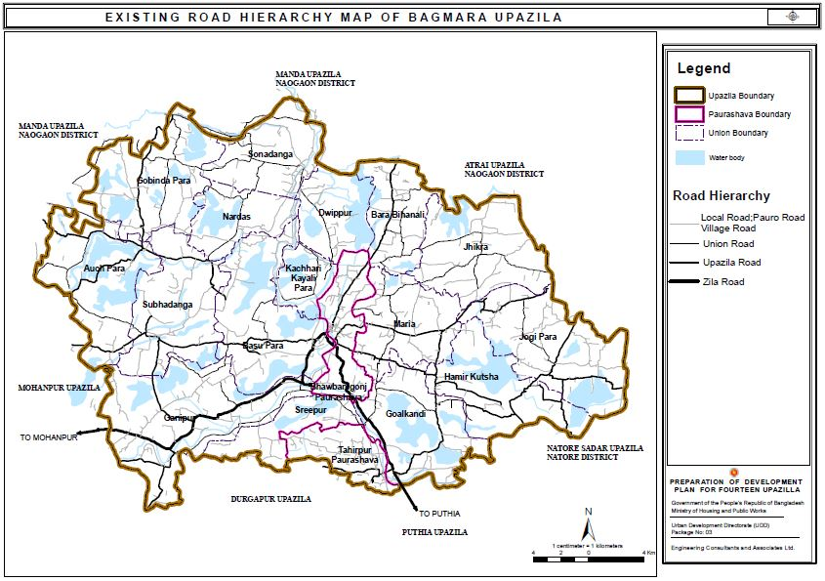
Existing Circulation Network
Road Hierarchy | Length in Km. | Percentage
Local Road | 14.07 | 2.03%
Pouro Road | 41.75 | 6.02%
Union Road | 152.14 | 21.93%
Upazila Road | 123.95 | 17.87%
Village Road | 338.57 | 48.80%
Zilla Road | 23.35 | 3.36%
Total | 693.83 | 100.00%

Slide 15
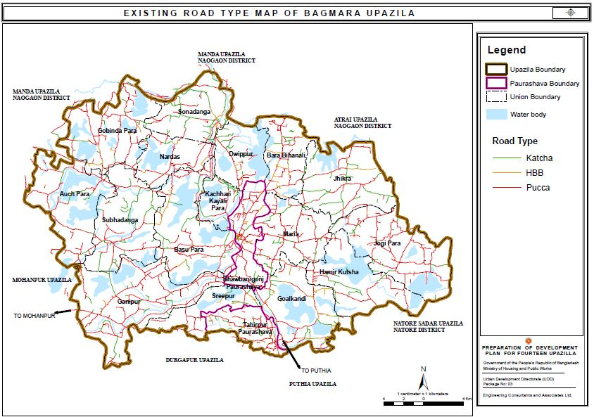
Existing Circulation Network
Road Type | Length in Km. | Percentage
Katcha | 166.96 | 24.15%
HBB | 45.32 | 6.55%
Pucca | 479.06 | 69.30%
Total | 691.34 | 100%

Slide 16
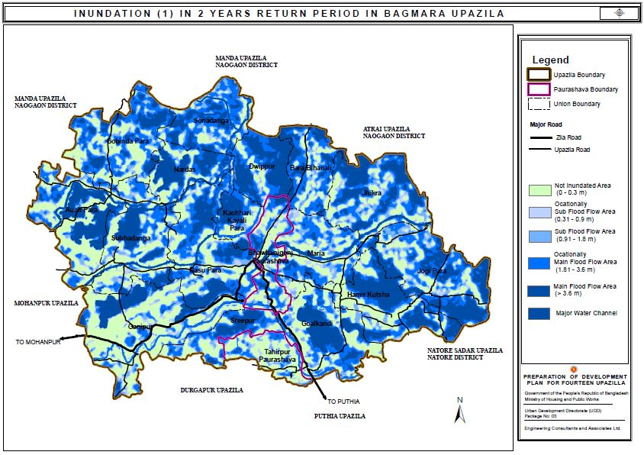
Flood Inundation Map
Flooded Land Category | Water Depth | Percentage area | Remarks
1st Degree Flooded area | 0-0.3m | 28% | Not Inundated Area
2nd Degree Flooded area | 0.31-0.9m | 9% | Ocationally Sub Flood Flow Area
3rd Degree Flooded area | 0.91-1.8m | 13% | Sub Flood Flow Area
4th Degree Flooded area | 1.81-3.6m | 22% | Ocationally Main Flood Flow Area
5th Degree Flooded area | >3.6m | 27% | Main Flood Flow Area

Slide 17
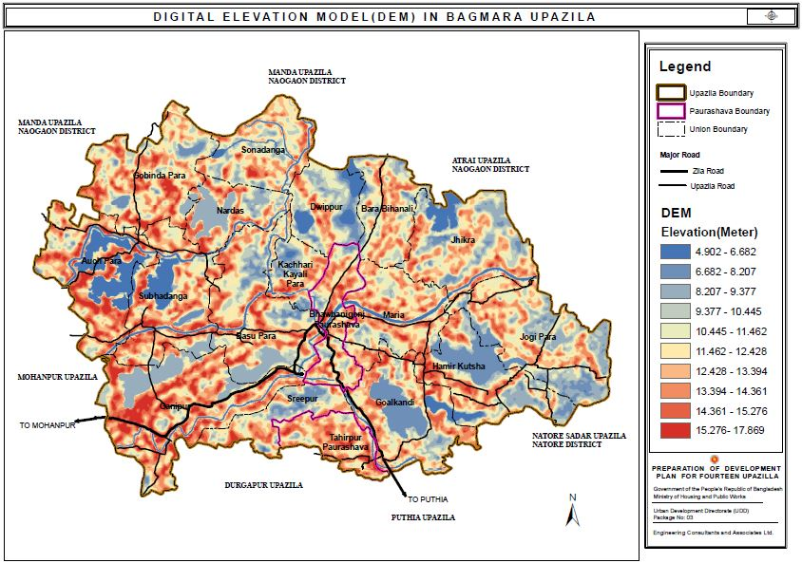
Digital Elevation Model in Bagmara Upazila
The overall elevation condition in Bagmara Upazila is moderately good. The higher elevation has been found in Ganipur, Gobindapara Union and half portion of Subhadanga Union. Taherpur and Bwabanigonj Pourashava have a medium elevation in context of the unions where higher elevation has been found.

Slide 18
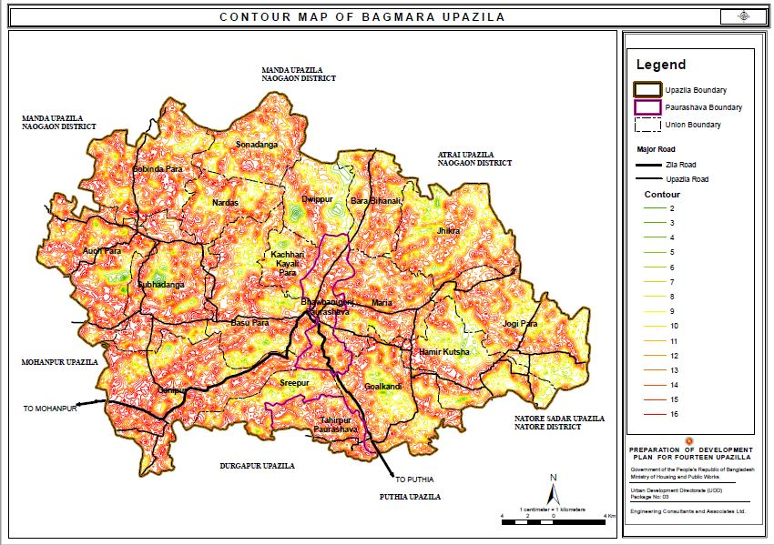
Contour Map of Bagmara Upazila

Slide 19
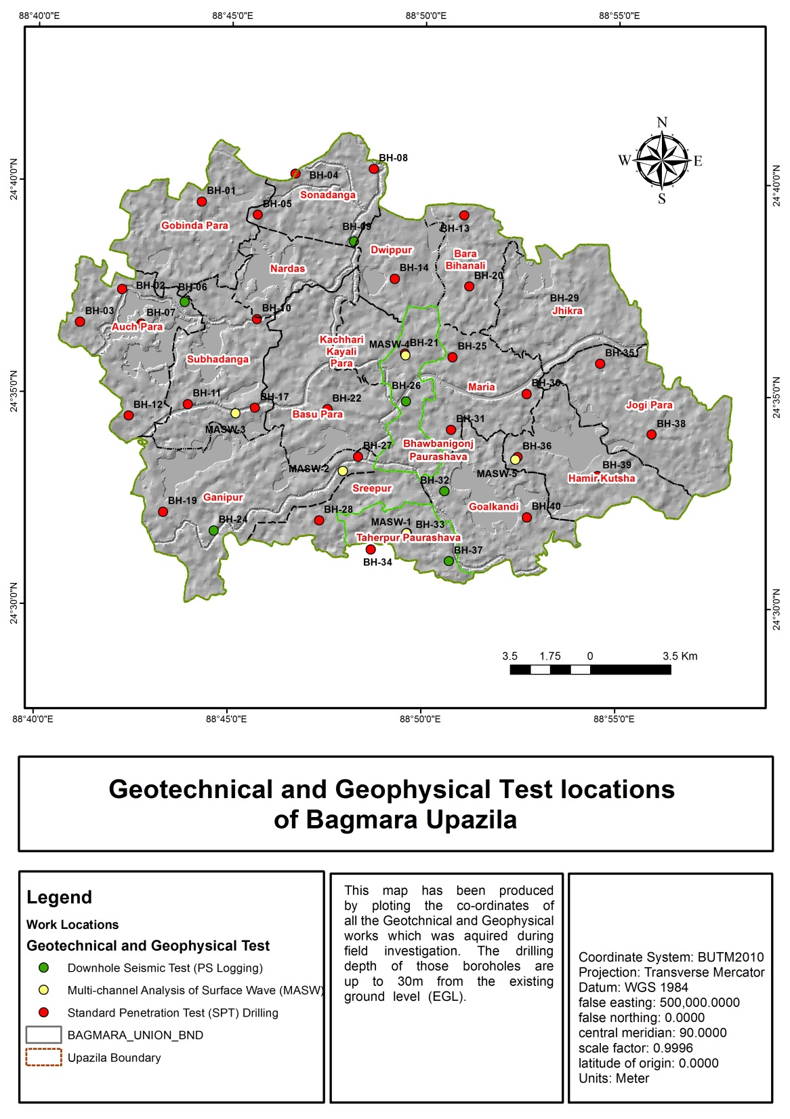
Geological Works

Slide 20
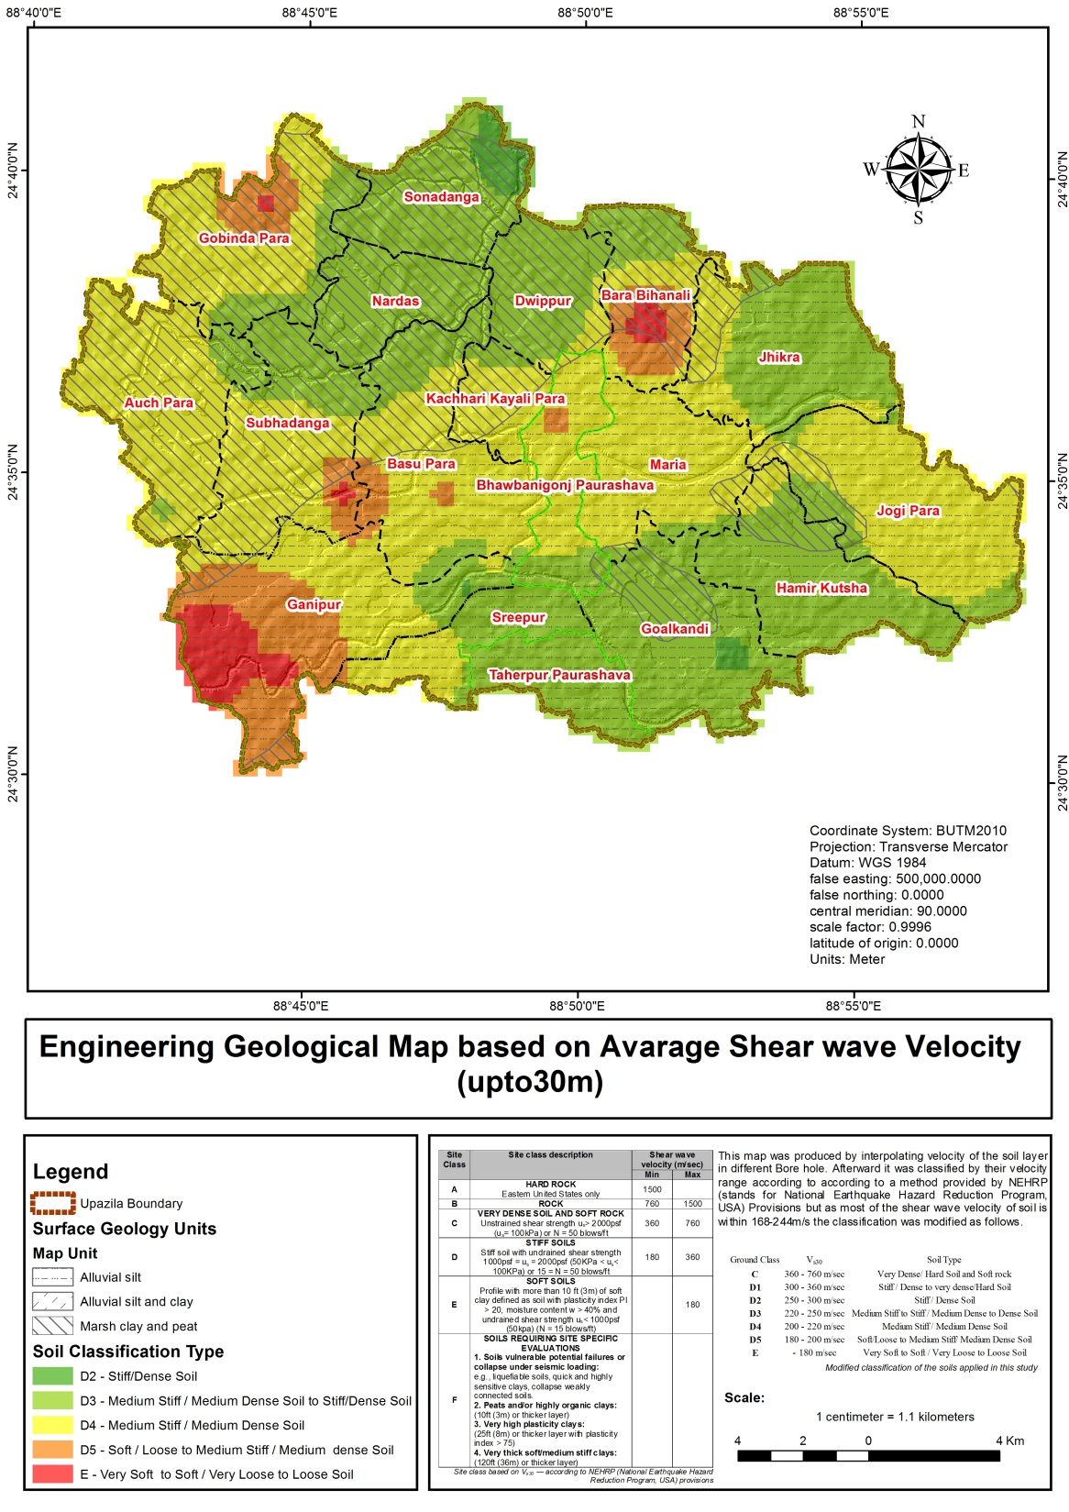
Geological Works (Soil Classification)

Slide 21
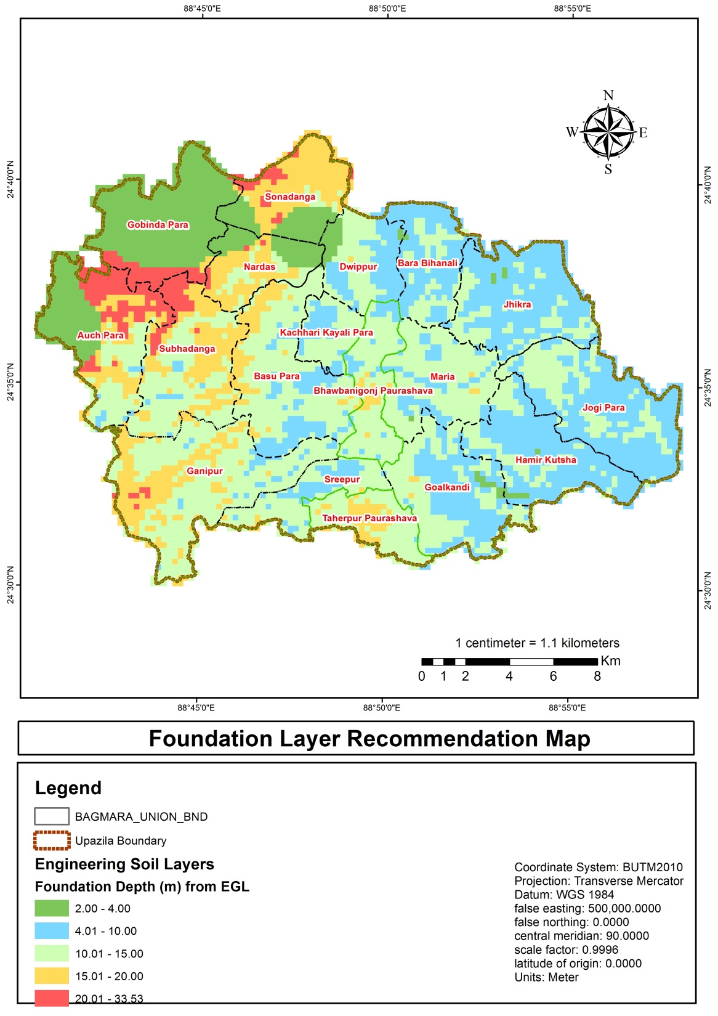
Geological Works
(Foundation Layer Recommendation)

Slide 22
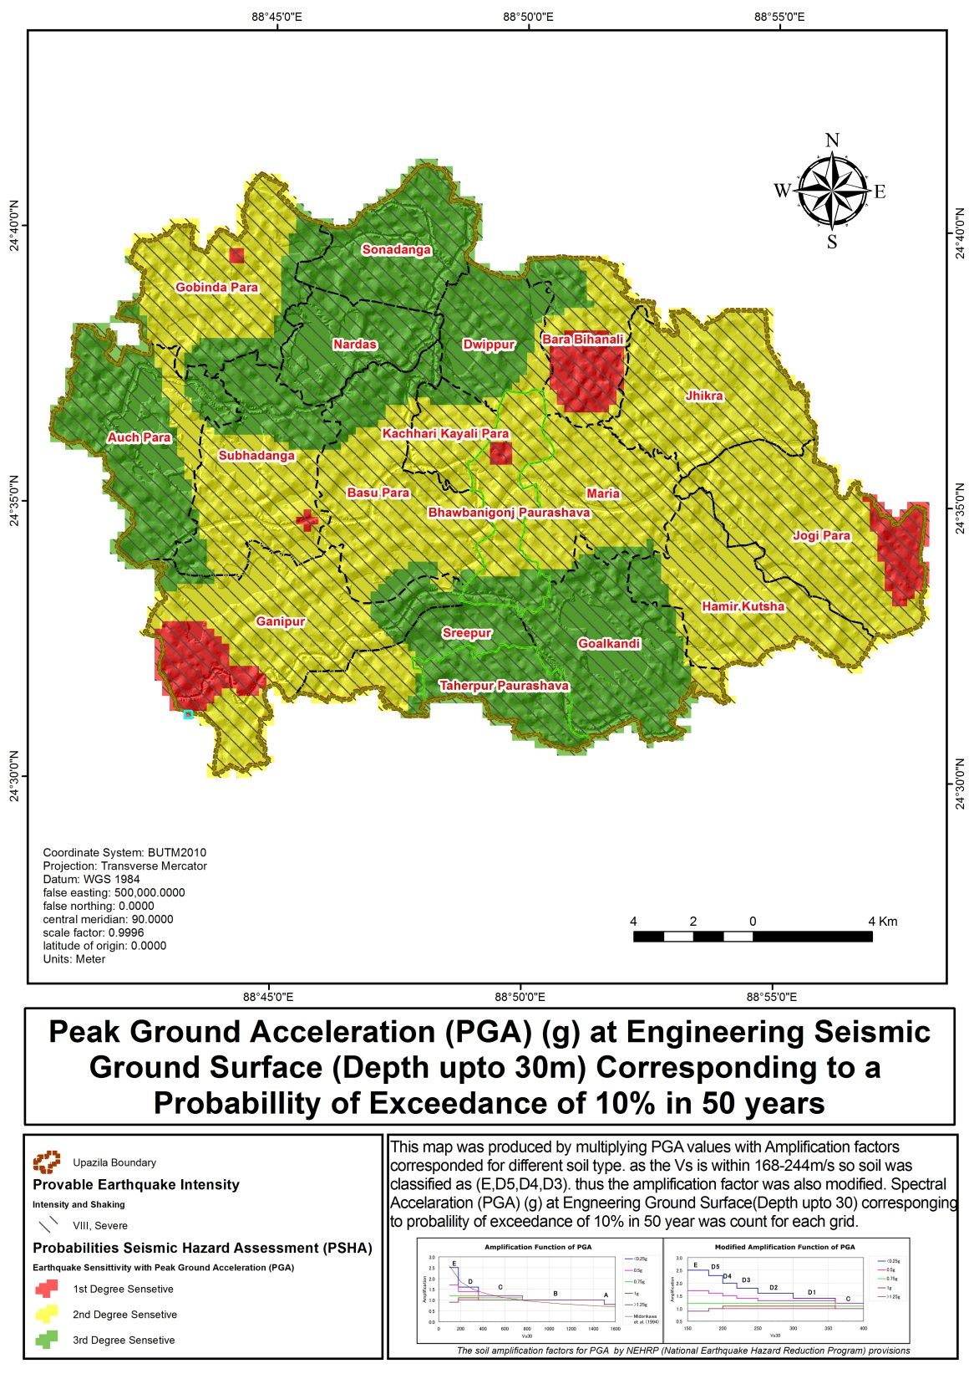
Geological Works (Probabilities Seismic Hazard Assessment)

Slide 23
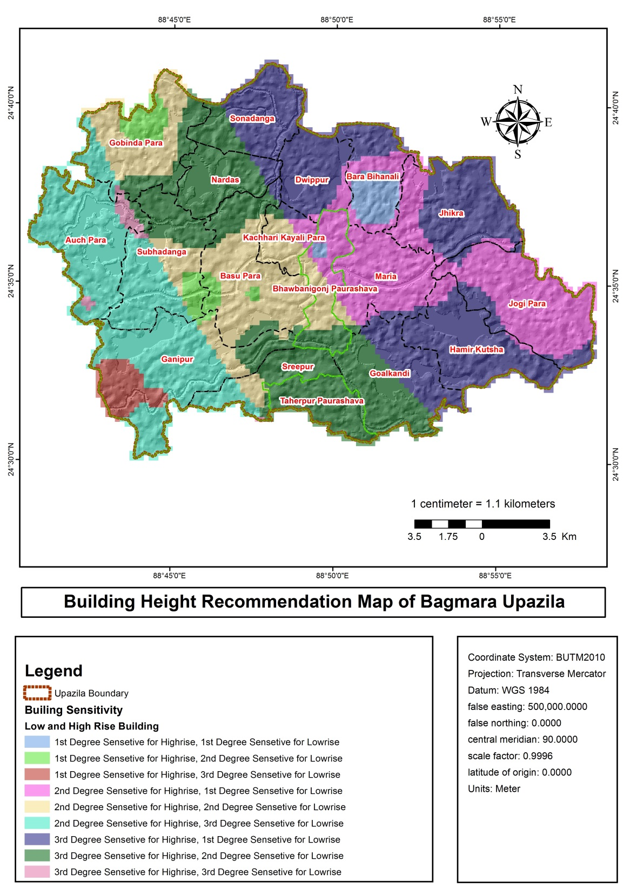
Geological Works
(Building Height Recommendation)

Slide 24
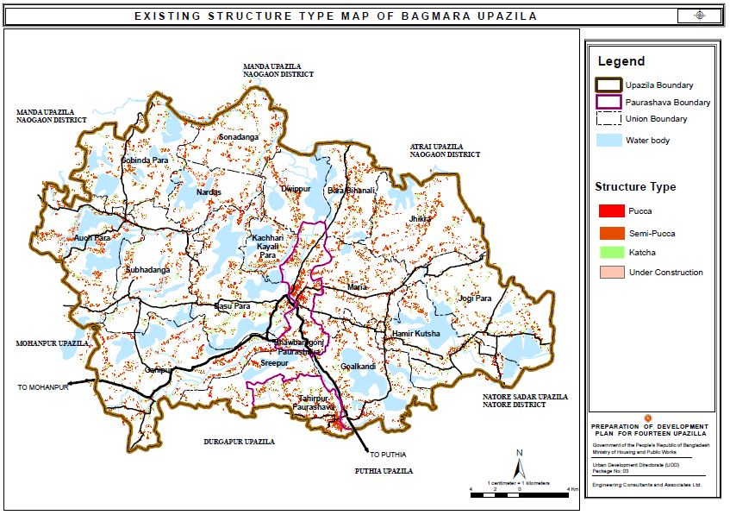
Existing Physical Features
Structure Type | No. of Structures | Percentage
Katcha | 17055 | 27.33%
Semi Pucca | 39703 | 63.62%
Pucca | 5604 | 8.98%
Under Construction | 48 | 0.08%
Total | 62410 | 100%

Slide 25
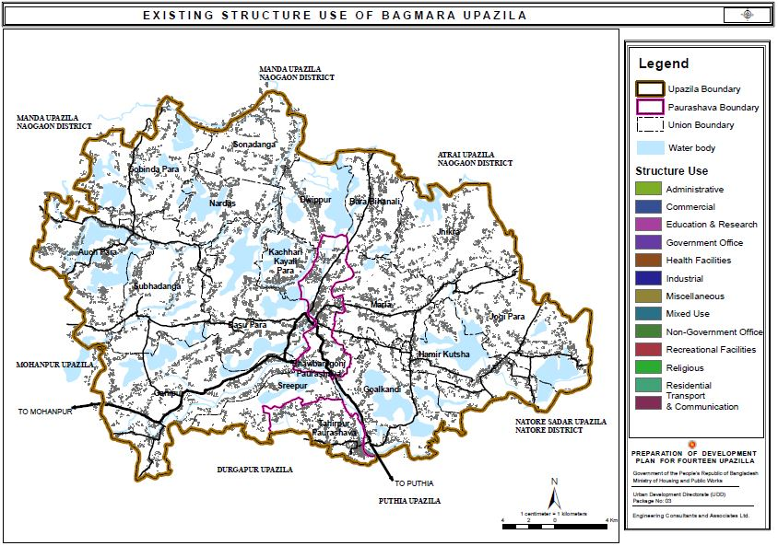
Existing Physical Features
Structure Use | No. of Structures
Administrative | 123
Agricultural | 70
Commercial | 1982
Community Facilities | 2
Education and Research | 220
Health Facilities | 22
Industrial | 34
Miscellaneous | 37
Mixed Use | 60
Non-Government Services | 21
Recreational Facilities | 2
Religious | 97
Residential | 59723
Transportation Facilities | 9
Utility Facilities | 8

Slide 26
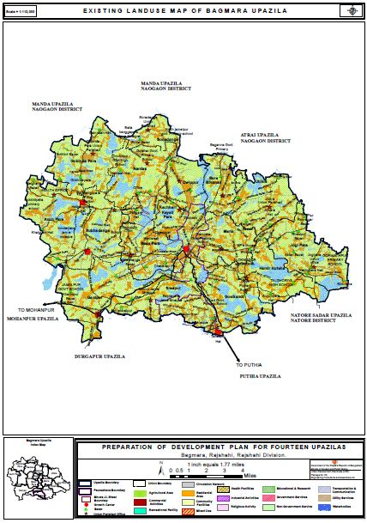
Landuse Map of Bagmara Upazila
Landuse | Area in Acres | Area in Sq.km
Administrative | 26.46 | 0.107072
Agricultural | 58611.48 | 237.192252
Commercial | 164.12 | 0.664175
Community Facilities | 0.39 | 0.001594
Education & Research | 61.28 | 0.247976
Health Facilities | 2.63 | 0.01066
Industrial | 6.96 | 0.028185
Miscellaneous | 0.50 | 0.002008
Mixed Use | 14.86 | 0.060136
NGO | 0.51 | 0.002046
Recreational Facilities | 0.14 | 0.00056
Religious | 8.55 | 0.034616
Residential | 16316.24 | 66.029498
Utility Facilities | 0.91 | 0.003689
Waterbodies | 15502.78 | 62.737509
Circulation Network | 495.50 | 2.00523
Total | 91213.32 | 369.13

Slide 27
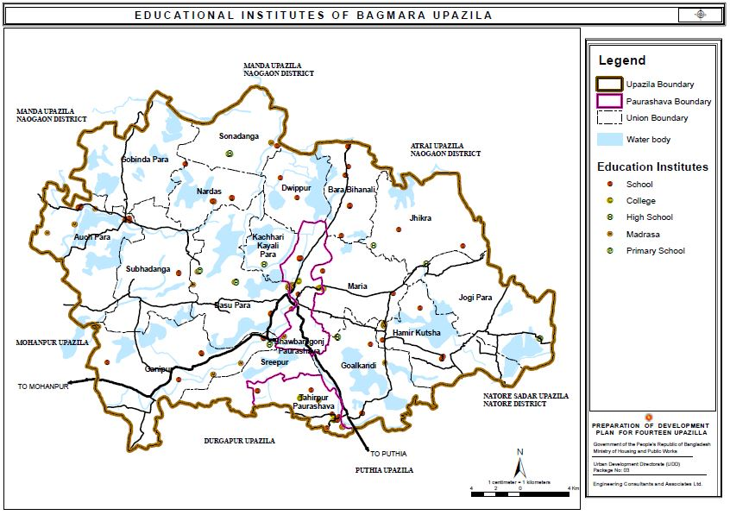
Existing Educational Facilities
Educational Facilities | No. of Structures
Primary School/School | 124
High school | 21
College | 22
Madrasa | 46

Slide 28
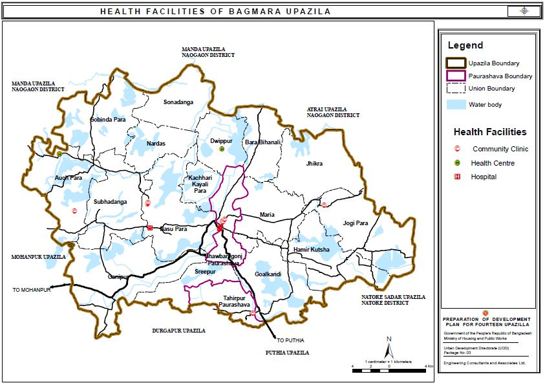
Existing Health Facilities
Health Facilities | No. of Structures
Community Clinic | 13
Health Center | 4
Hospital | 4

Slide 29
Draft Plan
Survey Findings
(Thematic Maps)
PRA Demand
Demand Analysis
Suitability Analysis
PRA Demand

Slide 30
PRA Findings of Bagmara Unions and Pourashavas
Union/Ward | Problems | Potentials
Auchpara Union | Communication Pure drinking water Drainage problem Education Unemployment | Agricultural land Fruit garden Cattle farming Fish farming Active manpower
Basu Para Union | Communication Pure drinking water Agricultural problem Educational infrastructure Health service | Agricultural land Educated people Cattle farming Fish farming Farmer
Bara Bihanali Union | Communication HealthFacilities Water Logging Electricity Child Marriage | Agriculture Fisheries Livestock & Fisheries Hat-Bazar Man power
Dwippur Union | Communication Health Facilities Water Logging Electricity Child Marriage | Agriculture Fisheries Livestock & Fisheries Hat-Bazar Man power
Goalkandi Union | Polder Communication Pure Drinking water Agricultural Instruments Health Complex lacking | Beel Agricultural Land availability Fisheries Active Manpower Livestock

Slide 31
PRA Findings of Bagmara Unions and Pourashavas
Union/Ward | Problems | Potentials
Gabindapara Union | Communication Electricity Pure Drinking Water Modern Education Agriculture | Agricultural Land Active Manpower Livestock & Fisheries Educational Institutions Hat-Bazar
Gonipur Union | Communication Pure Drinking Water Electricity Education Health | Bettle leaf Agriculture Fisheries Livestock Hat-Bazar
Hamirkutsha Union | Communication Health Facilities Water Logging Electricity Child Marriage | Agriculture Fisheries Livestock Hat-Bazar Man Power
Jhikra Union | Communication Electricity Water Logging Health Facilities Industry Lacking | Agriculture Land Fisheries Livestock Hat-Bazar Fruits & Forest
Jogipara Union | Communication Pure Drinking Water Drainage Problem Education Unemployment | Agriculture Land Fruit Garden Cattle Farming Fish Farming Active Manpower

Slide 32
PRA Findings of Bagmara Unions and Pourashavas
Union/Ward | Problems | Potentials
Kachari Kayalipara Union | Communication Electricity Educational Institute Health Facilities River Digging | Agriculture Fisheries Livestock Adeqate River Man Power
Maria Union | Communication Agricultural Facilities Health Facilities Residential Agriculture | Agriculture Land Fruit Garden Cattle Farming Fish Farming Active Manpower
Nordas Union | Communication Pure Drinking Water Drainage Problem Education Unemployment | Agriculture Land Fruit Garden Cattle Farming Fish Farming Active Manpower
Sonadanga Union | Communication Water Logging Education Agricultural Facilities Electricity & Fuel | Agriculture Fruit Garden Manpower Livestock & Fisheries Hat-Bazar
Sreepur Union | Communication Agricultural Facilities Health Facilities Residential Agriculture | Agriculture Land Fruit Garden Cattle Farming Fish Farmnig Acticve Manpower

Slide 33
PRA Findings of Bagmara Unions and Pourashavas
Union/Ward | Problems | Potentials
Subhadanga Union | Communication Agricultural Facilities Health Facilities Residential Agriculture | Agriculture Land Educated Person Cattle Farming Fish Farmnig Active Manpower
Bwabanigonj Pourashava Ward No. 01 | Shortage of Pure Drinking Water Road Broken Water Logging Unemployment to Women Problem of Drug addiction & Entertainment | River Children Park Natural Cannel Bus Stand Main Road in City
Bwabanigonj Pourashava Ward No. 02 | Shortage of Pure Drinking Water Road Broken Water Logging Unemployment to Women Problem of Drug addiction & Entertainment | River Children Park Natural Cannel Bus Stand Main Road in City
Bwabanigonj Pourashava Ward No. 03 | Shortage of Pure Drinking Water Road Broken Water Logging Unemployment to Women Problem of Drug addiction & Entertainment | River Children Park Natural Cannel Bus Stand Main Road in City
Bwabanigonj Pourashava Ward No. 04 | Shortage of Pure Drinking Water Road Broken Water Logging Unemployment to Women Problem of Drug addiction & Entertainment | River Children Park Natural Cannel Bus Stand Main Road in City

Slide 34
PRA Findings of Bagmara Unions and Pourashavas
Union/Ward | Problems | Potentials
Bwabanigonj Pourashava Ward No. 05 | Shortage of Pure Drinking Water Road Broken Water Logging Unemployment to Women Problem of Drug addiction & Entertainment | River Children Park Natural Cannel Bus Stand Main Road in City
Bwabanigonj Pourashava Ward No. 06 | Shortage of Pure Drinking Water Road Broken Water Logging Unemployment to Women Problem of Drug addiction & Entertainment | River Children Park Natural Cannel Bus Stand Main Road in City
Bwabanigonj Pourashava Ward No. 07 | Shortage of Pure Drinking Water Road Broken Water Logging Unemployment to Women Problem of Drug addiction & Entertainment | River Children Park Natural Cannel Bus Stand Main Road in City
Bwabanigonj Pourashava Ward No. 08 | Shortage of Pure Drinking Water Road Broken Water Logging Unemployment to Women Problem of Drug addiction & Entertainment | River Children Park Natural Cannel Bus Stand Main Road in City
Bwabanigonj Pourashava Ward No. 09 | Shortage of Pure Drinking Water Road Broken Water Logging Unemployment to Women Problem of Drug addiction & Entertainment | River Children Park Natural Cannel Bus Stand Main Road in City

Slide 35
PRA Findings of Bagmara Unions and Pourashavas
Union/Ward | Problems | Potentials
Taherpur Pourashava Ward No. 01 | Shortage of Pure Drinking Water Road Broken Water Logging Unemployment to Women Problem of Drug addiction & Entertainment | River Children Park Natural Cannel Bus Stand Main Road in City
Taherpur Pourashava Ward No. 02 | Shortage of Pure Drinking Water Road Broken Water Logging Unemployment to Women Problem of Drug addiction & Entertainment | River Children Park Natural Cannel Bus Stand Main Road in City
Taherpur Pourashava Ward No. 03 | Shortage of Pure Drinking Water Road Broken Water Logging Unemployment to Women Problem of Drug addiction & Entertainment | River Children Park Natural Cannel Bus Stand Main Road in City
Taherpur Pourashava Ward No. 04 | Shortage of Pure Drinking Water Road Broken Water Logging Unemployment to Women Problem of Drug addiction & Entertainment | River Children Park Natural Cannel Bus Stand Main Road in City
Taherpur Pourashava Ward No. 05 | Shortage of Pure Drinking Water Road Broken Water Logging Unemployment to Women Problem of Drug addiction & Entertainment | River Children Park Natural Cannel Bus Stand Main Road in City

Slide 36
PRA Findings of Bagmara Unions and Pourashavas
Union/Ward | Problems | Potentials
Taherpur Pourashava Ward No. 06 | Shortage of Pure Drinking Water Road Broken Water Logging Unemployment to Women Problem of Drug addiction & Entertainment | River Children Park Natural Cannel Bus Stand Main Road in City
Taherpur Pourashava Ward No. 07 | Shortage of Pure Drinking Water Road Broken Water Logging Unemployment to Women Problem of Drug addiction & Entertainment | River Children Park Natural Cannel Bus Stand Main Road in City
Taherpur Pourashava Ward No. 08 | Shortage of Pure Drinking Water Road Broken Water Logging Unemployment to Women Problem of Drug addiction & Entertainment | River Children Park Natural Cannel Bus Stand Main Road in City
Taherpur Pourashava Ward No. 09 | Shortage of Pure Drinking Water Road Broken Water Logging Unemployment to Women Problem of Drug addiction & Entertainment | River Children Park Natural Cannel Bus Stand Main Road in City

Slide 37
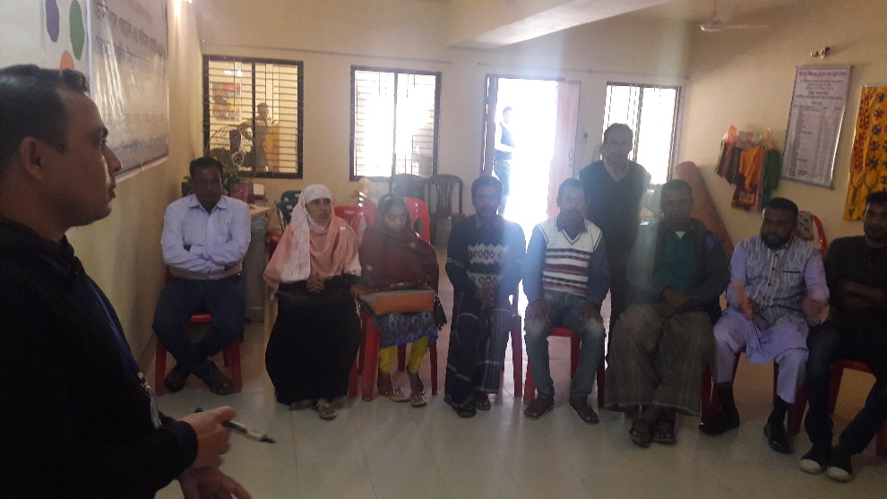
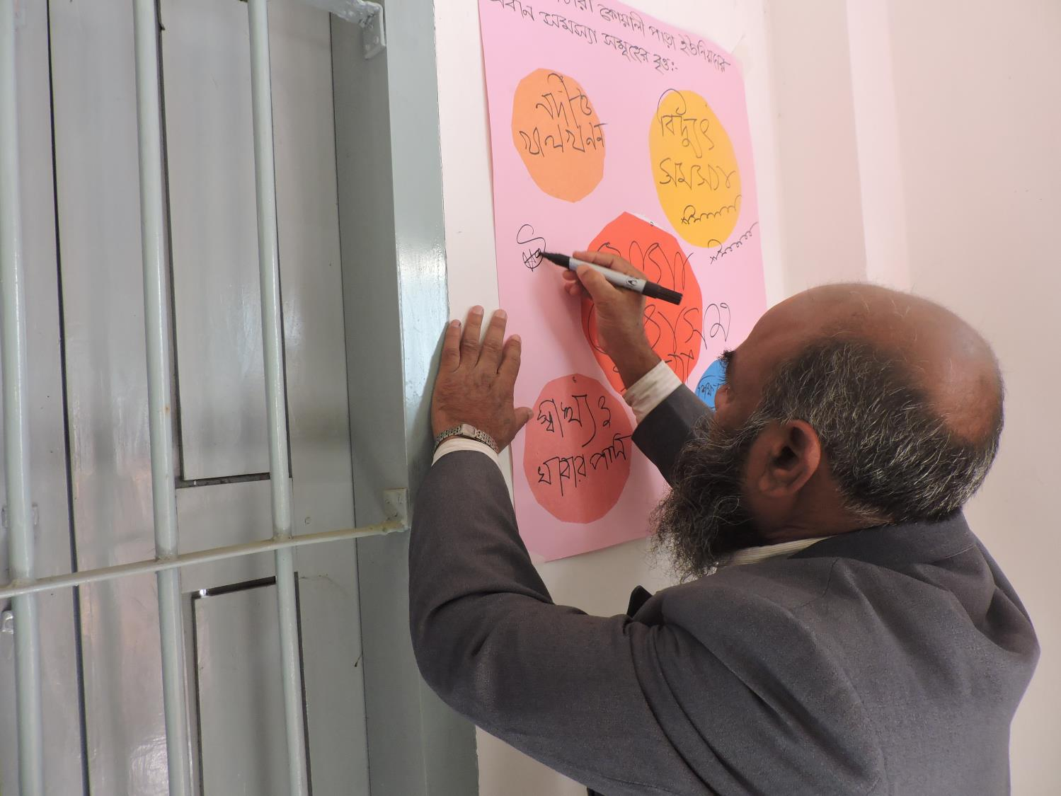
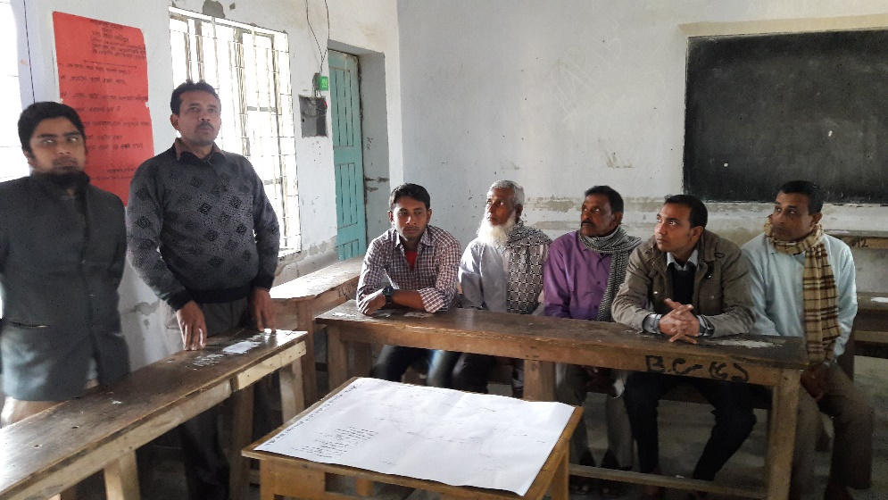
Participatory Rapid Appraisal (PRA) - City Level
PRA Taherpur Pourashava, Bagmara
PRA Bwabaniganj Pourashava, Bagmara

Slide 38
Draft Plan
Survey Findings
(Thematic Maps)
PRA Demand
Demand Analysis
Suitability Analysis
Demand Analysis

Slide 39
Projected Population
Exponential Compound Growth Method has been used for population projection
Area | Base Year Population (BBS,2011) | Projected Population (Consider Medium Growth Rate, 1.28%)
 |  | 2018 | 2023 | 2028 | 2035
Paurashava | 35899 | 39242 | 41818 | 44564 | 48714
Rural Area | 318765 | 348447 | 371326 | 395707 | 432553
Total | 354664 | 387689 | 413144 | 440271 | 481267
Urban Area Population Projection
Pourashava | Base Year Population (BBS,2011) | Projected Population (Consider Medium Growth Rate, 1.28%)
 |  | 2018 | 2023 | 2028 | 2035
Bwabaniganj | 17955 | 19627 | 20916 | 22289 | 24364
Taherpur | 17944 | 19615 | 20903 | 22275 | 24349

Slide 40
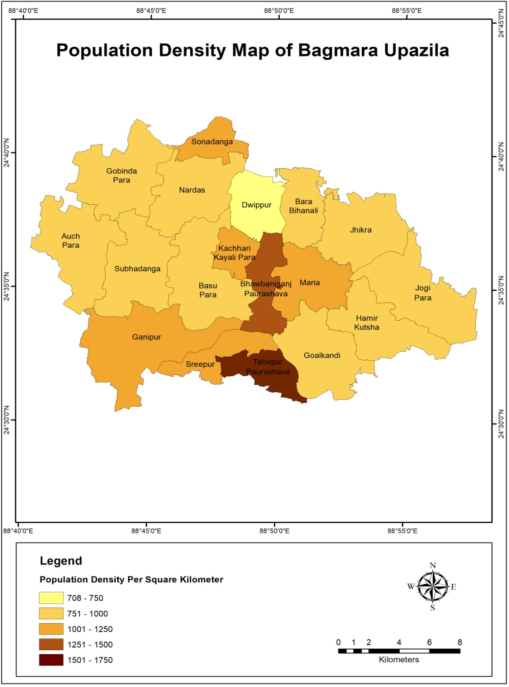
Rural Area Population Projection
Unions | Base Year Population (BBS,2011) | Projected Population (Consider Medium Growth Rate, 1.28%) 2035
Auch Para | 26685 | 36211
Bara Bihanali | 12571 | 17058
Basu Para | 26943 | 36561
Dwippur | 9852 | 13369
Goalkandi | 24275 | 32940
Gobinda Para | 22707 | 30813
Ganipur | 36469 | 49487
Hamir Kutsha | 19817 | 26891
Jhikra | 22026 | 29889
Jogipara | 24830 | 33693
Kachari Kayali Para | 7509 | 10189
Maria | 19487 | 26443
Nardas | 19528 | 26499
Sonadanga | 8684 | 11784
Sreepur | 11789 | 15997
Shubhadanga | 25593 | 34729

Slide 41
Demand Analysis of Bagmara Upazila
Union/ Paurashava | Facilties | Population Standard | Projected Population (2035) | Required Faciliities | Existing Facilities
Bhabaniganj Paurashava | Primary School/ kindergarten | 5000 | 24364 | 5 | 4
 | Secondary/High School | 20000 | 24364 | 1 | 3
 | College | 20000 | 24364 | 1 | 3
 | Neighborhood park | 10000 | 24364 | 2 | 1
 | Health center | 5000 | 24364 | 5 | 5
Taherpur Paurashava | Primary School/ kindergarten | 5000 | 24349 | 5 | 4
 | Secondary/High School | 20000 | 24349 | 1 | 4
 | College | 20000 | 24349 | 1 | 3
 | Neighborhood park | 10000 | 24349 | 2 | 0
 | Health center | 5000 | 24349 | 5 | 4
Auch Para | Primary School/ kindergarten | 5000 | 36211 | 7 | 14
 | Secondary/High School | 20000 | 36211 | 2 | 6
 | College | 20000 | 36211 | 2 | 3
 | Neighborhood park | 10000 | 36211 | 4 | 0
 | Health center | 5000 | 36211 | 7 | 5

Slide 42
Union/ Paurashava | Facilties | Population Standard | Projected Population (2035) | Required Faciliities | Existing Facilities
Bara Bihanali | Primary School/ kindergarten | 5000 | 17058 | 3 | 0
 | Secondary/High School | 20000 | 17058 | 1 | 4
 | College | 20000 | 17058 | 1 | 0
 | Neighborhood park | 10000 | 17058 | 2 | 0
 | Health center | 5000 | 17058 | 3 | 0
Basu Para Union | Primary School/ kindergarten | 5000 | 36561 | 7 | 2
 | Secondary/High School | 20000 | 36561 | 2 | 1
 | College | 20000 | 36561 | 2 | 1
 | Neighborhood park | 10000 | 36561 | 4 | 0
 | Health center | 5000 | 36561 | 7 | 3
Dwippur Union | Primary School/ kindergarten | 5000 | 13369 | 3 | 7
 | Secondary/High School | 20000 | 13369 | 1 | 3
 | College | 20000 | 13369 | 1 | 0
 | Neighborhood park | 10000 | 13369 | 1 | 0
 | Health center | 5000 | 13369 | 3 | 0
Goalkandi Union | Primary School/ kindergarten | 5000 | 32940 | 7 | 12
 | Secondary/High School | 20000 | 32940 | 2 | 2
 | College | 20000 | 32940 | 2 | 0
 | Neighborhood park | 10000 | 32940 | 3 | 0
 | Health center | 5000 | 32940 | 7 | 2

Slide 43
Union/ Paurashava | Facilties | Population Standard | Projected Population (2035) | Required Faciliities | Existing Facilities
Gobinda Para Union | Primary School/ kindergarten | 5000 | 30813 | 6 | 16
 | Secondary/High School | 20000 | 30813 | 2 | 4
 | College | 20000 | 30813 | 2 | 2
 | Neighborhood park | 10000 | 30813 | 3 | 0
 | Health center | 5000 | 30813 | 6 | 0
Ganipur Union | Primary School/ kindergarten | 5000 | 49487 | 10 | 4
 | Secondary/High School | 20000 | 49487 | 2 | 5
 | College | 20000 | 49487 | 2 | 3
 | Neighborhood park | 10000 | 49487 | 5 | 0
 | Health center | 5000 | 49487 | 10 | 0
Hamir Kutsha Union | Primary School/ kindergarten | 5000 | 26891 | 5 | 10
 | Secondary/High School | 20000 | 26891 | 1 | 2
 | College | 20000 | 26891 | 1 | 0
 | Neighborhood park | 10000 | 26891 | 3 | 0
 | Health center | 5000 | 26891 | 5 | 0
Jhikra Union | Primary School/ kindergarten | 5000 | 29889 | 6 | 15
 | Secondary/High School | 20000 | 29889 | 1 | 4
 | College | 20000 | 29889 | 1 | 1
 | Neighborhood park | 10000 | 29889 | 3 | 0
 | Health center | 5000 | 29889 | 6 | 0

Slide 44
Union/ Paurashava | Facilties | Population Standard | Projected Population (2035) | Required Faciliities | Existing Facilities
Jogi Para Union | Primary School/ kindergarten | 5000 | 33693 | 7 | 7
 | Secondary/High School | 20000 | 33693 | 2 | 4
 | College | 20000 | 33693 | 2 | 2
 | Neighborhood park | 10000 | 33693 | 3 | 1
 | Health center | 5000 | 33693 | 7 | 1
Kachhari Kayali Para Union | Primary School/ kindergarten | 5000 | 10189 | 2 | 2
 | Secondary/High School | 20000 | 10189 | 1 | 1
 | College | 20000 | 10189 | 1 | 1
 | Neighborhood park | 10000 | 10189 | 1 | 0
 | Health center | 5000 | 10189 | 2 | 0
Maria Union | Primary School/ kindergarten | 5000 | 26443 | 5 | 9
 | Secondary/High School | 20000 | 26443 | 1 | 8
 | College | 20000 | 26443 | 1 | 1
 | Neighborhood park | 10000 | 26443 | 3 | 0
 | Health center | 5000 | 26443 | 5 | 1
Nardas Union | Primary School/ kindergarten | 5000 | 26499 | 5 | 2
 | Secondary/High School | 20000 | 26499 | 1 | 2
 | College | 20000 | 26499 | 1 | 1
 | Neighborhood park | 10000 | 26499 | 3 | 0
 | Health center | 5000 | 26499 | 5 | 0

Slide 45
Union/ Paurashava | Facilties | Population Standard | Projected Population (2035) | Required Faciliities | Existing Facilities
Sonadanga Union | Primary School/ kindergarten | 5000 | 11784 | 2 | 5
 | Secondary/High School | 20000 | 11784 | 1 | 2
 | College | 20000 | 11784 | 1 | 1
 | Neighborhood park | 10000 | 11784 | 1 | 0
 | Health center | 5000 | 11784 | 2 | 0
Sreepur Union | Primary School/ kindergarten | 5000 | 15997 | 3 | 2
 | Secondary/High School | 20000 | 15997 | 1 | 1
 | College | 20000 | 15997 | 1 | 1
 | Neighborhood park | 10000 | 15997 | 2 | 0
 | Health center | 5000 | 15997 | 3 | 1
Subhadanga Union | Primary School/ kindergarten | 5000 | 34729 | 7 | 11
 | Secondary/High School | 20000 | 34729 | 2 | 2
 | College | 20000 | 34729 | 2 | 2
 | Neighborhood park | 10000 | 34729 | 3 | 0
 | Health center | 5000 | 34729 | 7 | 0

Slide 46
Draft Plan
Survey Findings
(Thematic Maps)
PRA Demand
Demand Analysis
Suitability Analysis
Suitability Maps

Slide 47
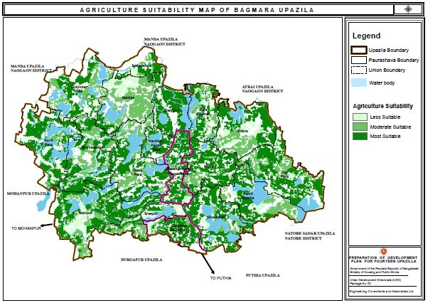
Agricultural Suitability
Crop-land suitability analysis is a prerequisite to achieve optimum utilization of the available land resources for sustainable agricultural production.
Maximum agricultural land condition of Bagmara Upazila is most suitable. A large part of Jhikra Union and Ganipur Kutsha Union are less suitable. Agricultural lands of Bwabanigonj Pourashava and Taherpur Pourashava are most suitable.

Slide 48
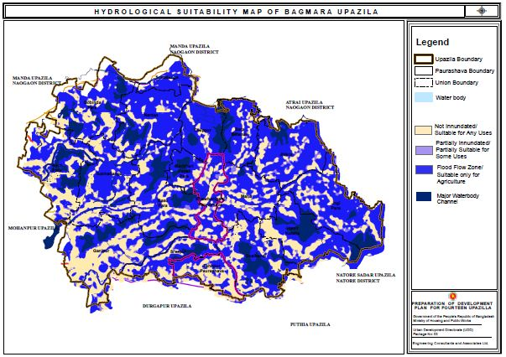
Hydrological Suitability
Maximum portion of Nardas, Dwippur, Jhikra, Jogipara, Maria and Subhadanga Unions have gone under flood flow zone. A huge area of Ganipur Union is not inundated. In the context of hydrological suitability analysis, the condition of Taherpur Pourashava is better than Bwabaniganj Pourashava.

Slide 49
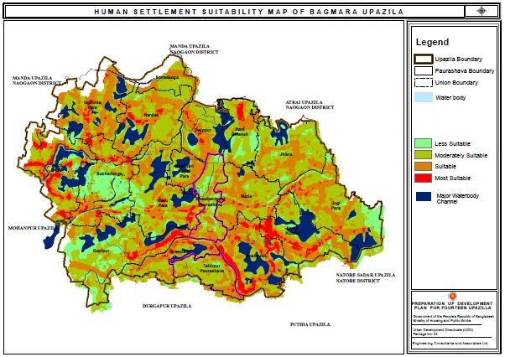
Land Suitability for Human Settlement
A less area of Bagmara Upazila is most suitable in the context of human settlement suitability. This most suitable human settlement is belonged to Goalkandi and Hamir Kutsha Union. Overall Bagmara Upazila have a suitable human settlement.

Slide 50
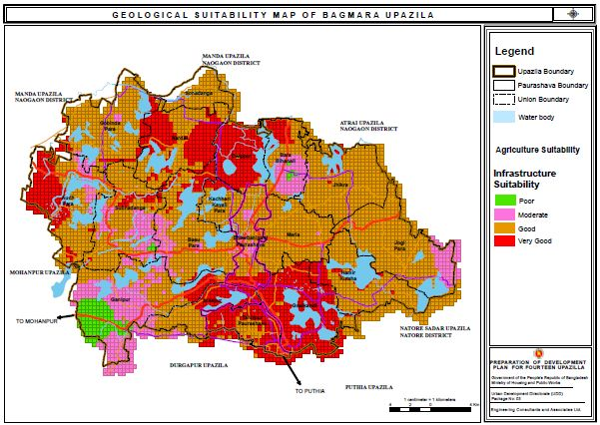
Geological Suitability
The infrastructure suitability condition of Goalkandi Union, Dwippur Union, Sreepur Union and Taherpur Pourashava are very good. Half portion of Nardas Union and Auch Para Union are in very good condition. On the other side, Ganipur Union has poor infrastructure suitability. Overall Infrastructure suitability of Bagmara Upazila is good.
Infrastructure Category | Area(Sq.Km) | % of Area
Good | 228.88 | 58.98%
Moderate | 46.00 | 11.85%
Poor | 8.06 | 2.08%
Very Good | 105.13 | 27.09%
Total | 388.06 | 100%

Slide 51
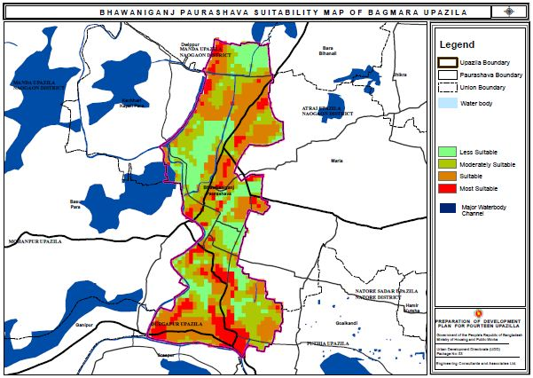
Urban Area Suitability: Bwabanigonj Pourashava
Half portion of the total area of Bwabaniganj Pourashava is less suitable. The center of Bwabaniganj Pourashava as well as the border area of pourashava consists of most suitable and moderately suitable area.

Slide 52
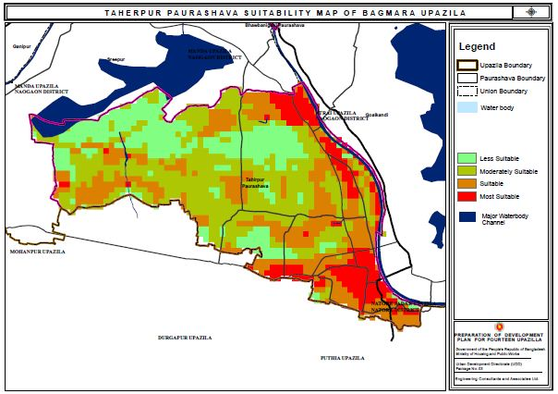
Urban Area Suitability: Taherpur Pourashava
Overall maximum area of Taherpur Pourashava are less suitable and moderately suitable. Taherpur growth center area is the most suitable area among Taherpur Pourashava area.

Slide 53
Sub-Regional Plan
Sub-Regional Plan
(20 years)
Structure Plan
(20 Years)
Urban Area Plan
(10 Years)
Rural Area Plan
(10 Years)
Action Area Plan
(5 Years)

Slide 54
Shift-Share Analysis
Sector wise Analysis
The aim of sector wise analysis is to compare the employment growth of each sector in Bagmara Upazila. From the calculation it could be easily recognized that which sector is progressive and which sector is less progressive in this sector by using Net Shift Component. If the value of Net Shift Component is positive it indicates regional growth of this sector is better than national growth. If the value is negative, it indicates less regional growth of this sector than national growth.

Slide 55
Progressive and Less Progressive Sectors of Bagmara Upazila.
Activity Sector | Progressive | Less Progressive
Mining and Quarrying
Manufacturing
Electricity, Gas, Water, Steam, and Air Conditioning Supply
Construction
Wholesale and Retail Trade, Repair of Motor Vehicles & Motorcycles
Transportation, Storage, Information and Communication
Accommodation and Food Services Activities (Hotel & Restaurants)
Financial and Insurance Activities
Public Administration and Defense
Education
Health and Social Works
Others
It is important to keep in mind that this is a descriptive tool rather than a diagnostic one is important. The shift-share analysis does not tell us why some local industries are more competitive and why some are less competitive—differences may be due to technology, management, or worker productivity. A more in-depth analysis of local versus national industries is required to sort out the sources of these differences. Potential factors could include access to natural resources, local wage rates, workforce productivity, or regional transportation networks.

Slide 56
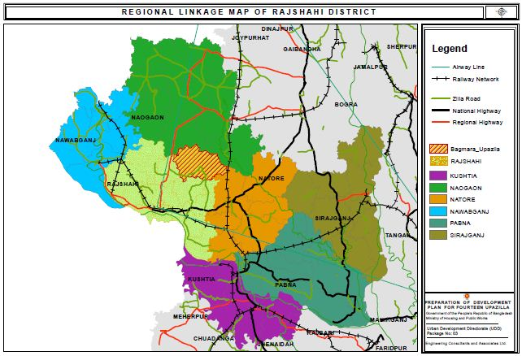
Regional Linkage Plan of Rajshahi District
Rajshahi District is directly connected with Natore, Pabna,and Kushtia through the national highway.
The regional highway covers Naogaon, Rajshahi, Bogra and Kushtia.
Railway network covers a huge area. Nawabganj, Rajshahi, Natore, Sirajganj, Pabna, Kushtia, Chuadanga and Bogura has a good railway communication

Slide 57
Regional Linkage Plan of Bagmara Upazila
Bagmara Upazila is directly connected with Mohonpur, Durgapur and Puthia through the zila road.
This zila road also covers Godagari, Poba, Shahmokhdum, Rajpara, Boalia Charghat and Bagha.
The regional highway doesn’t cover Bagmara Upazila but covers Godagari, Poba, Shahmokhdum, Rajpara, Boalia and Moanpur.
There is no railway network in Bagmara Upazila. Railway network passes by the outside of Bagmara Upazila area.

Slide 58
Policies for Sub-Regional Planning
Connectivity and Transportation Network
Accelerate high standard road links through widening of primary and secondary and construction of new tertiary roads.
Developing an integrated local, regional and national transportation
Improving local transport network within the Upazila linking the nearest districts.
Establishing a Railway Platform Connecting to the Jogi Para Union for better communications.
Biodiversity and Nature Conservation
Conserve natural/environmental resources like hills, reserve forests and water bodies.
Execute land use planning for the enhancement of ecosystem and species diversity.
Conserving the play field, open space, park and natural water reservoir.
Community Resilience through Disaster Management
Identification of seismic hazard prone zones.
Provision and implementation of a risk sensitive land use planning.

Slide 59
Structure Plan
Sub-Regional Plan
(20 years)
Structure Plan
(20 Years)
Urban Area Plan
(10 Years)
Rural Area Plan
(10 Years)
Action Area Plan
(5 Years)

Slide 60
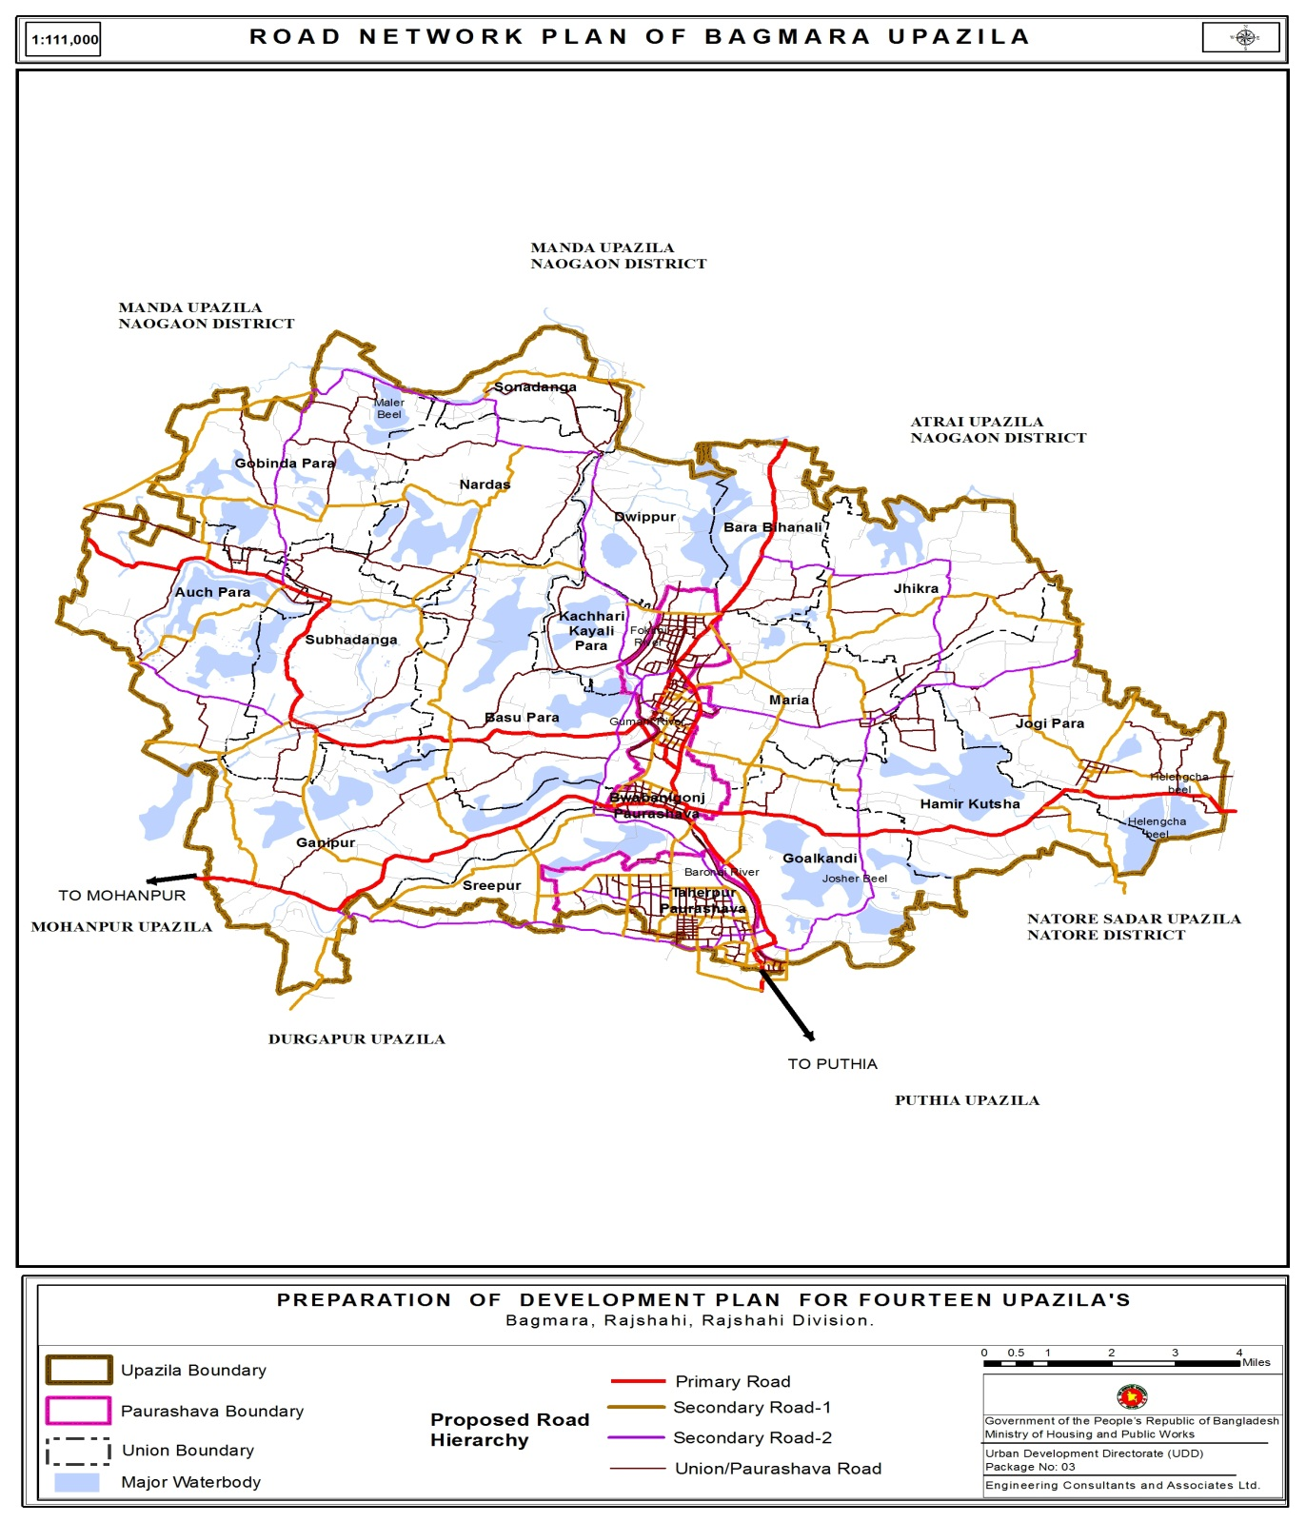
Proposed Road Network Plan of Bagmara Upazila
Proposed Road Type | Road Length(Km)
Primary Road | 67.44
Secondary Road-1 | 128.8
Secondary Road-2 | 81.18
Pouro/Union Road | 530.77
Total | 808.19

Slide 61
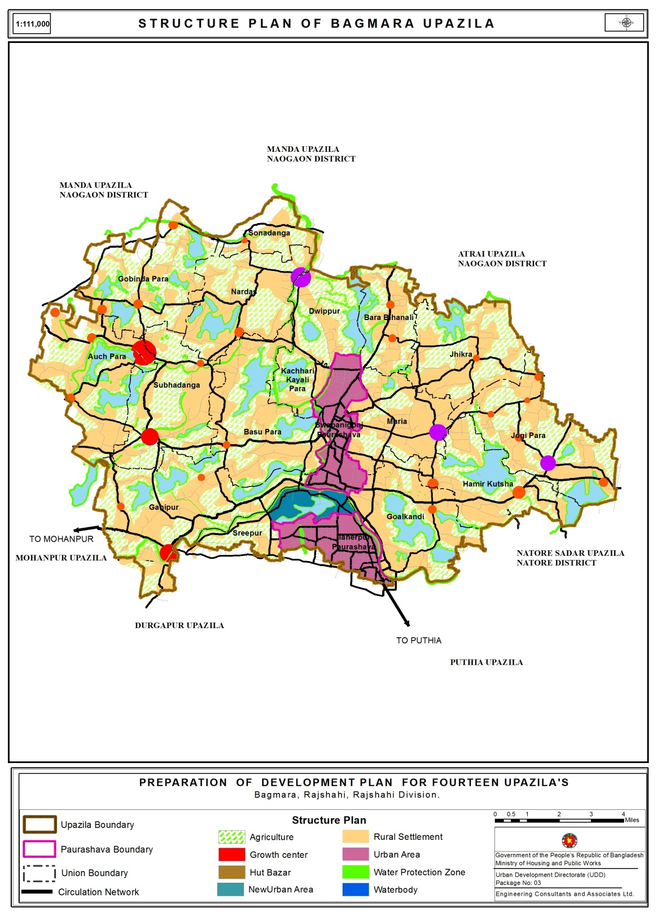
Structure Plan: Bagmara Upazila
Type | Area(Acre)
Growth center | 458.407315
Hut Bazar | 554.369952
New Growth Center | 355.444428
Rural Settlement | 38425.70047
Agriculture | 31059.09998
Urban Area | 5536.848893
Waterbody | 11023.7377
Water Protection Zone | 2272.860141
Circulation Network | 1297.68

Slide 62
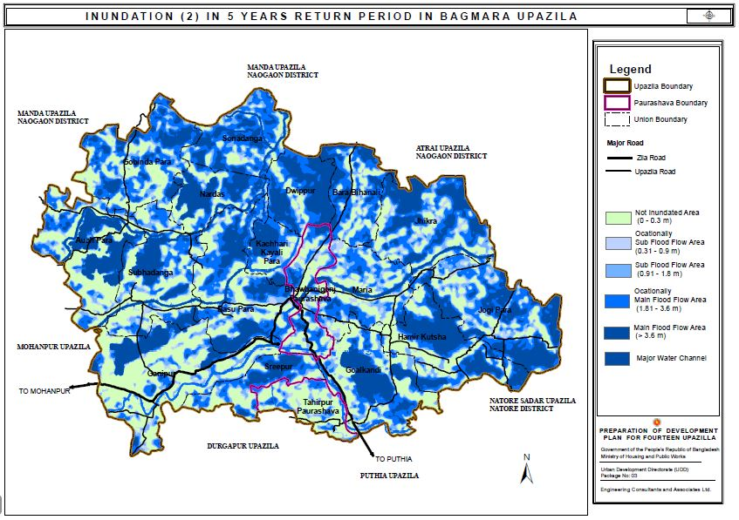
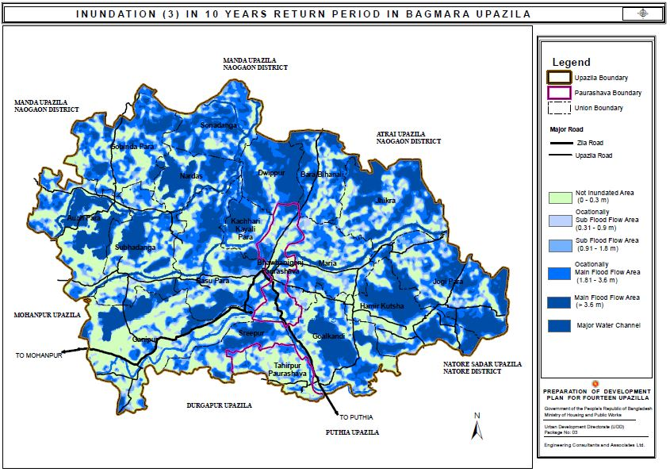

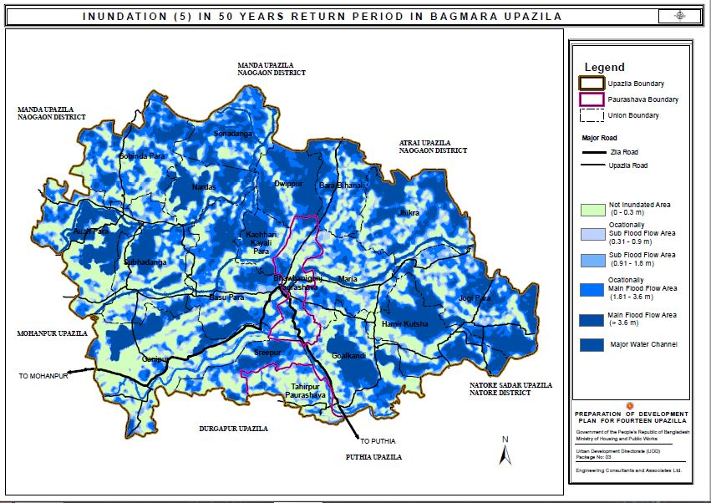
Flood Inundation Maps

Slide 63
Drainage Network Plan of Bagmara Upazila
Barannoi & Fakinni River
Land of Beel
Beels remaining water in all the year round:
Lakatti Beel- Kachari Koyalipara
Likra Beel- Dwippur
Pallarkati Beel- Basupara
Joshir Beel-Goalkandi
Kalar beel-Shuvadanga
Hathkholar Beel, Gamar Beel, Harjor Beel- Gobindapara
Nimar Beel-Auchpara
Hatar Beel-Nardas

Slide 64
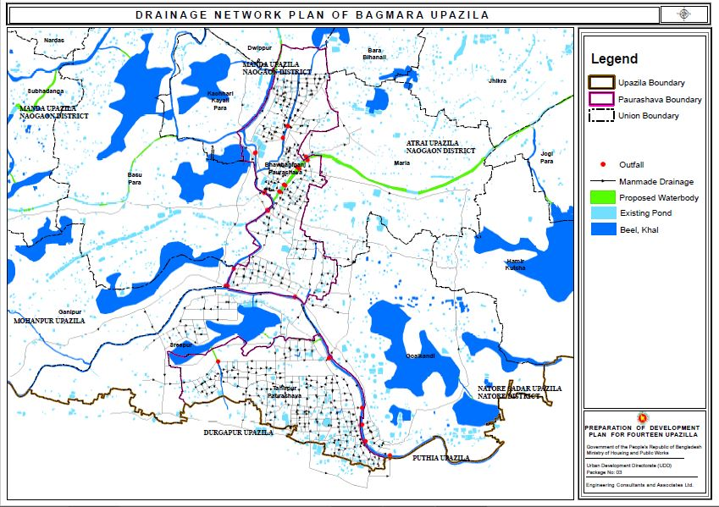
Man-made Drainage Network Plan of Bagmara Upazila

Slide 65
Policies for Structure Plan
Agriculture
Demarcating 2 crops and 3 crops land and preserving the existing agricultural lands.
Discouraging residential expansion in the agricultural land.
Demarcating and preserving the existing and future potential locations and areas for livestock production.
Stopping establishment of new brick fields within the Paurashava area and close proximity of any agricultural zone.
Ensure surface water irrigation keeping water bodies (canals and rivers) active for the sustainable agriculture development.
Increasing production in the existing agricultural lands.

Slide 66
Policies for Structure Plan
Circulation Network
Ensure integration of bus, rail and water transportation networks.
Connect union headquarters, market places, growth centres and hats/bazars through better transportation network.
Urban Settlements
Promote urban area to buildable lands.
Provision of appropriate infrastructure and service facilities (road, drain, bridge, culvert, water supply, sewerage and sanitation, garbage disposal, energy, education and health etc) with equity to the urban dwellers.

Slide 67
Policies for Structure Plan
Flood Flow, Water Body and Water Supply Protection Zone
Protect main flood flow zone from encroachment.
Preserving and maintaining the existing natural water bodies for drainage, flood control and environmental purposes.
Developing drainage system within the Paurashava area.
Preserving the existing beels and ponds to increase the fish production.
Geology
Discourage development of urban and industrial agglomeration, headquarters, market place and growth centres in seismic hazard prone zone
Promote and ensure alternation utilization (e.g. agriculture, forestry) in geologically vulnerable zone.

Slide 68
Policies for Structure Plan
Economic Development
Creating Industrial Area in Paurashava and Agro based industry in rural area for faster industrial development
Establishing agro based industries,
Promote technology-driven agriculture practices for intensive and extensive cultivation.
Other Policies
Expanding hospitals and other health facilities in the whole upazila area.
Taking appropriate measure for Solid Waste Collection and Management.
Providing street lighting within the whole upazila boundary

Slide 69
Contingency Plan
Planning Assumptions
Earthquakes are impact type events and provide no warning preventing any pre-event response activities
There is likelihood of secondary effects following an earthquake or aftershocks which may include fire, flood, liquefactions, subsidence and release of hazardous and toxic chemicals
Strong aftershocks will continue for several days resulting in further building collapse
Access will be severely restricted due to debris, collapsed bridges etc.
Operational Constraints
In order for the preparation of a successful contingent plan the first and foremost activity is to assess the disruptions and causalities which are likely to occur during the event as well as in the aftermath period. A pros and cons analysis of the operational constraints has been conducted for the earthquake hazard in Bagmara Upazila. A detailed list of the constraints are given below:
Disruption in the communication system
Disruption in the key supplies (electricity)
Lack of response capacity (first responders dead or injured)
Unavailability of decision-makers\
Disruption of infrastructure and transport system

Slide 70
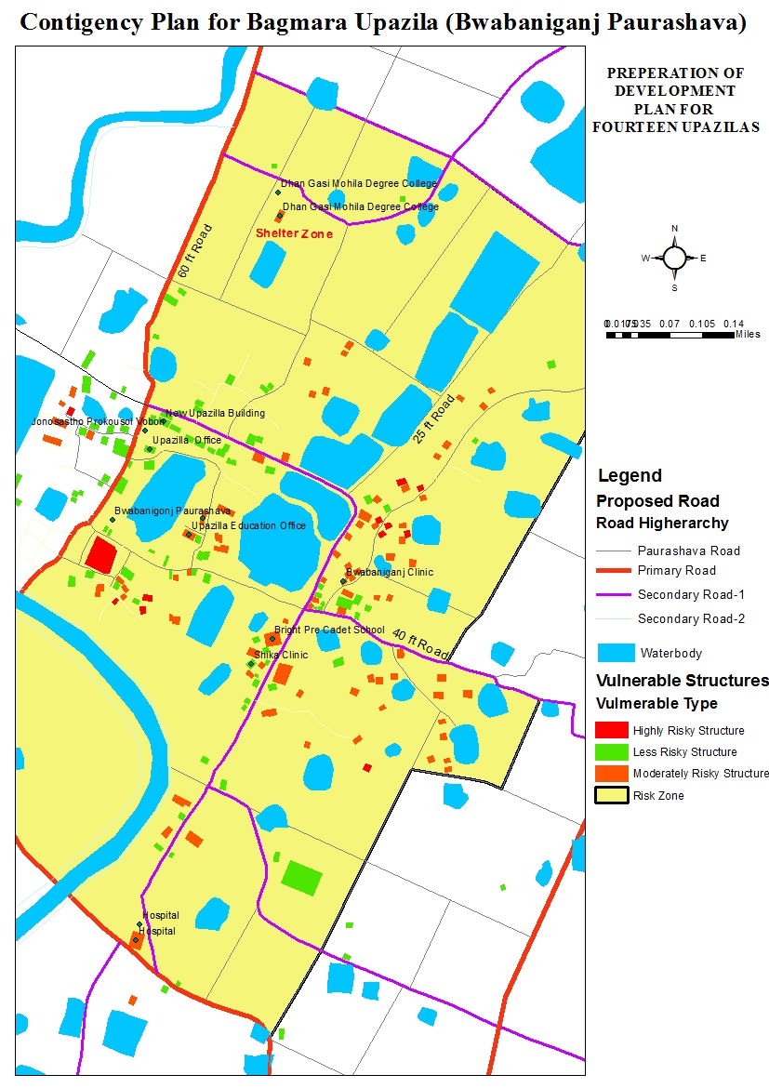
Statistics of Vulnerable structures of Bwabanigonj Paurashava
Vulnerable Type | No. Of Structures
Highly Risky | 12
Moderately Risky | 87
Less Risky | 109

Slide 71
Sector Wise Contingency Action Plan
Sectors | Actions | Physical Planning
Health | Preparedness planning for Community Clinic Mobilization of doctors and medical teams | Location of Clinic (Existing and Proposed) Connectivity with the Clinic
Food Security Cluster | Supply and distribution of Food and relief | Location of Godown and Food Storage
Shelter | Identification of Shelter Place | Location of Open Space and Safe Govt. Institution, multipurpose of Govt. School College
 | Identification of the people needing shelter in camps | Proximity of this place
WASH | Restoration of water supply and drainage | Identification of water hydrant and reservoir
Logistics | Risk Assessment Accommodations facilities for humanitarian workers (tents) | Accessibility to the vulnerable locations
Fire Service | Preparedness planning for Fire Service | Location of Fire Service Station Fire Service Route Planning
Child Protection | Family training Coordinate with other sectors
Early Recovery | Governance Debris Management | Waste Disposal Site locations

Slide 72
Urban Area Plan
Sub-Regional Plan
(20 years)
Structure Plan
(20 Years)
Urban Area Plan
(10 Years)
Rural Area Plan
(10 Years)
Action Area Plan
(5 Years)

Slide 73
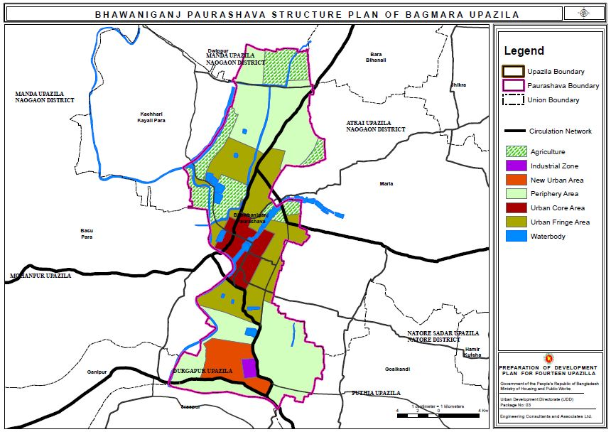
Urban Structure Plan: Bwabanigonj Pourashava
Type | Area
Periphery Area | 1353.114
Agriculture | 447.847
Urban Core Area | 209.6371
Urban Fringe Area | 720.7871
Industrial Zone | 27.87249
New Urban Area | 198.3439
Waterbody | 259.6626

Slide 74
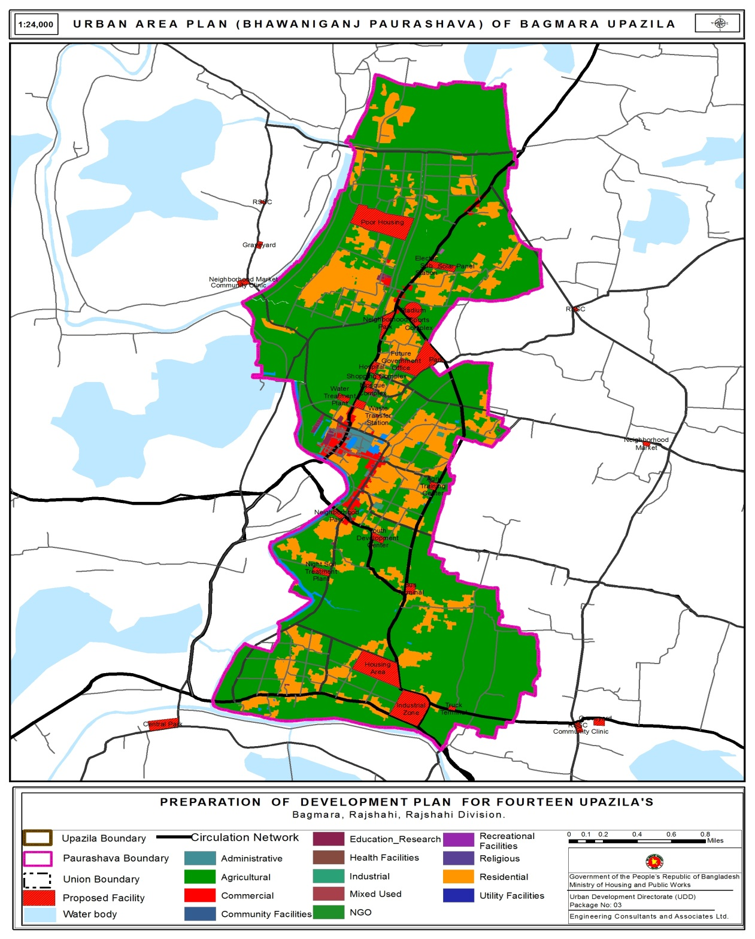
Bwabanigonj Paurashava | Poor Housing
Bwabanigonj Paurashava | Shopping Complex
Bwabanigonj Paurashava | Mosque Complex
Bwabanigonj Paurashava | Future Government Office
Bwabanigonj Paurashava | Waste Transfer Station
Bwabanigonj Paurashava | Bus Terminal
Bwabanigonj Paurashava | Industrial Zone
Bwabanigonj Paurashava | Truck Terminal
Bwabanigonj Paurashava | Night Soil Treatment Plant
Bwabanigonj Paurashava | Hospital
Bwabanigonj Paurashava | Pauro Market
Bwabanigonj Paurashava | Neighborhood Park
Bwabanigonj Paurashava | Water Treatment Plant
Bwabanigonj Paurashava | Neighborhood Park
Bwabanigonj Paurashava | Multi Purpose Hall
Bwabanigonj Paurashava | Agri Training Center
Bwabanigonj Paurashava | Community Center
Bwabanigonj Paurashava | Youth Development Center
Bwabanigonj Paurashava | Sports Complex
Bwabanigonj Paurashava | Park
Bwabanigonj Paurashava | Electric Sub Station
Bwabanigonj Paurashava | Solar Panel
Bwabanigonj Paurashava | Housing Area
Bwabanigonj Paurashava | Stadium
30.9864
0.73848
1.07285
15.3498
0.14864
2.43084
22.2581
0.70679
2.50918
1.74306
1.96548
3.74401
1.86574
1.61334
0.98793
1.38473
0.85305
2.09504
1.47509
2.03618
1.9064
2.55453
23.9803
5.56982
Proposed Urban Area Plan of Bwabanigonj Pourashava
Bwabanigonj Paurashava | Mosque Complex
Bwabanigonj Paurashava | Multi Purpose Hall
Bwabanigonj Paurashava | Sports Complex
1.07285
0.98793
1.47509

Slide 75
Plot Schedule for Proposed Facilities (Bhawaniganj)
3 | Shopping Complex | 0.738481 | 1025 1027 1028 1029 1030 1031 1032 1033 1036 1037 1038 1041 1045 1046 1047 1048 1061 | Dogachi 173 001 | Bwabanigonj Paurashava
4 | Mosque Complex | 1.0728524316 | 821 822 824 825 826 827 828 829 830 831 832 833 823 | Dogachi 173 001 | Bwabanigonj Paurashava (Ward-4)
5 | Future Government Office | 15.349849 | 1164 1170 1171 1172 1173 1174 1175 1176 1177 1178 1179 1179 1180 1181 1182 1183 1184 1185 1186 1187 1188 1189 1190 1191 1192 1193 1194 1195 1197 1198 1198 679 1158 1159 1160 1162 1165 468 469 470 471 472 473 474 475 476 480 481 482 483 484 | Takta Para 198 000, Dogachi 173 001, Paharpur 197 000 | Bwabanigonj paurashava
14 | Waste Transfer Station | 0.148637 | 854 855 856 1195 | Dogachi 173 001 | Bhawbaniganj Paurashava(Ward-04)
15 | Bus Terminal | 2.430839 | 279 280 281 282 286 287 288 289 290 291 292 293 294 295 296 297 298 298 299 300 302 303 304 308 309 428 429 430 431 432 433 434 435 436 441 657 658 660 660 661 662 663 664 665 666 671 672 426 | Dargamaria 246 000 | Bhawbaniganj Paurashava(Ward-08)
21 | Hospital | 1.743055 | 1044 1045 1053 1056 732 732 733 734 756 758 759 760 761 762 763 764 765 766 767 768 769 775 776 777 778 779 1054 1055 1057 | Dogachi 173 001 | Bhawbaniganj Paurashava(Ward-04)

Slide 76
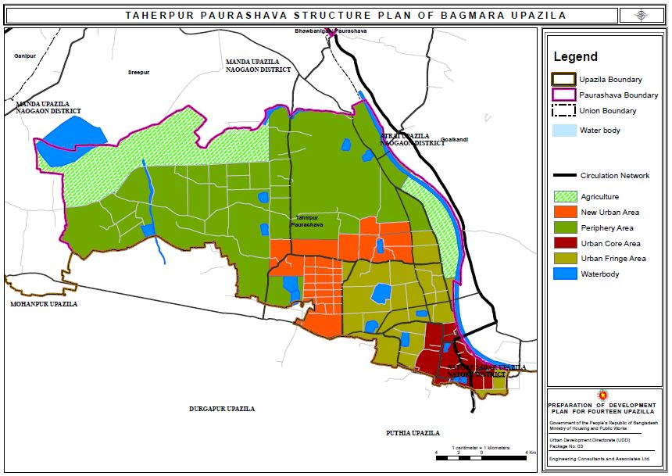
Urban Structure Plan: Taherpur Paurashava
Type | Area
Periphery Area | 1367.26546
Urban Core Area | 137.085676
New Urban Area | 302.739842
Agriculture | 503.300351
Urban Fringe Area | 422.878452
Waterbody | 199.605746

Slide 77
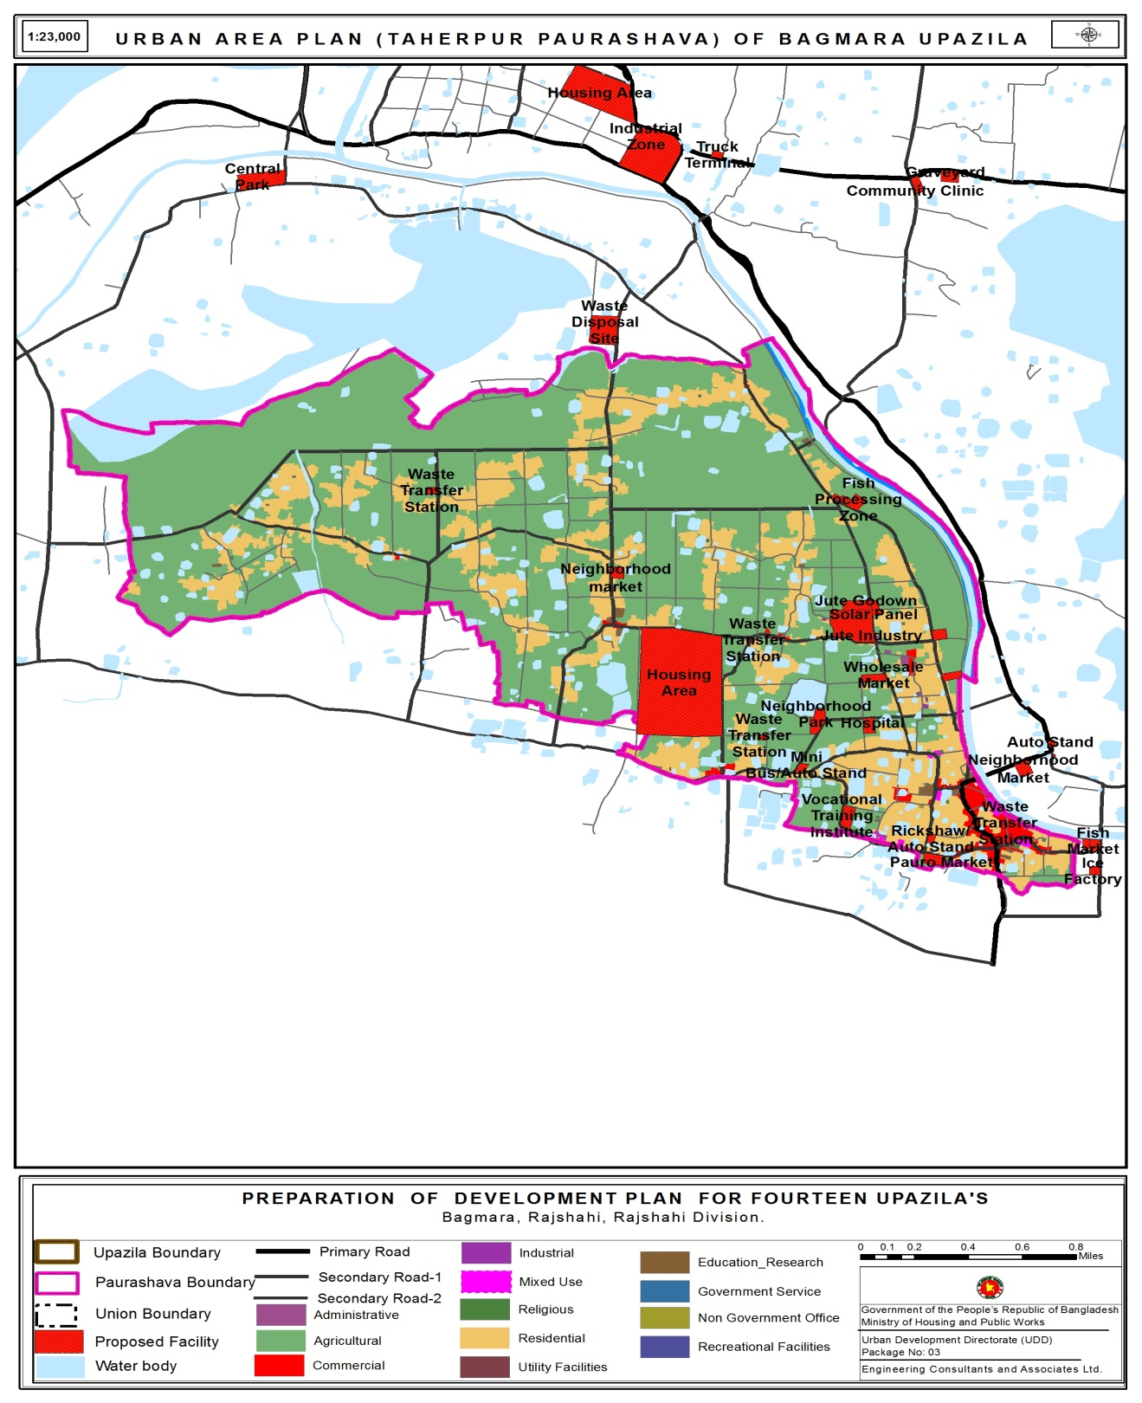
Proposed Urban Area Plan of Taherpur Pourashava
Taherpur Paurashava | Housing Area
Taherpur Paurashava | Water Treatment Plant
Taherpur Paurashava | Waste Transfer Station
Taherpur Paurashava | Waste Transfer Station
Taherpur Paurashava | Waste Transfer Station
Taherpur Paurashava | Public Toilet
Taherpur Paurashava | Waste Transfer Station
Taherpur Paurashava | Waste Transfer Station
Taherpur Paurashava | Mini Bus/Auto Stand
Taherpur Paurashava | Rickshaw/ Auto Stand
Taherpur Paurashava | Neighborhood Park
Taherpur Paurashava | Pauro Market
Taherpur Paurashava | Neighborhood Park
Taherpur Paurashava | Neighborhood market
Taherpur Paurashava | Wholesale Market
Taherpur Paurashava | Vocational Training Institute
Taherpur Paurashava | Fish Processing Zone
Taherpur Paurashava | Jute Industry
Taherpur Paurashava | Jute Godown
Taherpur Paurashava | Electric Sub Station
Taherpur Paurashava | Solar Panel
Taherpur Paurashava | Fish Mrket
Taherpur Paurashava | Ice Factory
Taherpur Paurashava | Cold Storage
Taherpur Paurashava | Hospital
87.9684
1.45313
0.13105
0.11918
0.25235
0.09015
0.73571
0.43652
0.83461
0.62336
1.37854
2.00816
2.92357
1.56327
1.8213
2.49237
1.77861
12.4998
2.70281
0.70914
0.57777
0.37835
0.33196
0.37423
1.80051

Slide 78
Plot Schedule for Proposed Facilities (Taherpur)
8 | Waste Transfer Station | 0.131048 | 115 120 202 208 230 237 238 | Jaganathpur 152 000 | Tahirpur Paurashava(Ward-05)
9 | Waste Transfer Station | 0.119176 | 1513 1514 | Taherpur Paschim 153 000 | Tahirpur Paurashava(Ward-02)
10 | Waste Transfer Station | 0.252347 | 1811 1758 1770 1771 1772 1773 1774 1775 1779 1809 | Taherpur Paschim 153 000 | Tahirpur Paurashava(Ward-02)
11 | Public Toilet | 0.090153 | 1672 1616 1646 1669 | Taherpur Paschim 153 000 | Tahirpur Paurashava(Ward-02)
12 | Waste Transfer Station | 0.735707 | 1342 1343 1365 1366 1394 1399 1385 1393 1164 1165 1170 1338 1340 1344 1345 1346 1354 1963 1339 | Dakshin Koalipara 158 000 | Tahirpur Paurashava(Ward-07)
13 | Waste Transfer Station | 0.436517 | 1762 1764 1765 1771 1781 1782 1783 1787 1790 1761 1763 1815 | Jaganathpur 152 000 | Tahirpur Paurashava(Ward-05)
18 | Mini Bus/Auto Stand | 0.834607 | 884 885 886 887 891 892 893 895 896 897 898 899 894 907 | Taherpur Paschim 153 000 | Tahirpur Paurashava(Ward-02)
19 | Rickshaw/ Auto Stand | 0.623361 | 1431 1433 1438 1464 1470 1476 1477 1660 1475 | Taherpur Paschim 153 000 | Tahirpur Paurashava(Ward-02)

Slide 79
Rural Area Plan
Sub-Regional Plan
(20 years)
Structure Plan
(20 Years)
Urban Area Plan
(10 Years)
Rural Area Plan
(10 Years)
Action Area Plan
(5 Years)

Slide 80
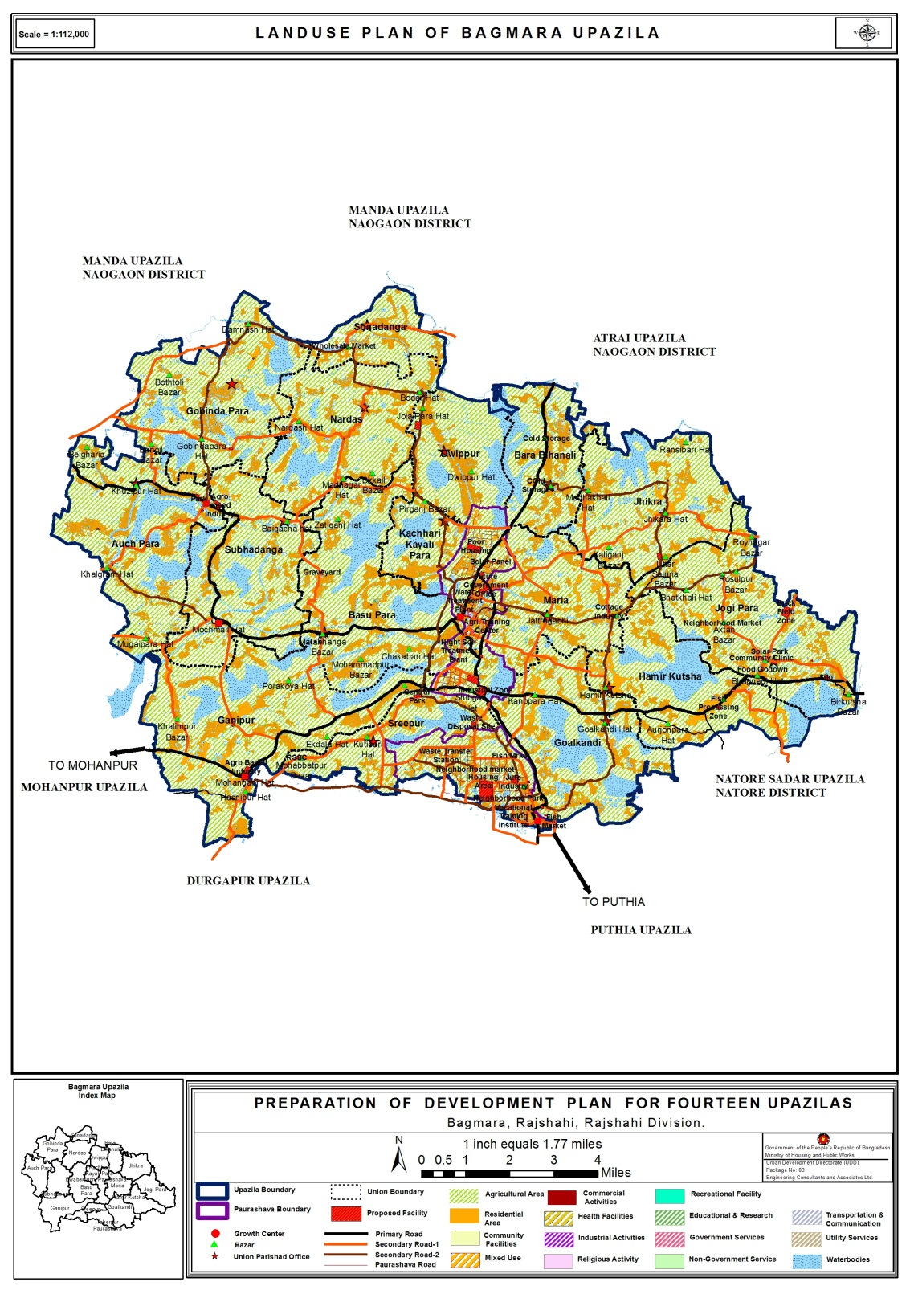
Proposed Rural Area Plan of Bagmara Upazila
The proposed facilities are:
Waste Disposal Site- Taherpur
Night Soil Treatment - Bwabanigonj
RSSC (Rural Sales And Service Center)
Agro Based Industry- Maria
Cottage Industry- Maria
Cold Storage- Ganipur, Dwippur
Fish Processing Zone- Goalkandi
Neighborhood Park - Auch Para, Subhadanga, Sreepur
Primary School-Ganipur, Bara Bihanali
Secondary School- Ganipur
College-Hamir Kutsha, Dwippur, GoalKandi
Mini Bus/Auto Stand
Health Center- Basu Para, Gobinda Para, Ganipur, Hamir Kutsha, Jhikra, Nardas, Sonadanga, Subhadanga, Bara Bihanali, Dwippur
Waste Transfer Station- Every Union
Wholesale Market - Sonadanga
Wholesale Market
Cottage Industry
Hospital
Agro Based Industry
Secondary School
Poor Housing
Fish Processing Zone
Waste Disposal Site
Community Clinic
Night Soil Treatment Plant

Slide 81
Proposal In Rural Area
Auch Para | Agro based Industry
Auch Para | Neighborhood Market
Auch Para | Hospital
Auch Para | Park
Auch Para | Graveyard
Auch Para | Vocational Training Institute
Auch Para | Cold Storage
Auch Para | Food Godown
Auch Para | Solar Park
Auch Para | RSSC
Auch Para | RSSC
Auch Para | RSSC
Auch Para | Community Clinic
Auch Para | Community Clinic
Auch Para | Neighborhood Market
Auch Para | Graveyard
Basu Para | RSSC
Basu Para | Community Clinic
Basu Para | RSSC
Basu Para | Community Clinic
Basu Para | Graveyard
Basu Para | RSSC
Basu Para | Community Clinic
Gobinda Para | RSSC
Gobinda Para | Community Clinic
Gobinda Para | Neighborhood Market
Gobinda Para | Community Clinic
Gobinda Para | Cold Storage
Gobinda Para | Graveyard
Gobinda Para | RSSC
Jogi Para | Brick Field Zone
Jogi Para | Community Clinic
Jogi Para | Food Godown
Jogi Para | Solar Park
Jogi Para | Neighborhood Market
Jogi Para | Silo
Jogi Para | Wholesale Market
Dwippur | Brick Field Zone
Dwippur | RSSC
Dwippur | Community Clinic
Ganipur | Agro Based Industry
Ganipur | Neighborhood Market
Ganipur | RSSC
Ganipur | RSSC
Ganipur | Community Clinic
Ganipur | Graveyard
Ganipur | Community Clinic
Goalkandi | Neighborhood Park
Goalkandi | Fish Market
Goalkandi | Cold Storage
Goalkandi | Neighborhood Market
Goalkandi | Auto Stand
Goalkandi | Waste Transfer Station
Goalkandi | Graveyard
Goalkandi | RSSC
Goalkandi | Community Clinic
Goalkandi | RSSC
Maria | Future Government Office
Maria | Park
Maria | Neighborhood Market
Maria | Community Clinic
Maria | Neighborhood Market
Maria | Agro Based Industry
Maria | Cottage Industry
Maria | RSSC
Maria | RSSC
Maria | Community Clinic
Bara Bihanali | RSSC
Bara Bihanali | Cold Storage
Bara Bihanali | Neighborhood Market
Bara Bihanali | Community Clinic
Bara Bihanali | Neighborhood Market
Bara Bihanali | Cold Storage
Bara Bihanali | Community Clinic
Hamir Kutsha | Agro Based Industry
Hamir Kutsha | Fish Processing Zone
Hamir Kutsha | Fish Market
Hamir Kutsha | Neighborhood Market
Hamir Kutsha | RSSC
Hamir Kutsha | Community Clinic
Hamir Kutsha | RSSC
Hamir Kutsha | Community Clinic
Sreepur | Waste Disposal Site
Sreepur | Central Park
Sreepur | RSSC
Sreepur | Community Clinic
Sreepur | Neighborhood Market
Jhikra | Agro Based Industry
Jhikra | Community Clinic
Jhikra | RSSC
Jhikra | Neighborhood Market
Jhikra | Community Clinic
Jhikra | Cold Storage
Jhikra | RSSC
Jhikra | Community Clinic
Subhadanga | Community Clinic
Subhadanga | Neighborhood Market
Subhadanga | Agro based Industry
Kachhari Kayali Para | Neighborhood Market
Kachhari Kayali Para | Community Clinic
Kachhari Kayali Para | RSSC
Kachhari Kayali Para | Graveyard
Nardas | Community Clinic
Nardas | RSSC
Nardas | Community Clinic
Nardas | RSSC
Sonadanga | Wholesale Market
Sonadanga | RSSC
Sonadanga | Community Clinic

Slide 82
Plot Schedule for Proposed Facilities (Rural Areas)
Serial No. | Name | Area in acres | Plot No. | MAUZA JL S | Union/ Paurashava
5 | Neighborhood Park | 1.37854 | 273 273 273 277 277 279 279 313 320 324 324 361 1429 1430 1431 1454 1456 1457 322 1430 1459 847 | Taherpur Paschim 153 000, Muthrapur 154 000, Hasnipur 256 000 | Taherpur Paurashava(Ward-02, Ward-04), Goalkandi
6 | Fish Market | 1.190312 | 10976 | Ramrama 257 004 | Goalkandi
7 | Waste Disposal Site | 7.664404 | 821 822 824 825 826 | Ramguia 160 000 | Sreepur

Slide 83
Action Area Plan
Sub-Regional Plan
(20 years)
Structure Plan
(20 Years)
Urban Area Plan
(10 Years)
Rural Area Plan
(10 Years)
Action Area Plan
(5 Years)

Slide 84
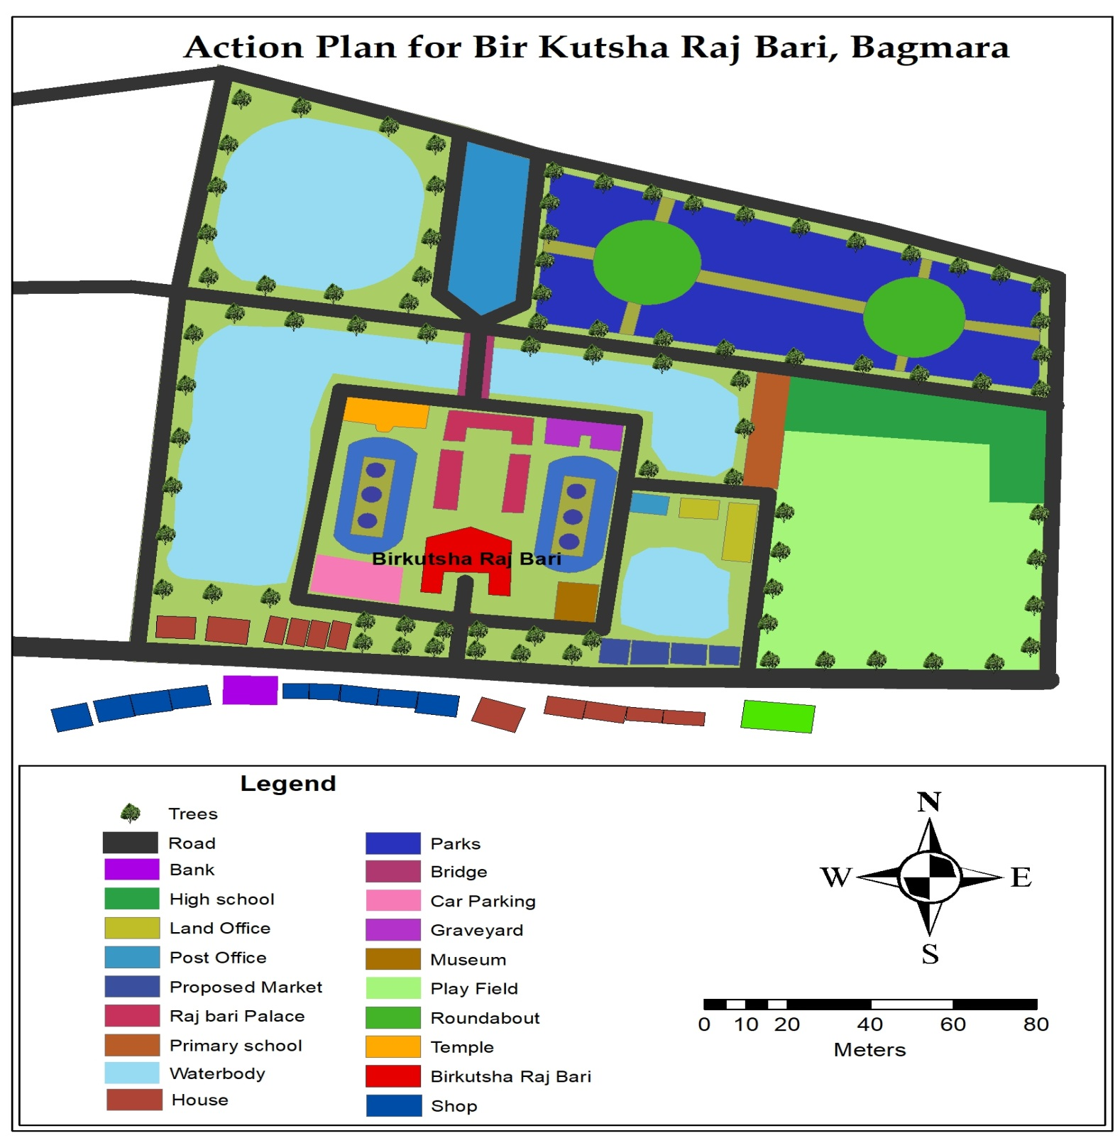
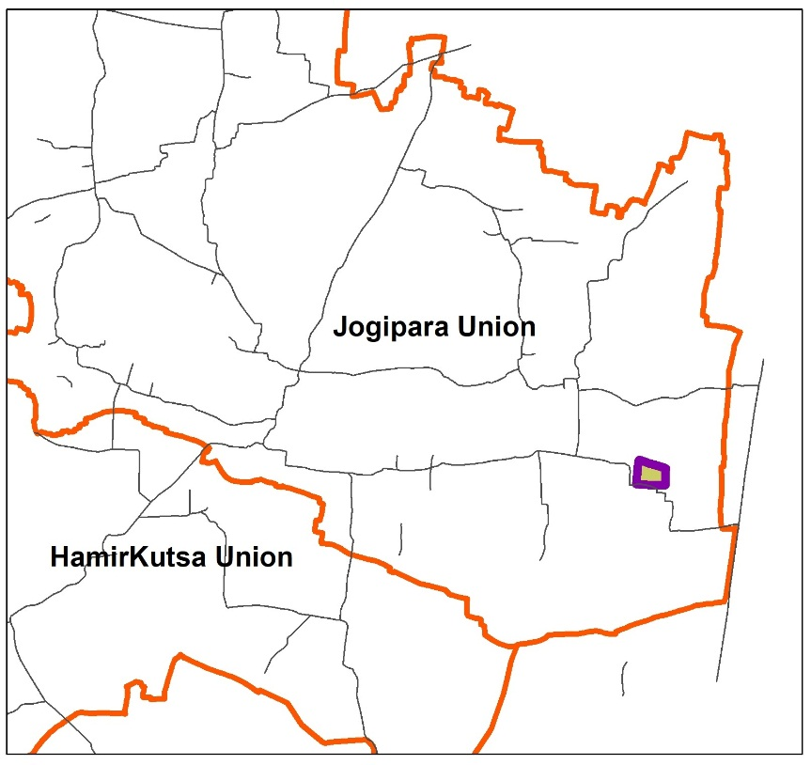
Action Area Plan for Bir Kutsha Raj Bari, Bagmara
Area Of Proposed Action Area Plan is 8.5 Acres

Slide 85
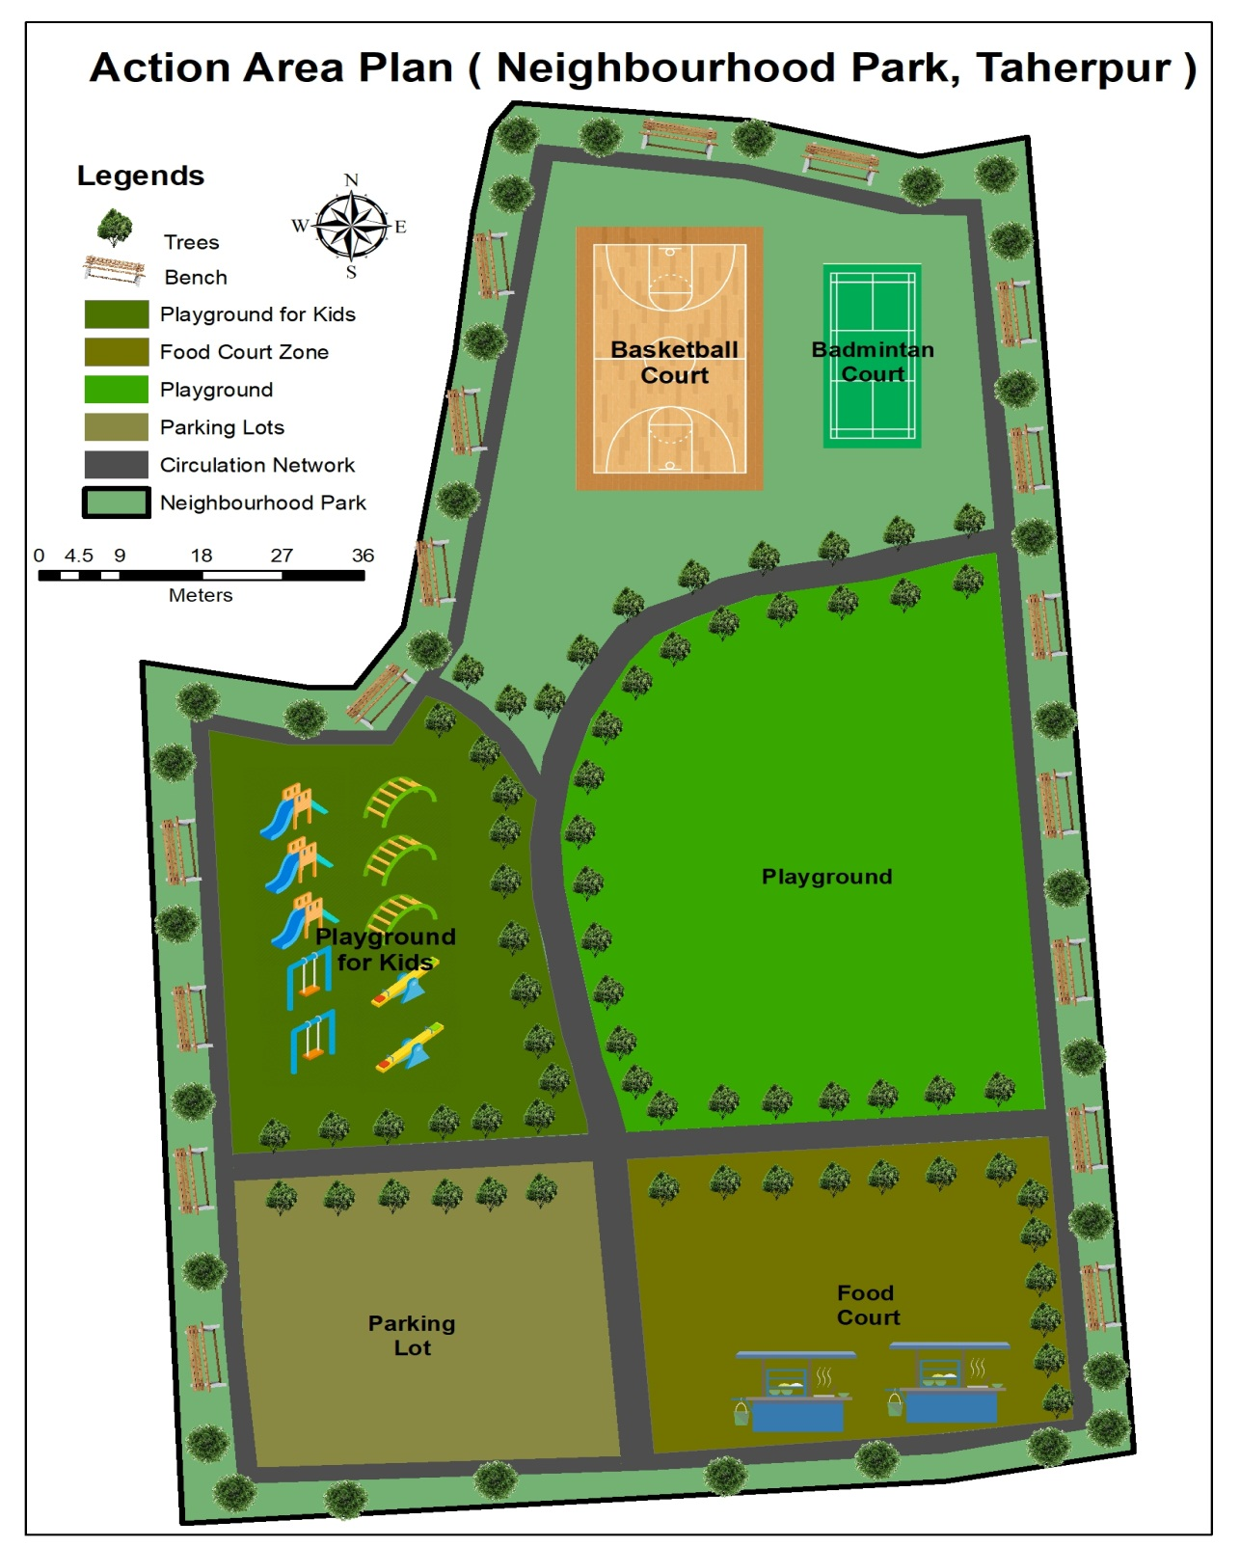
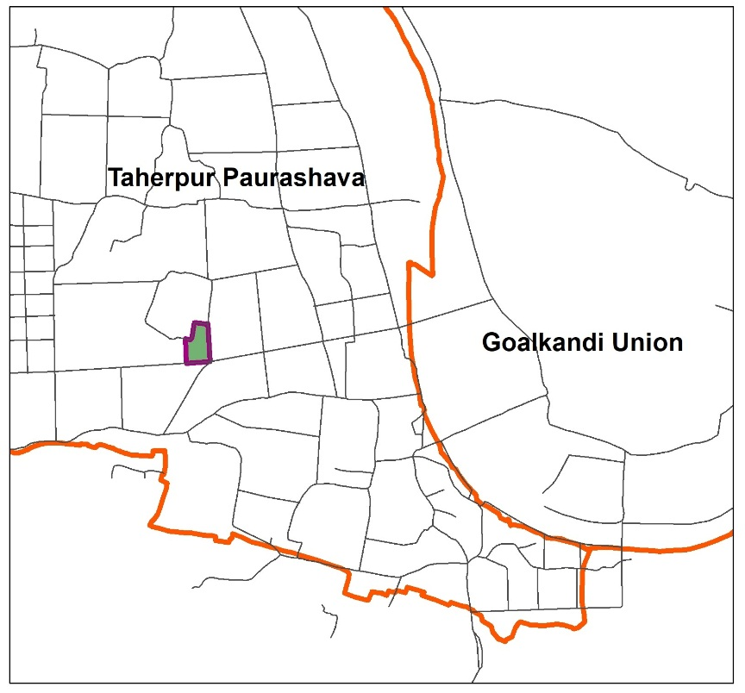
Action Area Plan of Neighborhood Park, Taherpur
Area Of Proposed Action Area Plan is 3.14 Acres

Slide 86
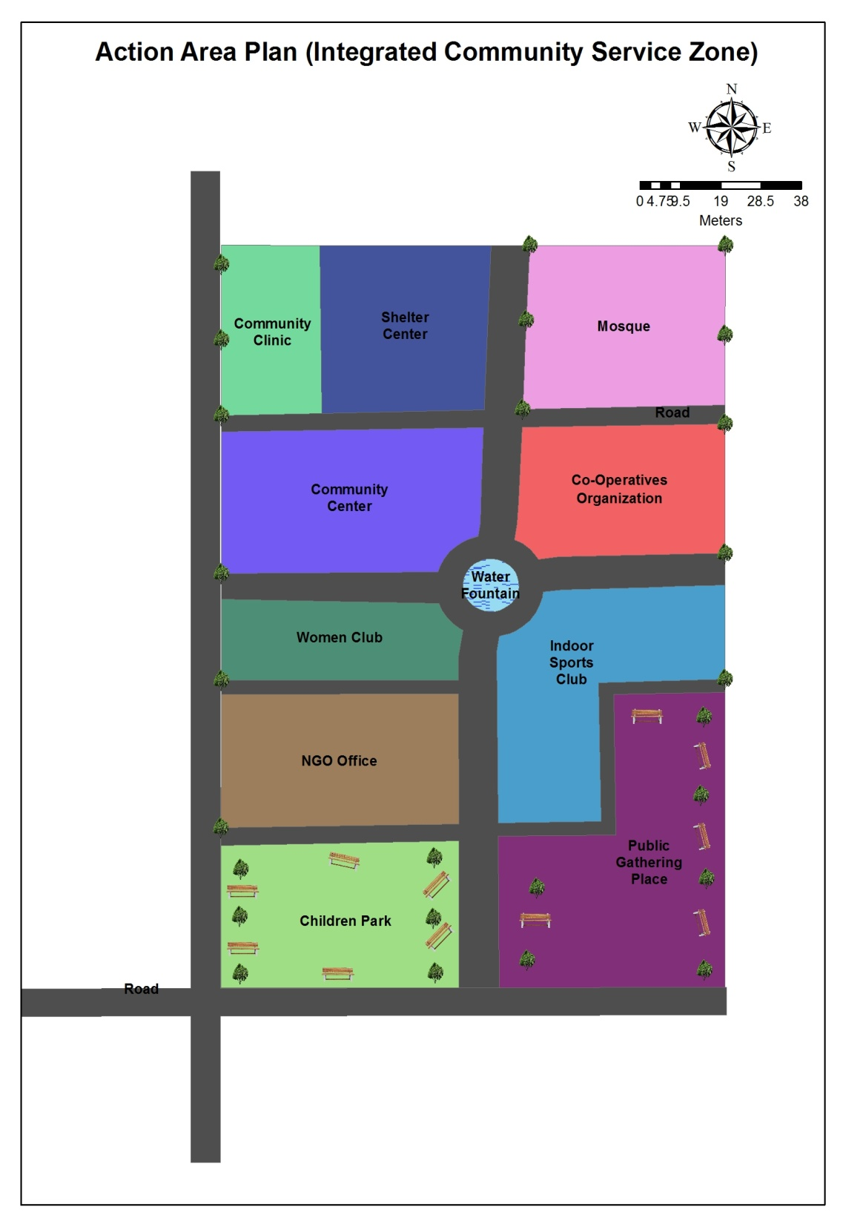
Action Area Plan of Integrated Community Service Zone, Bhawaniganj
Area Of Proposed Action Area Plan is 5.16 Acres

Slide 87
Draft TMC Meeting
Final Plan
Draft TMC Meeting
Public Hearing
Consultation
(MP, Local Authority)
Workshop at Upazila

Slide 88
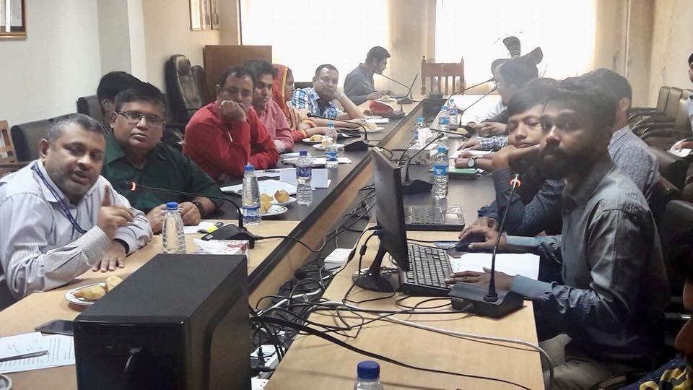
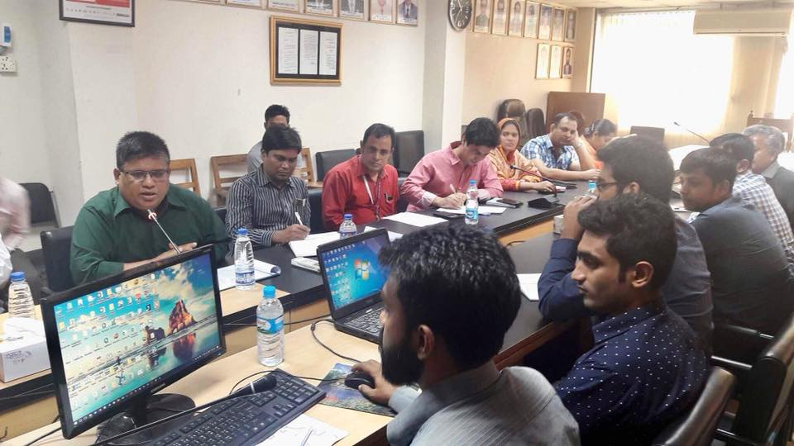
TMC MEETING AT URBAN DEVELOPMENT DIRECTORATE

Slide 89
Comments and Adjustment status
Comments | Action
Total Water Network Among Beels | Has been Addressed
Solar Park | Has been Addressed
Conflict Zone | Has been Addressed
As the two Paurashava areas are situated side by side and there are two rivers named Baronoi and Fokirni go on, the two Paurashava area can be merged under one Paurashava area | Has been Addressed
Identifying the Sources of River Channels | Has been Addressed
Bypass to Puthia at the outside of the boundary | Has been Addressed
Proposed Housing Area at BwabanigonjPaurashava | Has been Addressed
Roads will be Straight | Has been Addressed
Allocate Bridges in Regional Network | Has been Addressed
Helipad at Stadium | Has been Addressed
Government Offices Will be Allocated in Administrative Zone | Has been Addressed
Electric Service Station at Each Paurashava | Has been Addressed
Creation of a Eco Sensitive Zone with the Beels | Has been Addressed
Swimming Pool | Has been Addressed
Creation an Urban Network by fixing Water Network | Has been Addressed
Cold Storage Beside Taherpur Bazar | Has been Addressed
A Park Between Two Paurashava Areas | Has been Addressed
Bypass Road at Maria Union | Has been Addressed
Change the location of Waste Disposal Site | Has been Addressed

Slide 90

Comments and Adjustment status
Bypass for Bhawaniganj Paurashava
Eco Sensitive Zone
Water Network among Beels, Canal and River Re excavation
Road Straighten
Outer Bypass
New Urban Area
Right Bypass for Taherpur Paurashava(For Goalkandi Road)
Left Bypass for Taherpur Paurashava (For Mohonpur Road)

Slide 91

Comments and Adjustment status
Waste Disposal Site Location Change
Electric Sub
Station
Common Park Area for two Paurashava
Government
Offices
Solar Park
Electric Sub Station
Cold Storage and Ice factory at Taherpur
Housing Area

Slide 92
Public Hearing
Final Plan
Draft TMC Meeting
Public Hearing
Consultation
(MP, Local Authority)
Workshop at Upazila

Slide 93






Newspaper, Miking, Banner Announcement

Slide 94




Miking at Union Level

Slide 95





Slide 96




PUBLIC HEARING COMMENTS BOOK

Slide 97
Comments and Plan adjustment (Upazila)
Serial no. | Notebook Serial no. | Name | Location and Address | Comments | Consulting farms Comments
01. | 04 | Shamim Osman | Chowgasi | Need water drainage system ,wards no­­- 4 and 5 Mouza no-(72-73). | Already proposed a planned drainage system in Urban area.
02. | 05 | Mohammed Shakil | Mohanpur | Need passenger shade beside Mohonpurroad. | Have been proposed
03. | 06 | Md. Tushar Ali | Vabaniganj, municipality | Need permanent burial ground at BaghmaraUpzilla | Have been proposed
04. | 07 | Md. Salam Uddin | Vabaniganj, municipality | Need Park | Have been proposed
05. | 08 | Md. Ibrahim | Vabaniganj, municipality | Need Youth Development Training Centre | Already proposed in two urban areas
06. | 09 | Abdul Jalil | Uttar Ekdala | Need permanent waste dumping place | Have been proposed
7. | 12 | Sree Horan | Uttar Ekdala | Need cremation ground (shoshanghat) | Have been proposed

Slide 98
Comments and Plan adjustment (Upazila)
8. | 13 | Shobuj Ali | Vabaniganj | Need playground | Has been Proposed
9. | 14 | Md. Hatem | Dangasi | Primary school is needed at Dangachivillege. | Has been Proposed
10. | 15 | SreeDipok | Borokoa, Borobihanoli Union | Need playground | Has been Proposed
11. | 16 | Md. Monzu | Dorgamaria | School playground or playground need | This is under concern of local municipality
12. | 17 | MdMamun | Dangasi, Vabaniganj | Need Eidgah ground | Has been Proposed
13. | 18 | Md. Nayem | Bagmara | Stadium is needed | Has been Proposed
14. | 19 | Md. Mamunur Rashid | Dangasi | Graveyard needed | Has been Proposed
15. | 21 | Md. Jakirul | Dwogasi | Water supply station is needed | Has been Proposed
16. | 22 | MunirHosain | Dwogasi | Dustbin is needed | This is under concern of local municipality
17. | 23 | Md. ImtiasIsrak | Vabaniganj | Solar panel light system | Has been Proposed
18. | 25 | Md. Altab | Vabaniganj | Drainage system is needed | Has been Proposed
19. | 26 | Abdul Malake | Hadaetpara | Drainage system is needed | Has been Proposed
20. | 28 | Md. Montu shake | Dwogasi | Graveyard need | Will be proposed
21. | 31 | Md. Rajon | Vabaniganj | Mini Stadium is needed | A large stadium already proposed in two urban areas

Slide 99
Comments and Plan adjustment (Bhawaniganj Paurashava)
08 | 09 | Md. Abdul Malek Mayor, | Vabaniganj Pourashova | Construction of Bridge over Fakirniriver at Bhabanigar Degree Collage for removing traffic jam. Developed burial ground is needed Stadium is needed Children Park is to be needed. Buss/truck terminal is to be established at Chanpara. Solar panel is needed at Chanpara. Construction of public toilet every ward at Bhabanigang. Prevention of Fakirni river bank erosion for sustain haose. Construction of wider road from Taherpur to Naogon Construction of public toilet center of the Bhabanigang. Crippler hospitals is needed at Suryopara. Construction Vatenari training center. Need to build an industry at Surjopara, konipar, Dagafaria. Irrigation system developed by solar panel. Construct fish hatchery for fish processing at Bhabaniganj and Chanpara. Build an Open University for developing education system. Construct a bridge/culvert for transporting agricultural at Bilsoti and Matikata. | Has been Proposed
04. | 05. | Md. FayazUddin | 7 no. ward | 1. children park 2. Passenger shade. 3. Supply pure drinking water. 4. Agricultural training center 5.House facility for homeless people | Has been Proposed
05 | 06. | MossammotShahanara Woman Councilor ( 4,5,6 no ward) | 5 no ward | Ward no-5 Govt. graveyard, public toilet, and project to prevent river erosion is to be needed. Eidgah ground is to be needed. School is needed for autistic child. | Has been Proposed
06 | 07. | Md. Rohidul Islam | VabaniganjPourashova | 1. Govt. graveyard 2. Eidgah ground is to be needed. 3. Seepage system is needed. 4. Employments for educated unemployed women and youth. | Has been Proposed
07 | 08 | RunaBibi Woman Councilor (1,2,3 no ward) | VabaniganjPourashova | Development of road Supply pure drinking water Public toilate is to be needed | Proposed

Slide 100
Comments and Plan adjustment (Taherpur Paurashava)
01. | 02. | Md. Raisuddin Councilor | 9. no ward | Nine Waste transfer stations build in nine Wards. | A large waste transfer station has been proposed in urban area.
02. | 06. | Hafizul Islam Councilor | 7 no ward | Managing Fish Processing Zone in large area. | Proposed already
03. | 07. | Md. AubaliShordar Councilor | 2 No. ward | Construct Bypass road from Walton-mor to Bachiapara. | Have been Addressed
04. | 08. | Md, Abdul Rahim Professor Mohila College | Mohila college | Vocational training center is in the right place but another is needed at Zamgram village. | No need
05. | 09. | Ashraful Islam | Jamgram | Vocational training center is needed at Zamgram village. | It has been proposed at urban area
06. | 11. | Abdul Zalil Councilor | 4 no ward | Several public toilet is essential at the market place in 1, 2, &3 No Ward. | Have been proposed
07. | 13. | ShamimaAkhtar Beauty Councilor | 7,8.9 no ward | Park situated in right place. | Have been proposed
08. | 14. | Doctor Yeasin | 2 no ward | 1. Essential for construct a Medical and Maternity center. 2. Need nine Community Clinic in nine wards. | Have been proposed
9. | 15. | MdHasanuzzaman Primary teacher | 2 no ward | Fire Brigade | Will be Addressed
10. | 16. | Md. AyubaliShorkar | 2. No ward | Need to manage drainage system | Have been proposed
11. | 18. | Taposh Kumar pintu councilor | 9. no ward | Construct a bridge over Barnoy river in 1No Ward. | Will be Addressed
12. | 19. | Abdur Rahim Principle | Mohila college | Environmental Office is needed preservation of agricultural product and meat processing | Will be Addressed
13. | 21. | Abulkalam Azad Mayor | Taherpur. | A stadium and children park is needed. | Have been proposed

Slide 101
Wholesale Market
Cottage Industry
Night Soil Treatment Plant
Agro Based Industry
Jute Industry
Poor Housing
Fish Processing Zone
Community Clinic
Waste Disposal Site
Night Soil Treatment Plant

Slide 102
Poor Housing
Electric Sub
Station
Stadium
Sports Complex
Government
Offices
Neighborhood Park
Solar Park
Waste Transfer station
Electric Sub Station
Water treatment Plant
Agri training Center
Housing Area
Night Soil Treatment Plant
Industrial Zone
Truck terminal

Slide 103
Industrial Zone
Housing Area
Fish Processing Zone
Waste Disposal Site
Neighborhood Market
Waste Transfer station
Solar Panel
Government Offices
Neighborhood Park
Hospital
Fish Market
Housing Area
Vocational Training Institute

Slide 104
Consultation
(MP Meeting,
Local Authority)
Final Plan
Draft TMC Meeting
Public Hearing
Consultation
(MP, Local Authority)
Workshop at Upazila

Slide 105



PUBLIC PARTICIPATION AND LOCAL CONSULTATION

Slide 106


PUBLIC PARTICIPATION AND LOCAL CONSULTATION

Slide 107



MP CONSULTATION

Slide 108


MP CONSULTATION

Slide 109

Waterway Preservation
Grid Road Network in
Paurashava Area
Proposed Silo
Proposed Primary Road (60 Feet)

Slide 110
Workshop at Upazila
Final Plan
Draft TMC Meeting
Public Hearing
Consultation
(MP, Local Authority)
Workshop at Upazila

Slide 111




Workshop at
Bagmara
Upazila

Slide 112




Workshop at
Bagmara
Upazila

Slide 113
Meeting Discussion at Workshop
Designation | Comments
Engineer, Member of Parliament, Rajshahi-4 | Need drainage map in details Detailed landuse policy
Chairman, Sonadanga | Natural conservation at rural area Need cold storage
Chairman, Auchpara | No widen road at east bagmara and west bagmara
Chairman, Gobindapara | River excavation Supply of pure drinking water Establishment of dam
President, Bonik Somiti | Bypass at bwabaniganj bazaar
Chairman, Kachari kayalipara | Flood Control Dam repair Excavation of river
Principal, Bwabaniganj College | Plan for border area people of upazila boundary

Slide 114
SDGs and Proposed Plan

Slide 115
SDGs | Proposed Plan of Bagmara Upazila
SDG-1: Ensure access for all to adequate housing and basic services and upgrade slums | Core Housing Area- for low income people Planned Housing Area
SDG-2: Provide access to safe affordable accessible and sustainable transport systems for all, improving road safety, notable by expanding public transport . | By pass Over pass Grade separations and Different types of new service roads
SDG-3: Enhance inclusive and sustainable urbanization and capacity for participatory, integrated and sustainable human settlement planning and management in all countries | Human settlement land suitability analysis Hydrological suitability analysis Geological suitability analysis Road network analysis
SDG-4: Strengthen efforts to protect and safeguard the worlds cultural and natural heritage | Heritage sites such as Bir Kutsha Jomidar Bari Goalkandi Rajar Bari
SDG-5: Reduce the number of deaths and the number of people affected and substantially decrease the direct economic losses . | Only some sub flood flow zone has identified after analyzing previous 20 years flood flow data. Human settlement on sub flood flow zone are discouraged.

Slide 116
SDG-6: Reduce the adverse per capita environmental impact of cities including by paying quality and municipal and other waste management. | One waste transfer station at each union and 4 waste transfer station in paurashava. One waste Disposal Site in Upazila. One Night Soil Treatment Plant in Upazila. A Water Treatment Plant to evade direct mix of industrial waste with water. Suggestion of different policy and strategy for waste management and pollution control.
SDG-7: Reduce the adverse per capita environment impact of cities including by paying special attention to air quality and municipal and other waste management | In Urban, and peri-urban area brick field is restricted within 3 km. buffer zone from centre of the Paurashava. Considering this consultant has proposed the brick field area near to paurahsava will be converted into different facilities and for other uses.
SDG-8: Provide universal access to safe inclusive and accessible green and public spaces in particular for women and children, older persons and persons with disabilities . | Urban parks, Village parks, Play grounds Public Place Action Plan Bir Kutsha and Taherpur 2 new park and A stadium
SDG-9: Support positive economic , social and environment links between urban, peri-urban and rural areas by strengthening national and regional development planning | Shopping complex, Pauro market, Residential zone , Recreational park, Government college, Mosjid complex, Hospital, Bus terminal and Central park etc.
SDG-10: Support least developed countries including through financial and technical assistance in building sustainable and resilient buildings utilizing local material. | Risk Assessment survey Collection of 8 type’s structural data such as Overhanging, Soft Story, Pounding, Set Back, Short Column, Mobile Tower, tilting and Ground Set.

Slide 117

SDG 2030 Vision 2021
Elimination of Poverty & Inequity
SDGs and Proposed Plan of Bagmara Upazila
Goal 01: No Poverty
Policy Guideline to reduce Proverty
Housing
Poor Housing
Poor Housing at Bwabanigonj(30 Acre)
Housing(23.98 Acre)

Slide 118
SDG 2030 Vision 2021
Elimination of Poverty & Inequity
SDGs and Proposed Plan of Bagmara Upazila
Goal 02: Zero Hunger
Ensure food Security by Preserving Agriculture Land
Cropping Pattern | Area in Acre | Area in Sq.km | Percentage
Single Cropping | 7790.023111 | 31.525105 | 12.85%
Double Cropping | 15651.78868 | 63.340542 | 25.81%
Triple Cropping | 34876.84722 | 141.141593 | 57.51%
Four Cropping | 2324.321155 | 9.406194 | 3.83%
Total | 60642.98017 | 245.413434 | 100%

Slide 119

SDG 2030 Vision 2021
Health and Family Welfare
SDGs and Proposed Plan of Bagmara Upazila
Goal 03: Good Health and Well-Being
Ensure healthy lives and promote well-being for all at all ages.
Proposed Hospital
Proposed Community Clinic in each Union
Hospital
Community Clinic

Slide 120
SDG 2030 Vision 2021
Health and Family Welfare
SDGs and Proposed Plan of Bagmara Upazila
Goal 06: Clean Water and Sanitation
Water Treatment Plant -2 no's (1.85 acres and 1.45 acres)
Night Soil Treatment Plant(2.5 acre) in Bwabanigonj Paurashava
Waste Disposal Site (7.66 acre) in between Bwabanigonj and Taherpur Paurashava
Water Treatment Plant
Waste Disposal Site

Slide 121
SDG 2030 Vision 2021
Power and Energy
SDGs and Proposed Plan of Bagmara Upazila
Goal 07: Affordable and Clean Energy
Solar Park (3 acre)
Solar Panel (2 acre)
Solar Park
Solar Panel

Slide 122
SDG 2030 Vision 2021
COMMUNICATION AND INFRASTRUCTURE
SDGs and Proposed Plan of Bagmara Upazila
Goal 09: Industry, Innovation & Infrastructure ,Commerce and Industry
Activities and Strategies
Industrial Zone
Jute Industry
Rural Sales Service Center
Sustainable Transportation Planning
(Road, Walkway and Water way)
Truck Terminal, Bus Terminal, Auto/Minibus/CNG Stand
Industrial Zone(22.25 acre)

Slide 123
Thank You for Your Kind Attention

