Slide 1
“Preparation of Development Plan
for Fourteen Upazilas”
Package- 04 (Upazila: Saghata, District: Gaibandha)
CONSULTANT:
Modern Engineers, Planners & Consultants Ltd.

Slide 2
Welcome to the Presentation……………

Slide 3
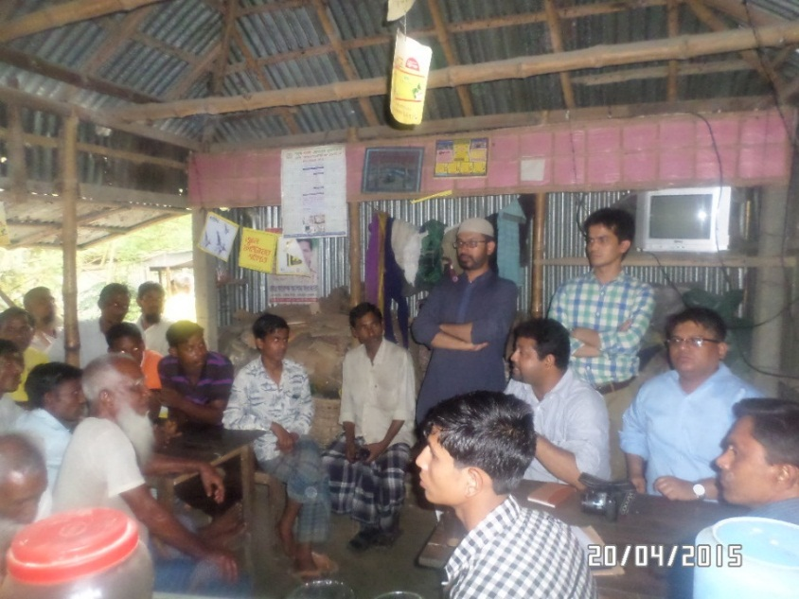
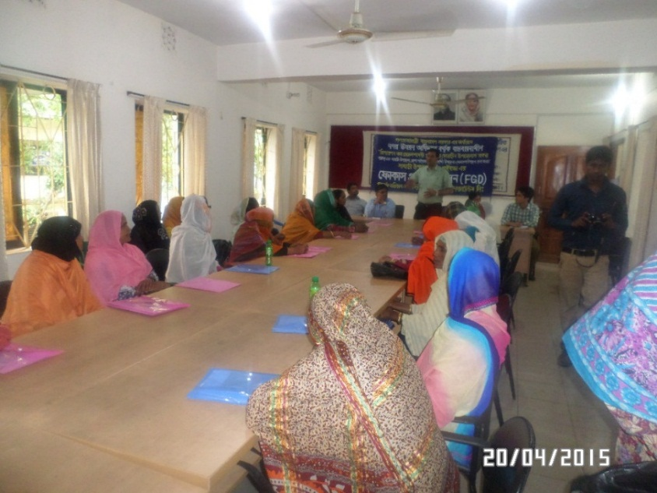
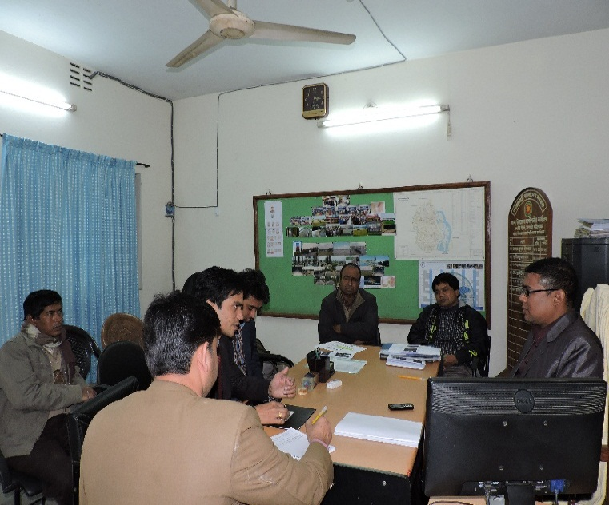
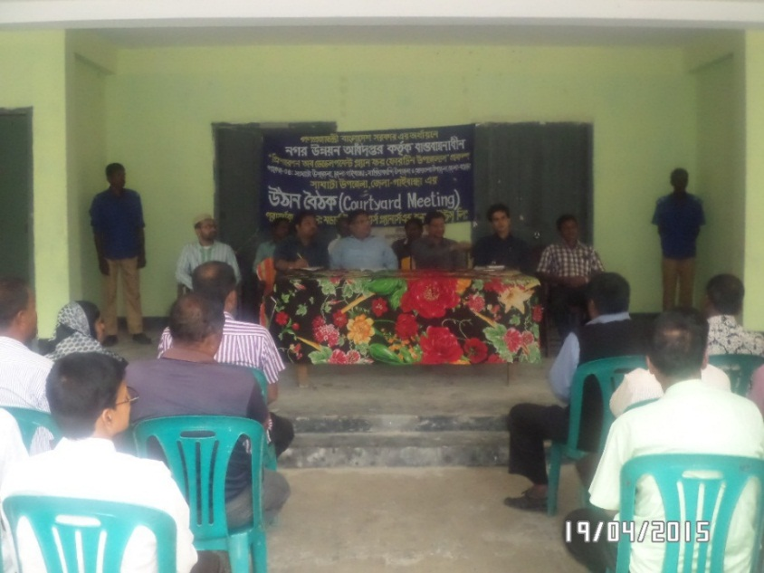
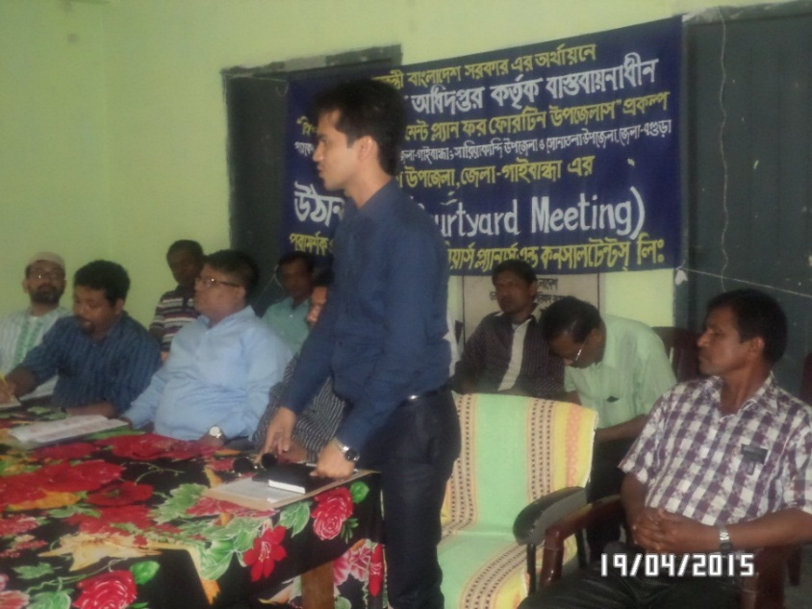
Inception Period
Focus Group Discussion at Saghata
Focus Group Discussion (FGD) at Saghata
Meeting With Local Upazila Level Officials
Courtyard Meeting at Saghata
Focus Group Discussion at Saghata

Slide 4
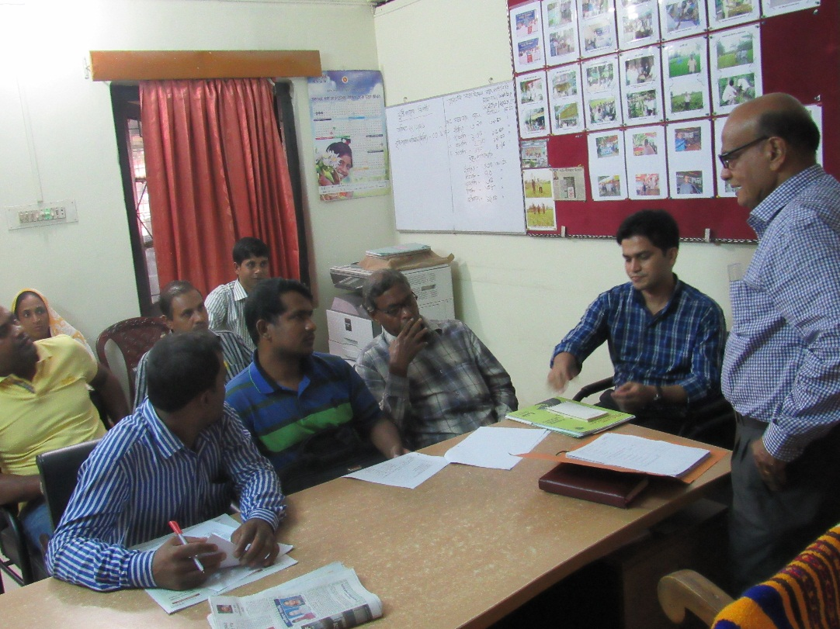
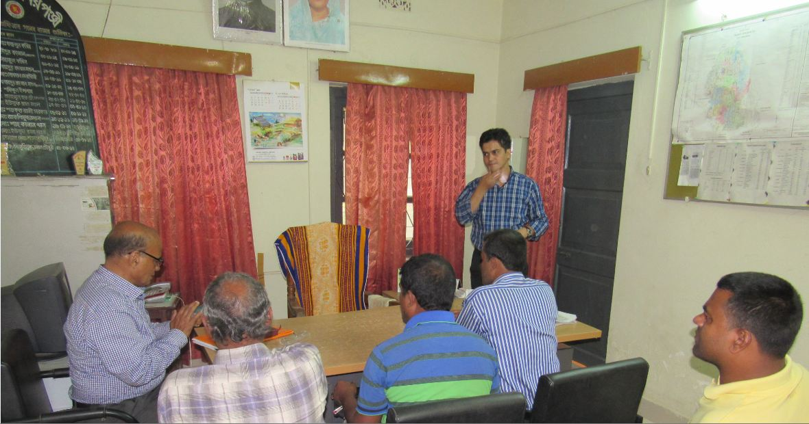
Agricultural Survey
Major Crop Diversification at Saghata Upazila
Knowledge Sharing with Local Stakeholders
Consultation with Local People

Slide 5
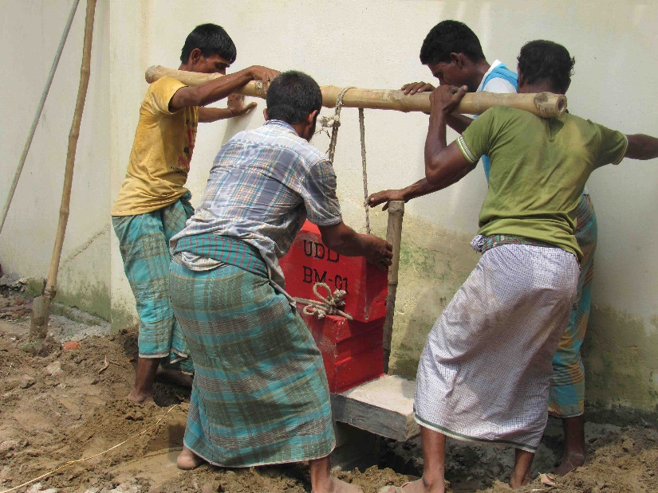
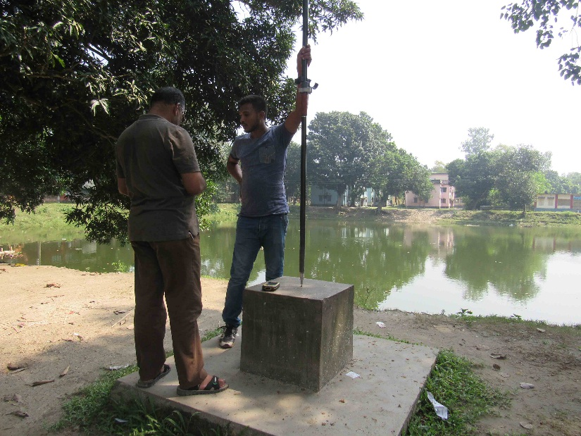
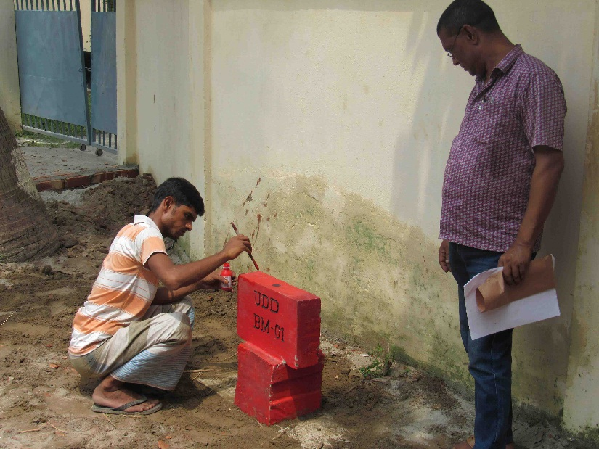
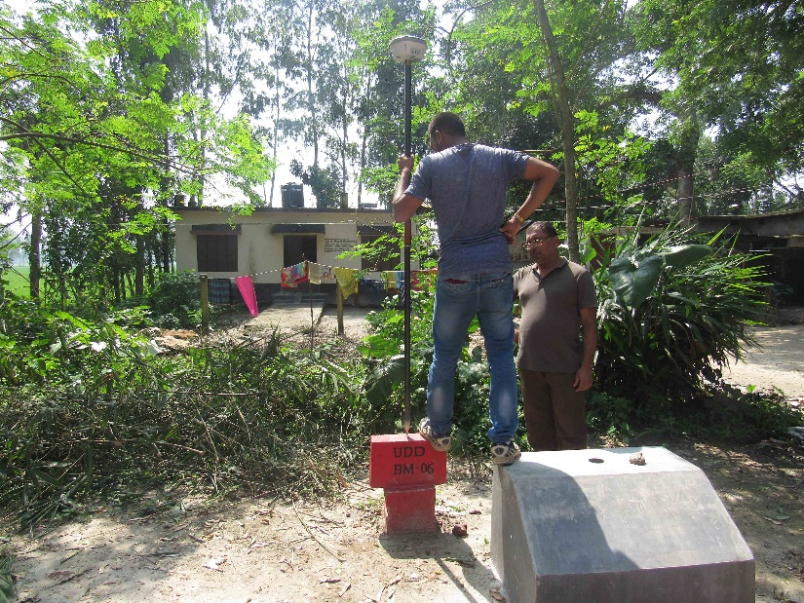
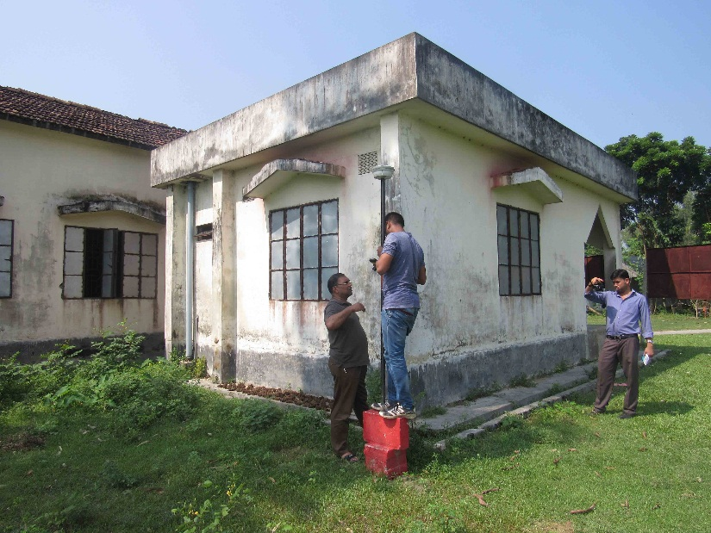
BM Pillar Installation & Baseline Survey
Establishment of UDD Reference BM Pillar
Establishment of UDD Reference BM Pillar
SOB BM Pillar at Bonarpara, Saghata
UDD BM Pillar
RTK GPS point survey
Collection of Base Point GPS Coordinate

Slide 6
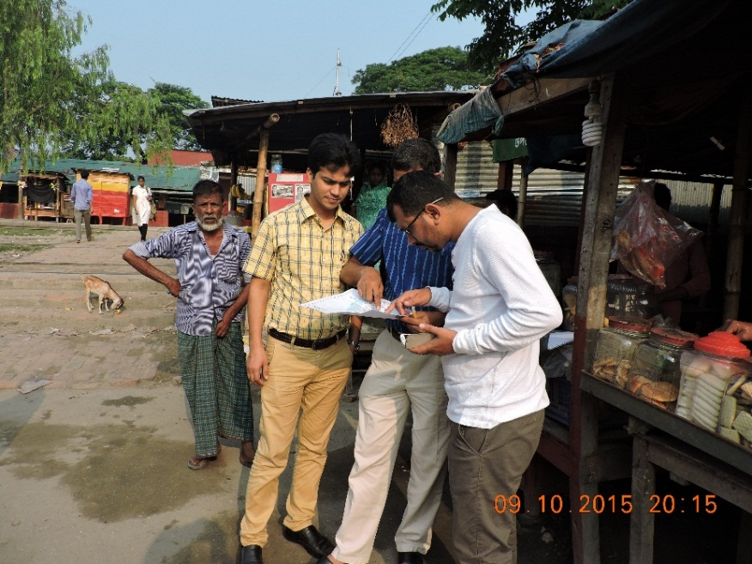
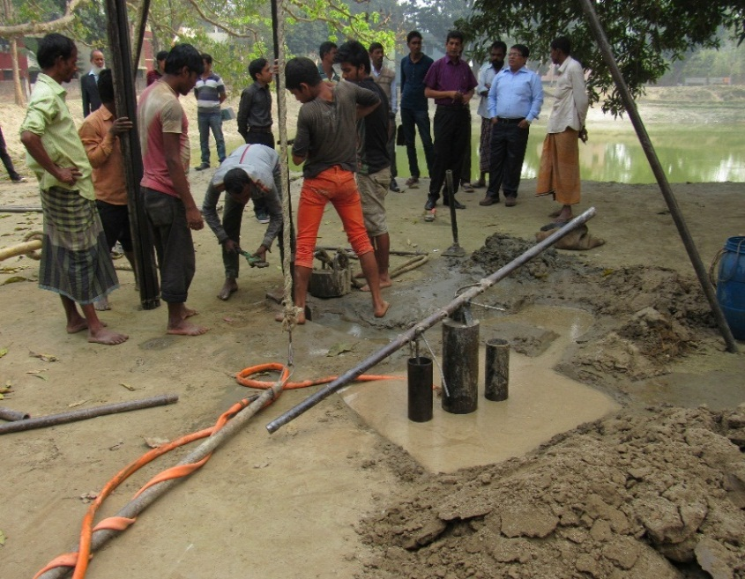
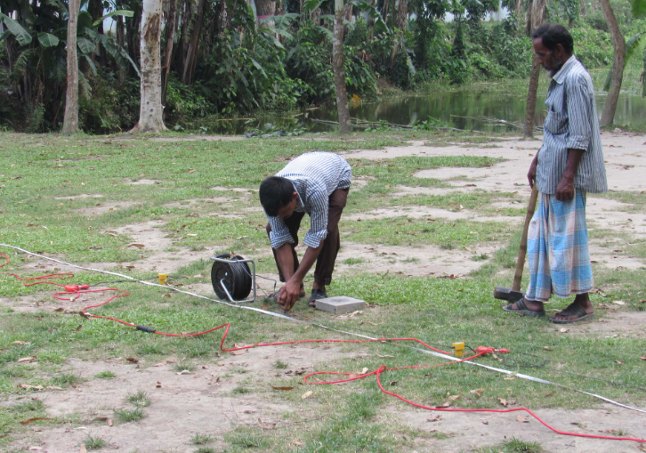
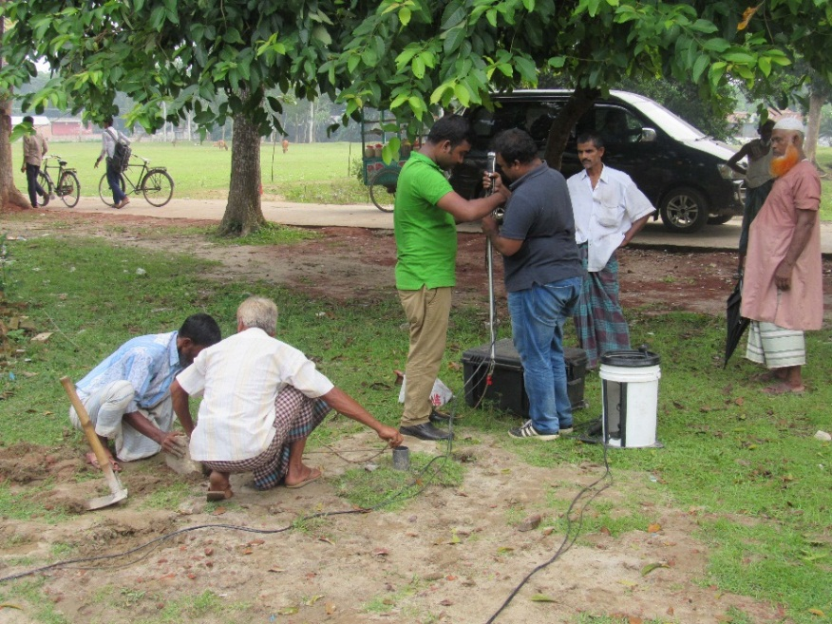
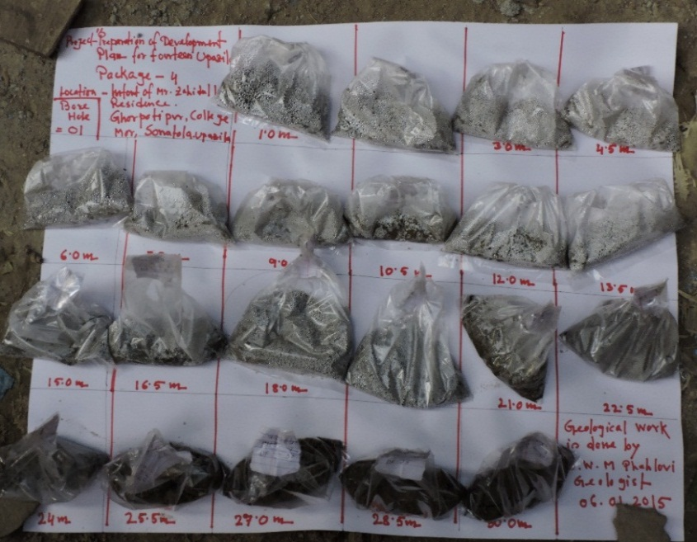
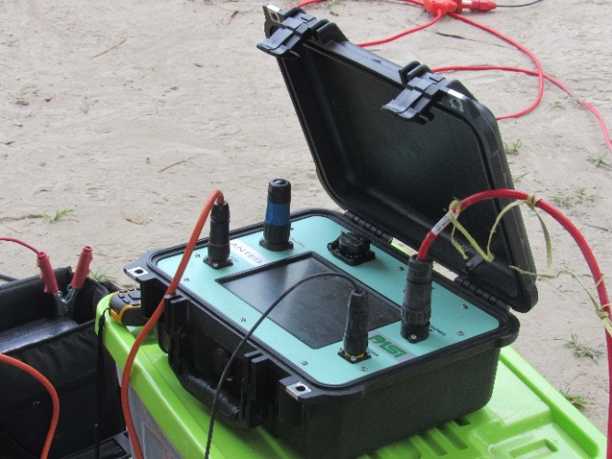
Geological Survey
Selection of Borehole Location
Piling For Geological Survey
Data Acquisition Unit
Down hole Seismic Test Data Logger
Data Acquisition Unit
Collection of Soil Sample for Lab Test

Slide 7
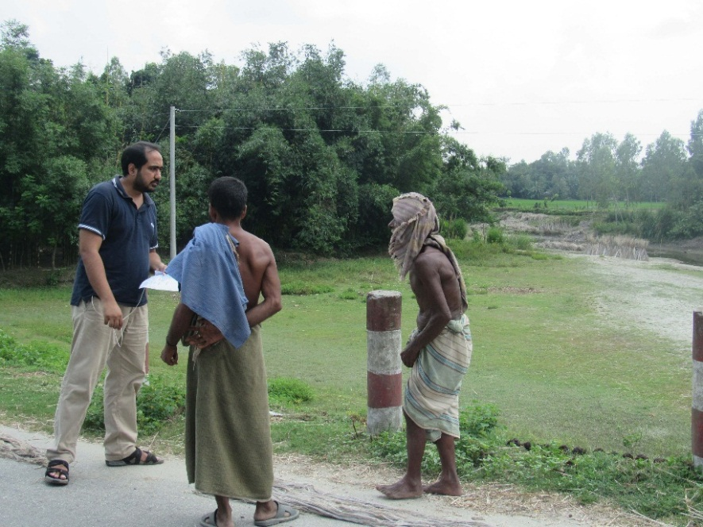
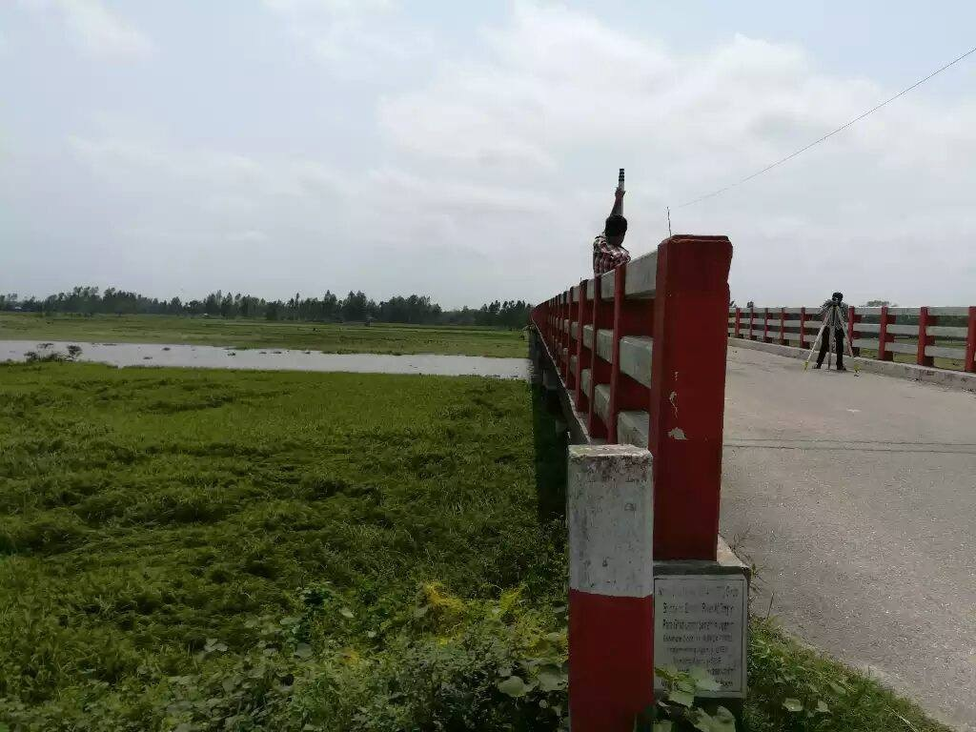
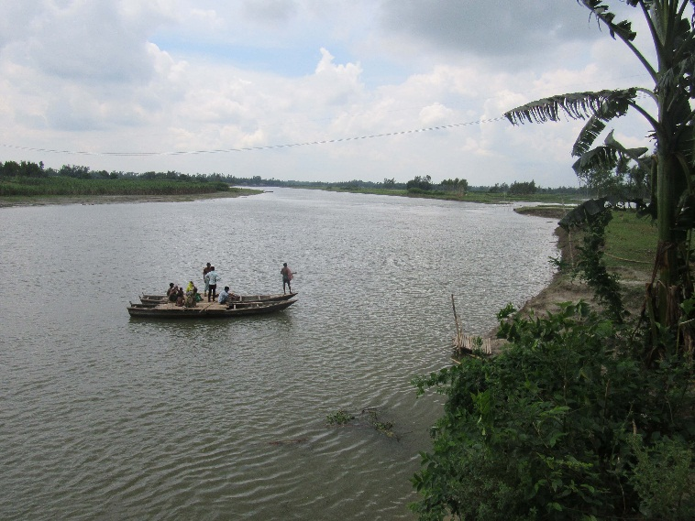
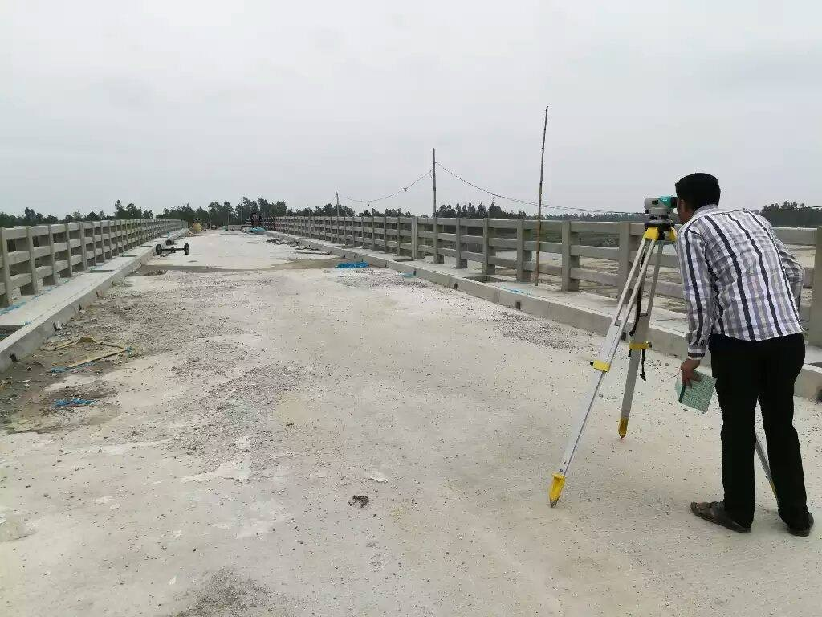
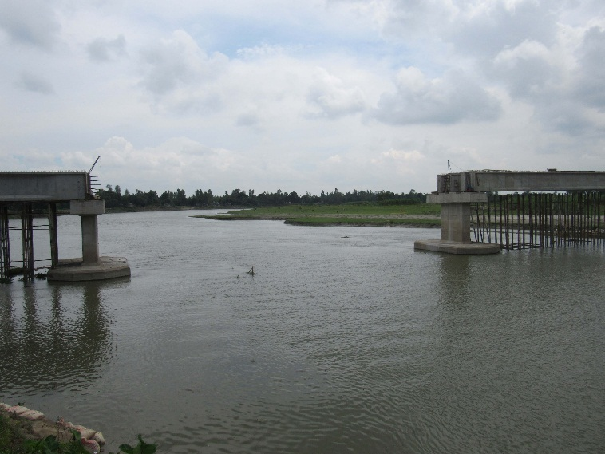
Hydrological Survey
Consultation with Local People
Bathymetry Survey Point
Cross-Section of Bengali and Alai River
Cross-Section Point at Bengali River
Cross-Section of Bengali and Alai River

Slide 8
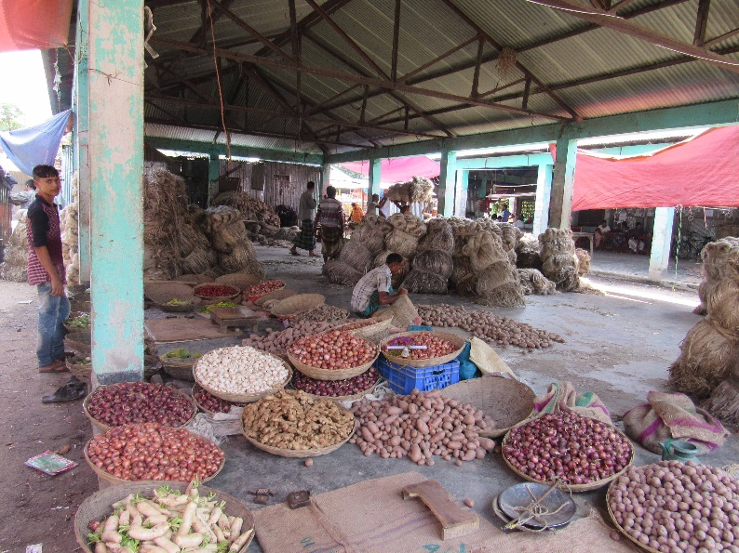
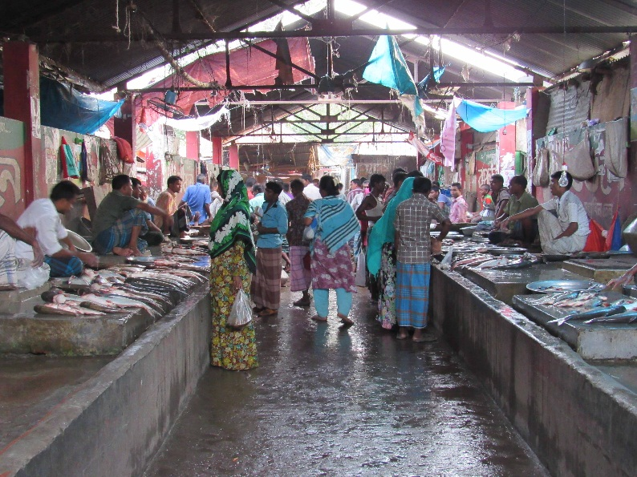
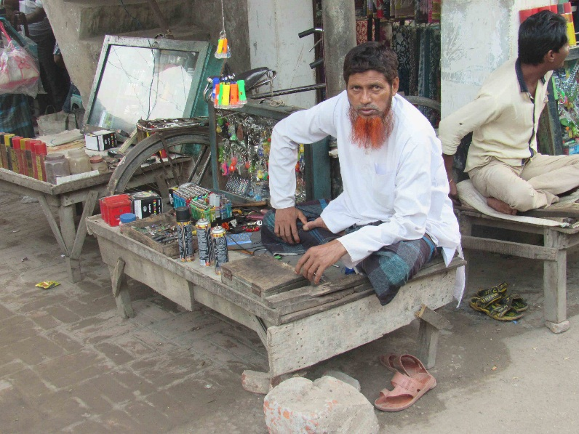
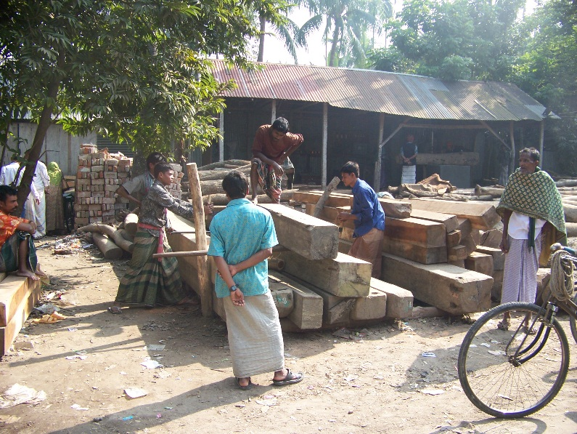
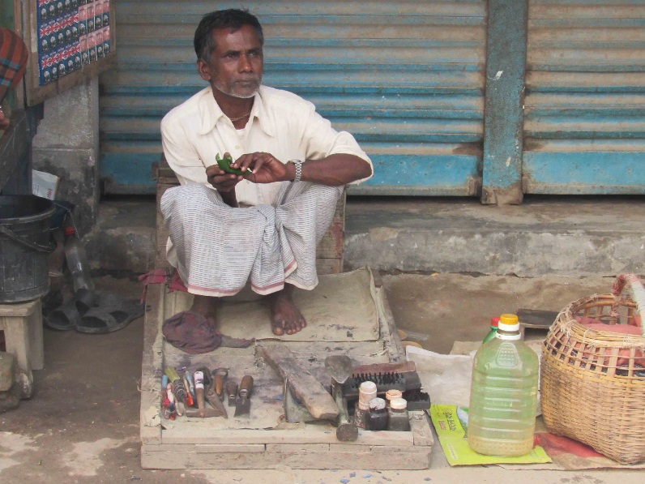
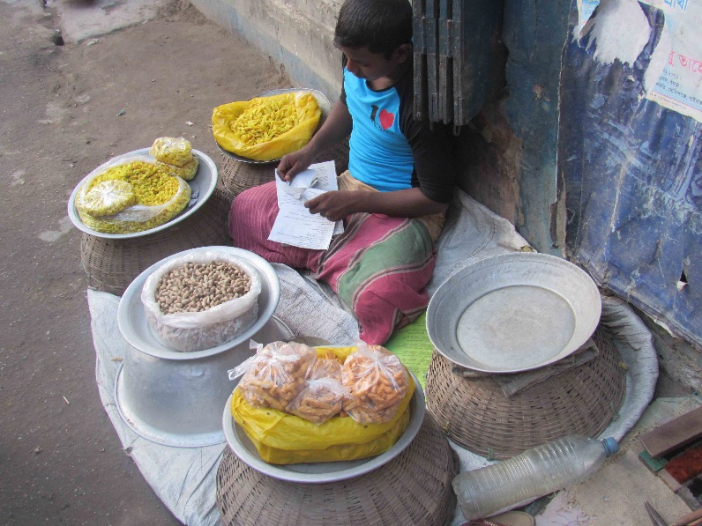
Common Formal & Informal Economic Activities

Slide 9
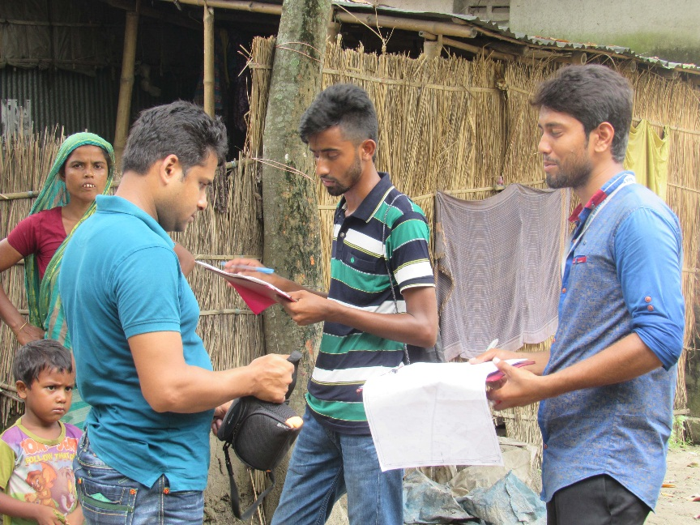
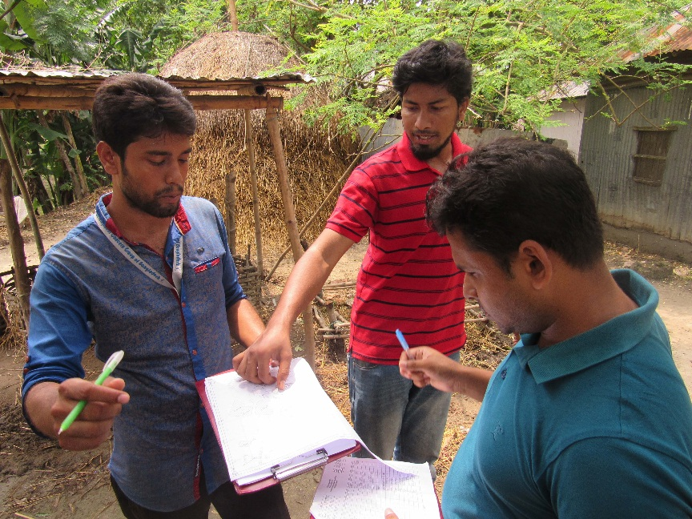
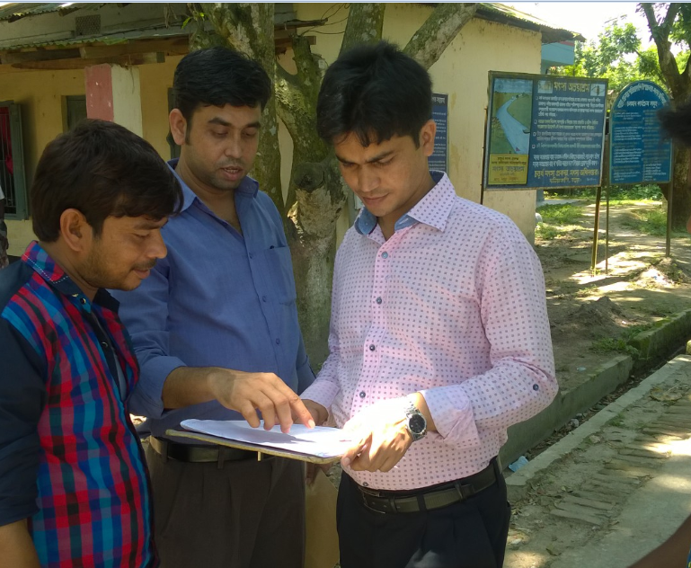
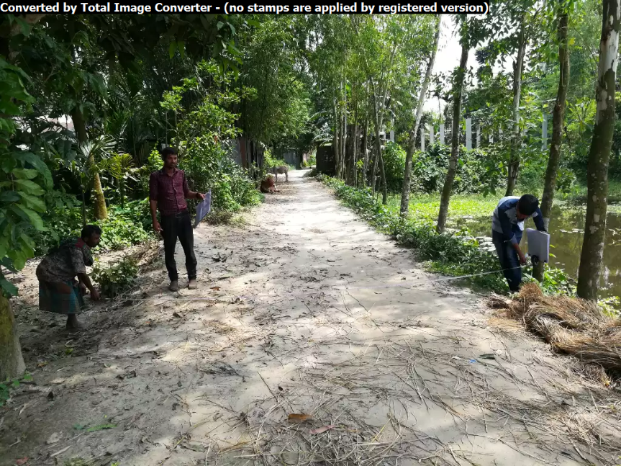
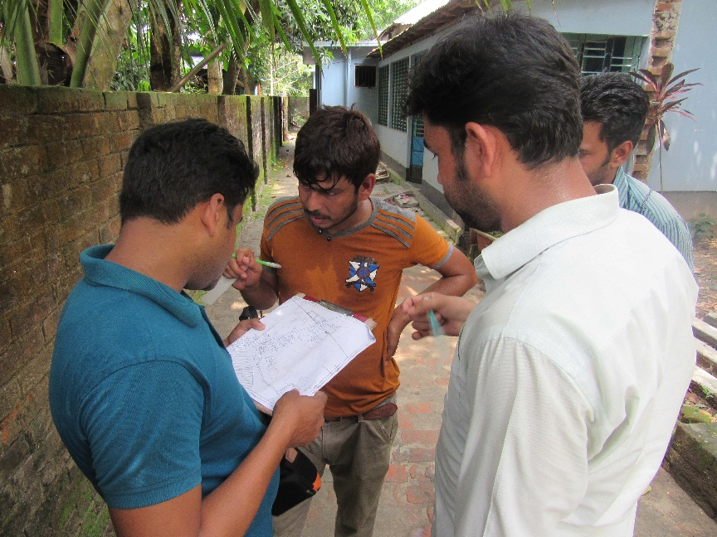
Physical Feature Survey

Slide 10
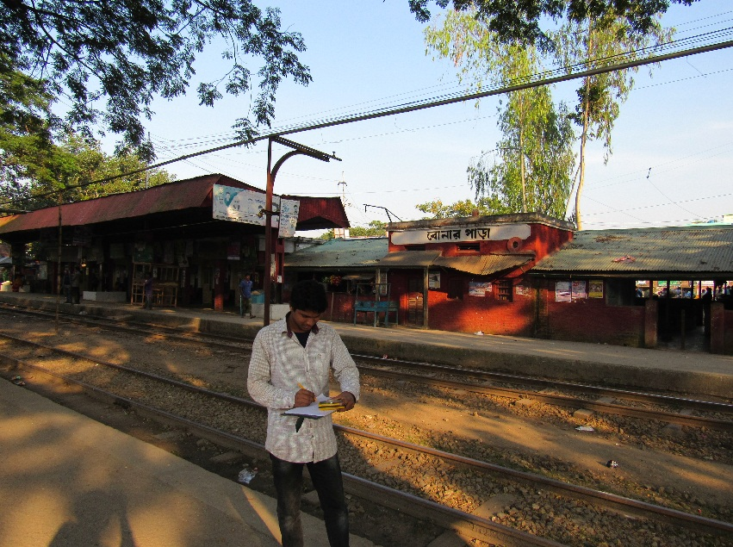
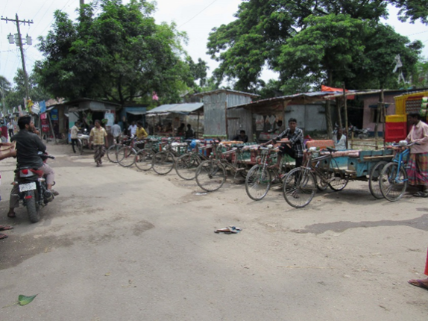
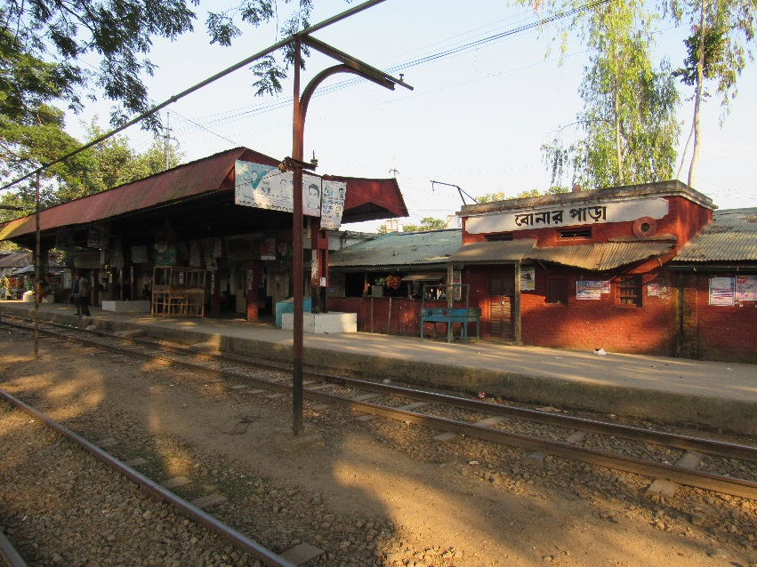
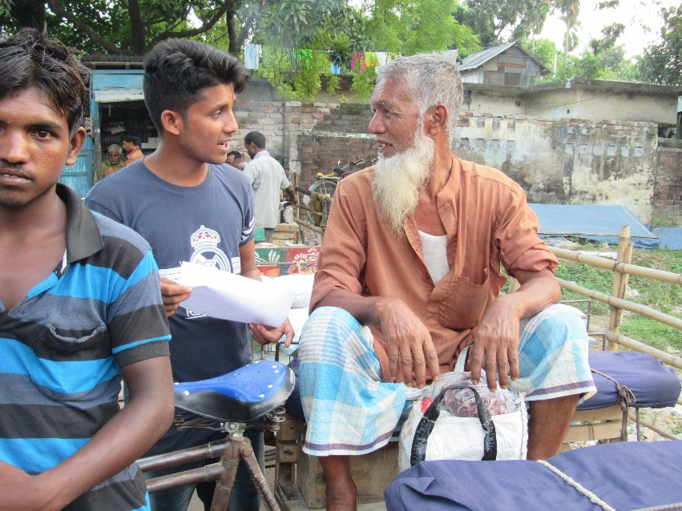
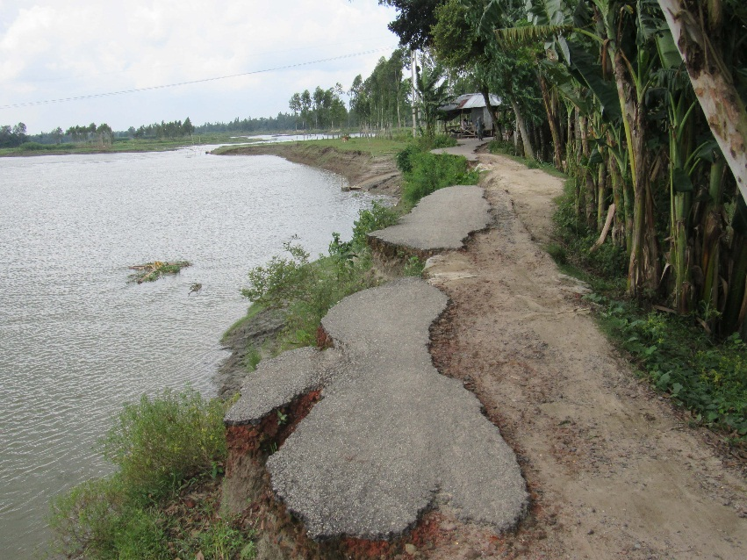
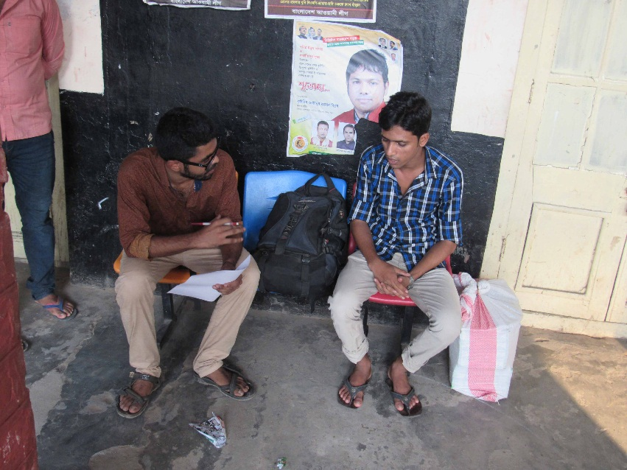
Traffic Survey
Survey at Bonarpara Railway Station
Common Traffic Mode in Saghata
Bonarpara Railway Station, Saghata
Origin-Destination Survey of Passengers
Existing Road Condition on River Embankment
Railway Passenger Survey

Slide 11
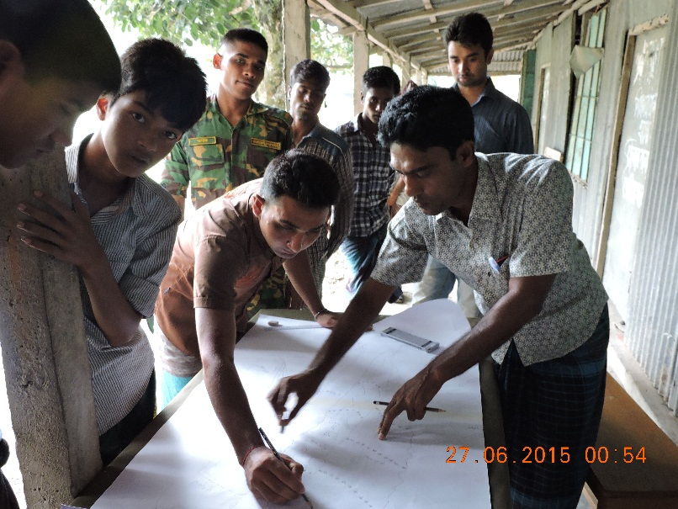
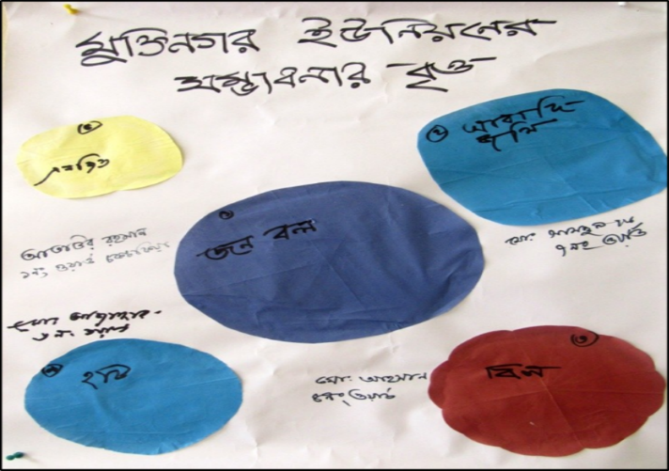
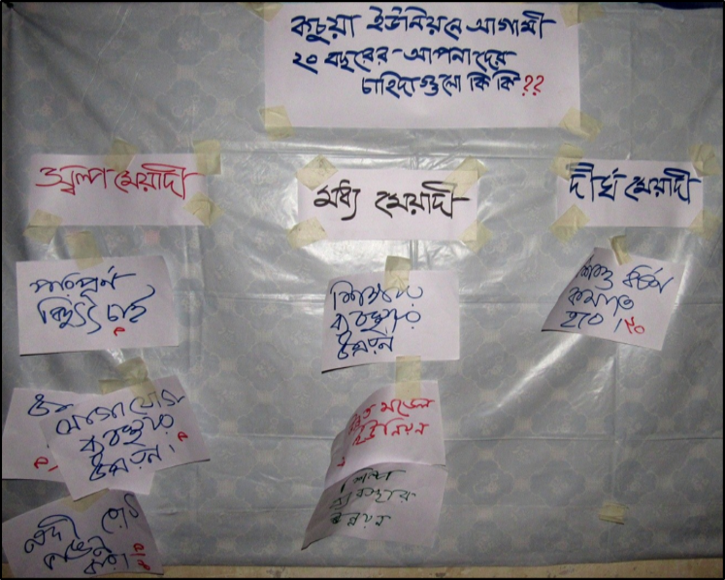
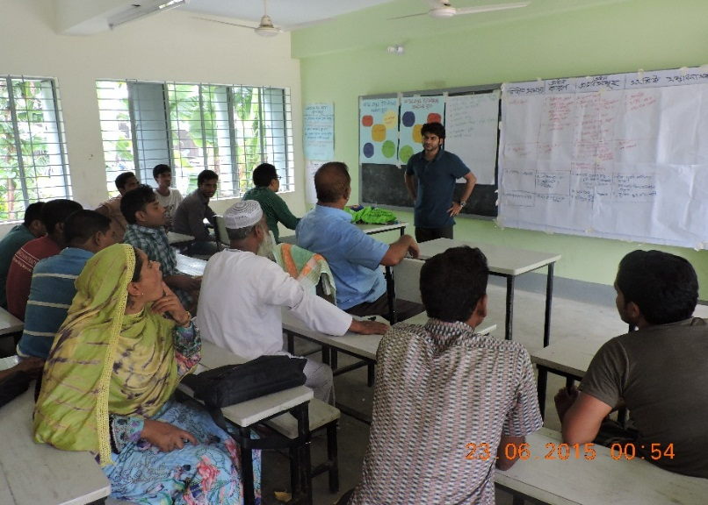
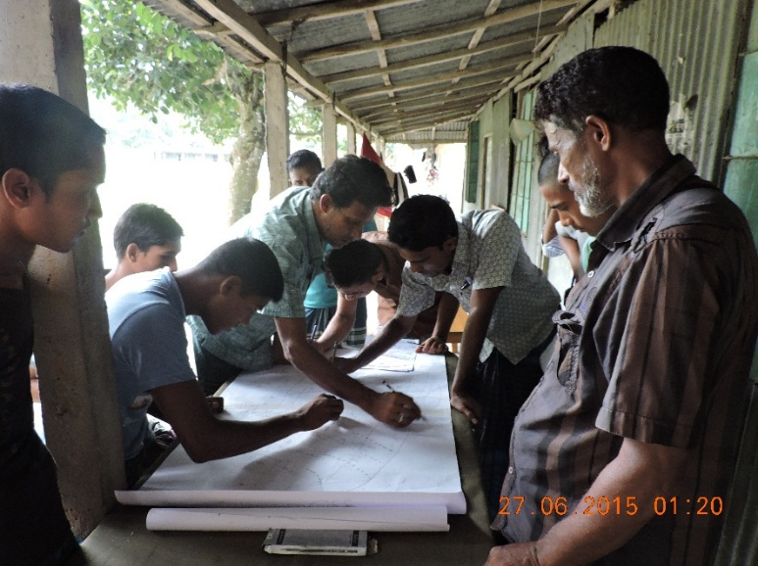
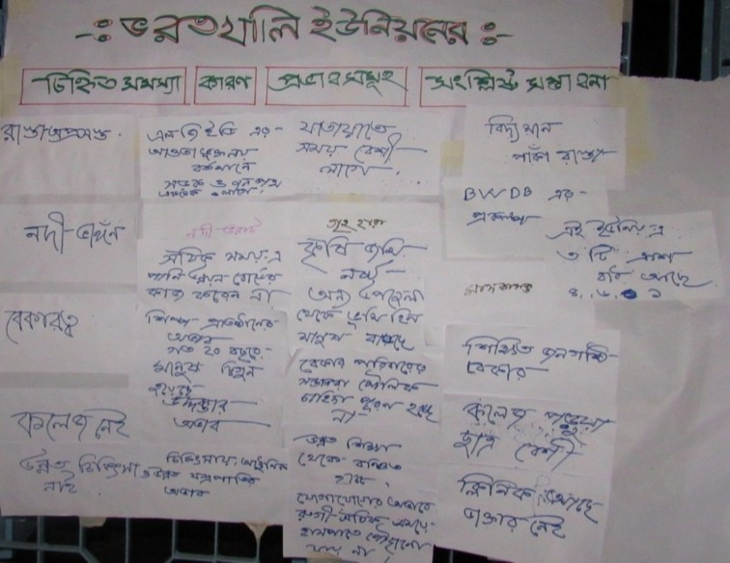
Finding Necessities & Challenges Through PRA

Slide 12
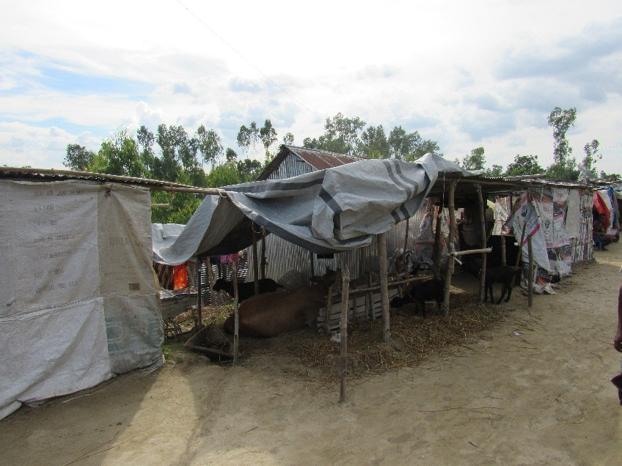
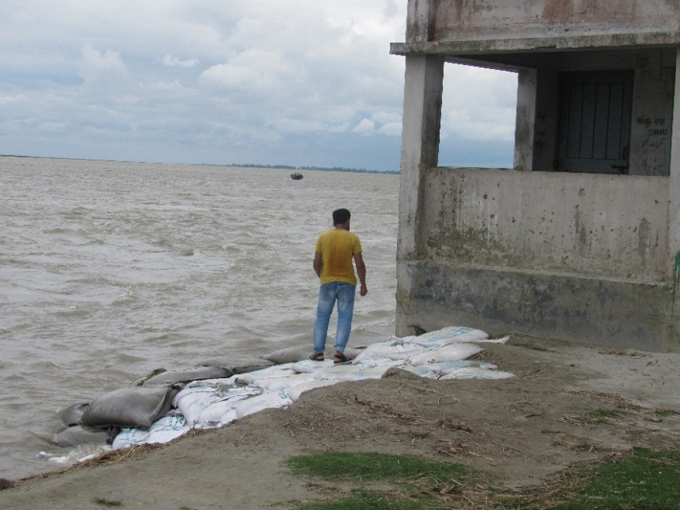
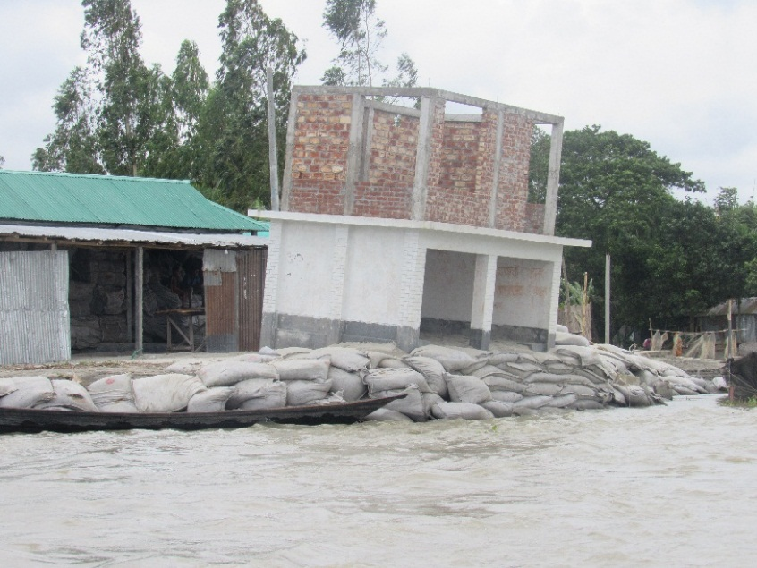
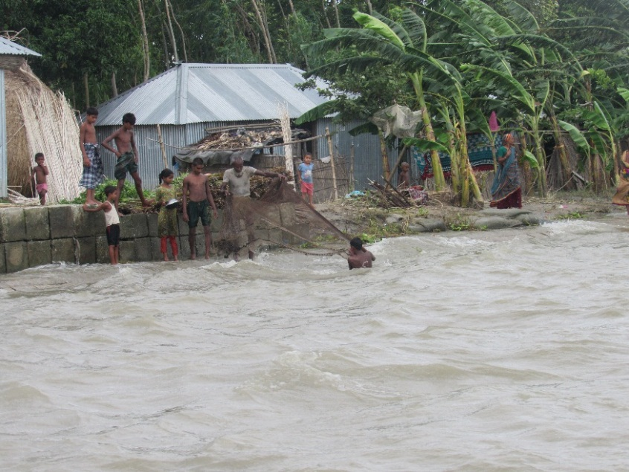
Visit During Flood Situation on Project Area (July, 2017)
Temporary Shelter on Road
Vulnerable Building Structure
Vulnerable Prone Building Structure
Vulnerable Prone Households
Temporary Shelter on Embankment
Data Collection on Flood Damage

Slide 13
Real Time Kinematic(RTK) GPS Survey for Ground Trothing

Slide 14
Building Vulnerability Assessment

Slide 15
Workshop with Stakeholders

Slide 16
Thank You For Attention

