Slide 1
TOURIST ZONE
Subtitle

Slide 2
TOURIST PLAN
Waterfront Development\Moinot Ghat-Model.pdf

Slide 3
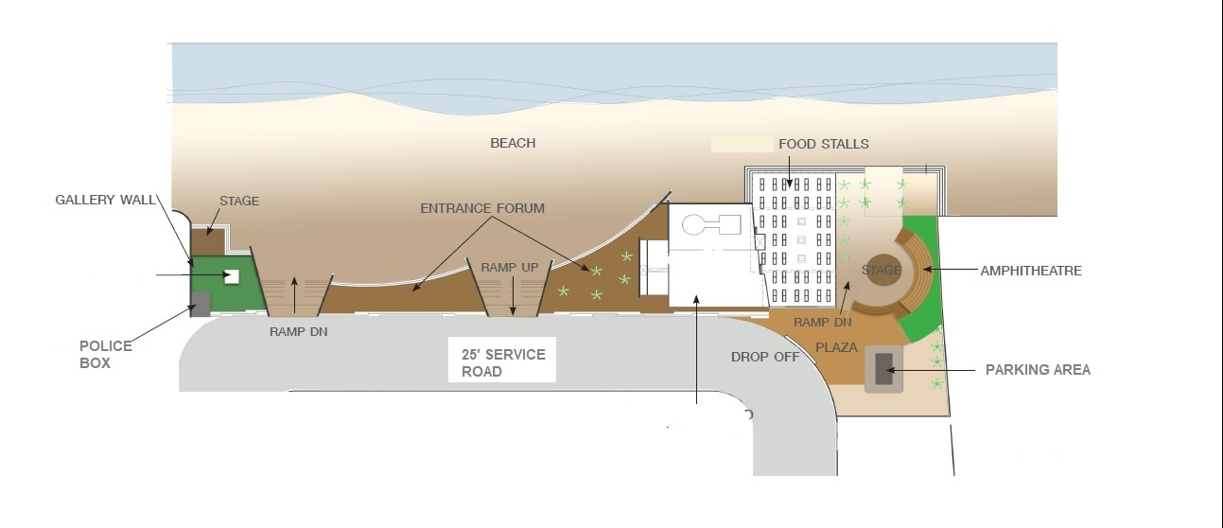
Development point A

Slide 4
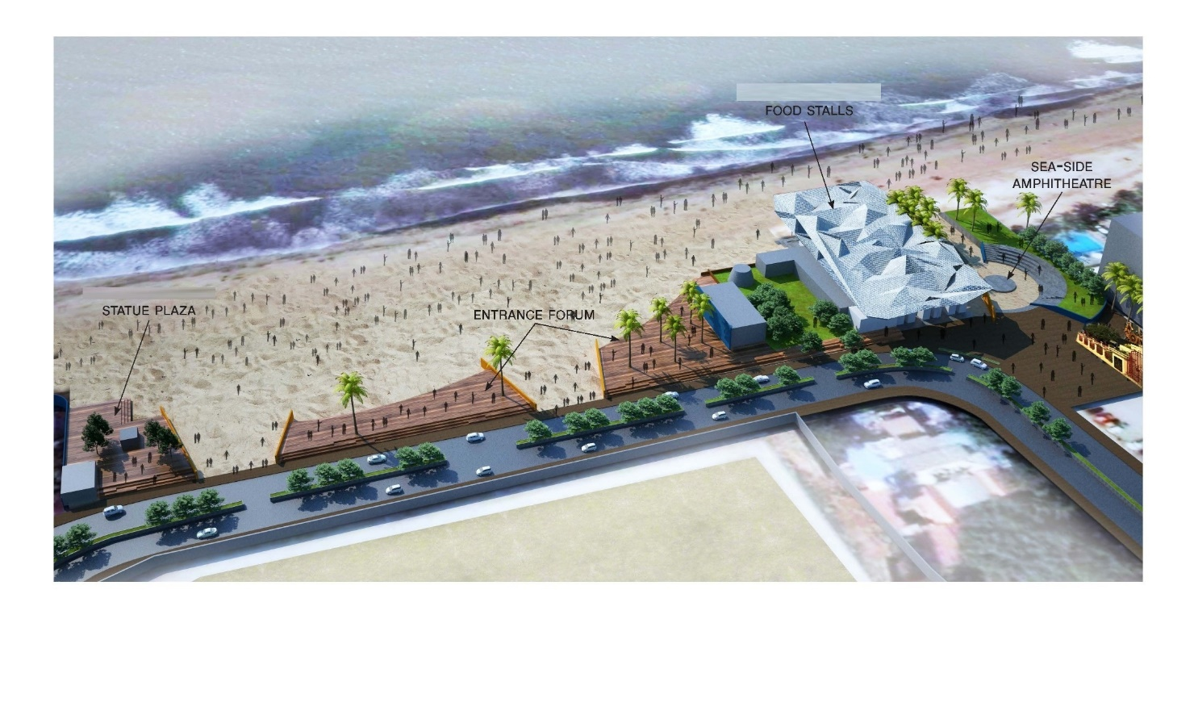

Slide 5
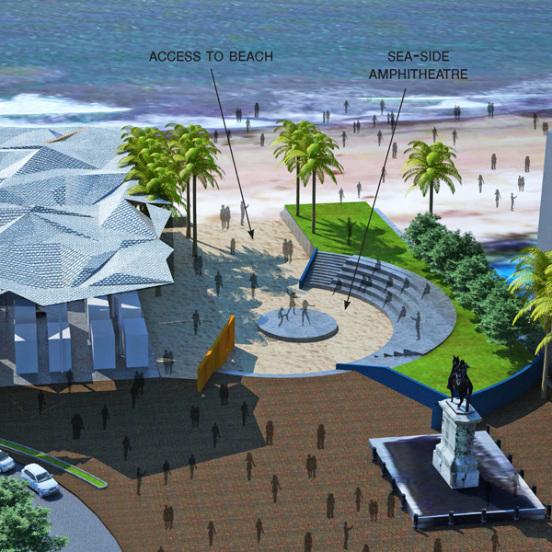

Slide 6
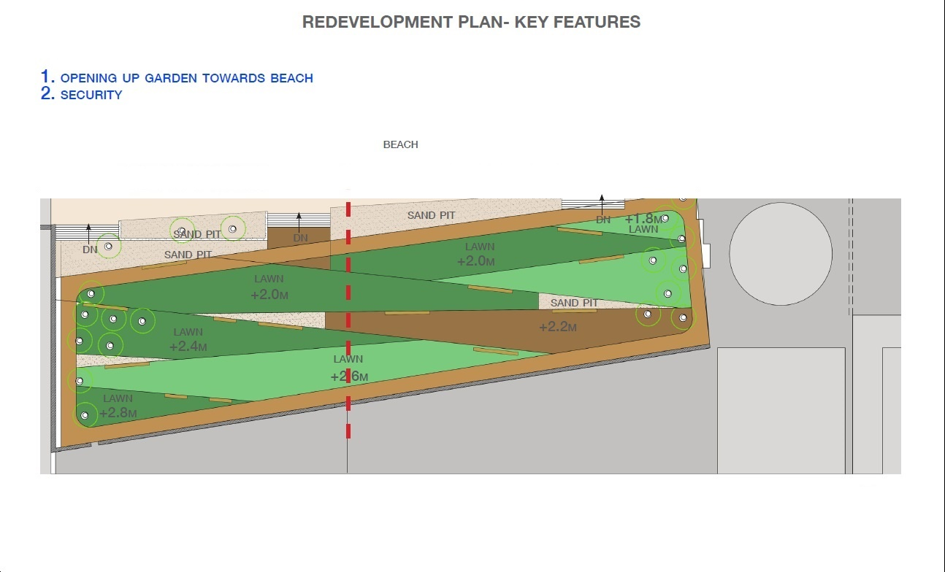
Development point B (Children's’ Park)

Slide 7
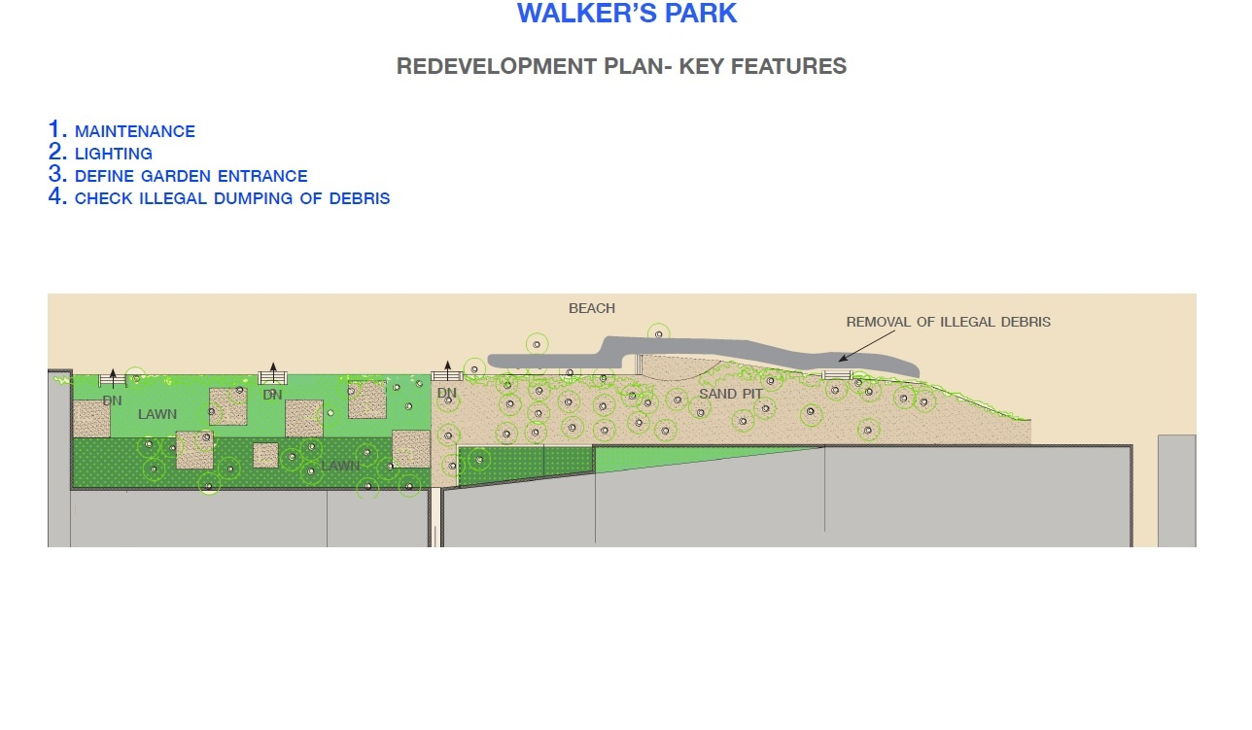
Development point C (Walkers Park)

Slide 8
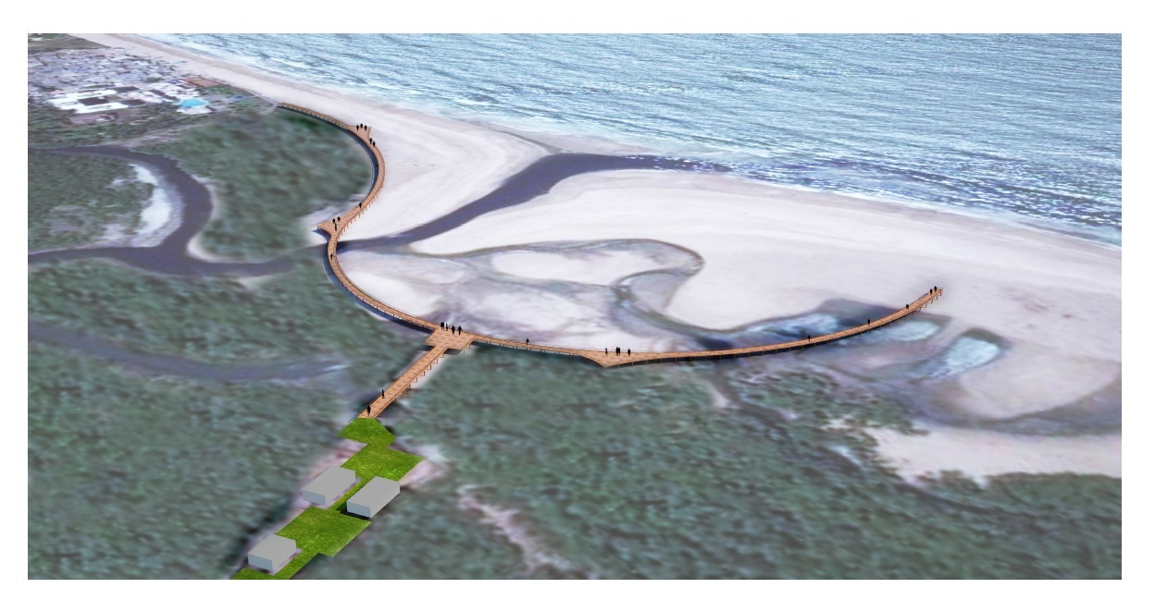
Proposed Boardwalk

Slide 9

Amphitheatre

Slide 10
Amphitheatre
amphitheater.pdf
elevation 1.pdf
elevation.pdf
elevation 2.pdf
elevation 3.pdf

